Slide 1
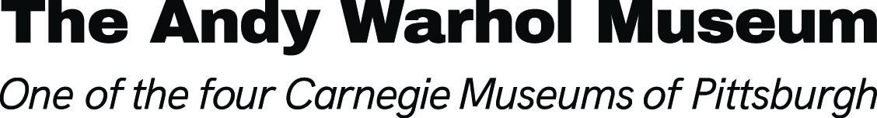
Pop Art

Slide 2
The Pop idea, after all, was that anybody could do anything, so naturally we were all trying to do it all.
Andy Warhol, POPism: The Warhol Sixties, 1980

Slide 3
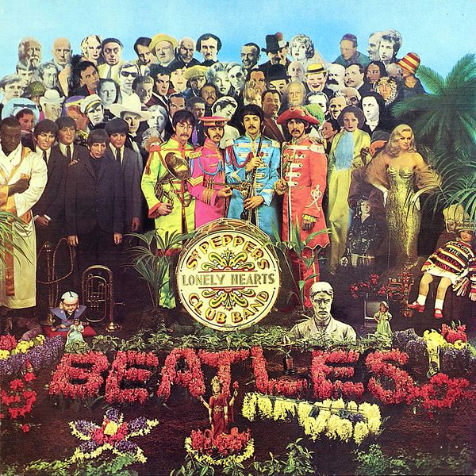
Andy Warhol might have been the most famous Pop artist, but he did not invent the style. The Pop Art movement began in London, England, during the 1950s.
Artists like Richard Hamilton and Peter Blake merged mass popular culture (e.g. music, movies, celebrity) with high art and commercial design.
Pop Art was short for “popular art” and reflected everyday life and common objects and products.
Sir Peter Blake and Jann Haworth, Sgt. Pepper's Lonely Hearts Club Band (Record Sleeve),1967
Given by Kevin Edge © Victoria and Albert Museum, London
Notes:
Additional information on the 1950s Pop Art movement retrieved from The Art Story: Modern Art Insight at www.theartstory.org/movement-british-pop-art.htm
1950s British Pop Art:
Although the term Pop art is usually associated with the work of artists working in New York in the 1960s such as Andy Warhol and Roy Lichtenstein, the movement actually found its earliest voice in Britain a decade earlier. Still recovering from World War II, with a bankrupt population dependent on rations, the nation's artists looked west to the new consumerist paradise being advertised in the prospering United States. British Pop Art rose out of a strong outsider's perspective as it looked both longingly and critically, yet with a healthy sense of irony, at the new visual imagery arising in the U.S. In this commercial dreamland, everything from toasters to cars to beauty creams were placed on colorful pedestals in the glossy pages of magazines or touted on television in the hands of long-legged beauty queens.
The Beatles' Sgt. Pepper's Lonely Hearts Club Band album cover by Pop Artist Peter Blake:
This album, released by EMI Records in 1967, is arguably the most famous album sleeve of all time. The image on the album cover is composed of a collage of celebrities. There are 88 figures, including the band members themselves. Pop artist Peter Blake and his wife Jann Haworth conceived and constructed the set, including all the life-sized cut-outs of historical figures. The set was photographed, with the Beatles standing in the center, by Michael Cooper. Copyright was a problem as Brian Epstein, the Beatles' manager, had to locate each person in order to get permission to use their image in this context.
Image information retrieved from The Victoria & Albert Museum’s collections https://collections.vam.ac.uk/item/O88532/sgt-peppers-lonely-hearts-club-record-sleeve-sir-peter-blake/:

Slide 4
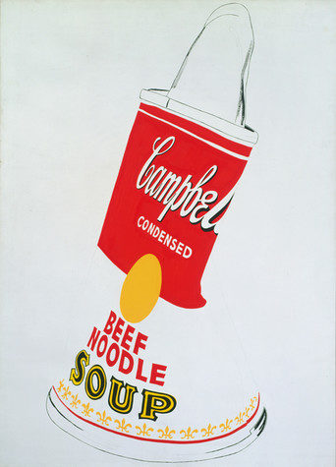
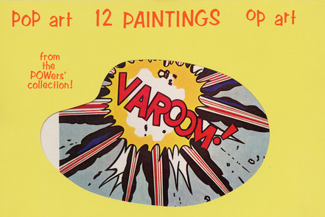
New York City artists like Warhol and Roy Lichtenstein popularized the Pop Art movement in America in the 1960s.
Andy Warhol and David Dalton, 1966
Cards and envelope (“Pop Art: 12 Paintings from the POWers' Collection!”)
The Andy Warhol Museum, Pittsburgh; Founding Collection, Contribution The Andy Warhol Foundation for the Visual Arts, Inc., © The Andy Warhol Foundation for the Visual Arts, Inc., TC23-6-4a_int_01
Andy Warhol, Crushed Campbell's Soup Can (Beef Noodle), 1962
The Andy Warhol Museum, Pittsburgh; Founding Collection, Contribution The Andy Warhol Foundation for the Visual Arts, Inc.,
© The Andy Warhol Foundation for the Visual Arts, Inc., 1998.1.30
Notes:
Additional information:
Andy Warhol, Crushed Campbell's Soup Can (Beef Noodle), 1962:
Warhol's Campbell's Soup Can paintings are key works of the 1960’s Pop Art movement, a time when many artists created work derived from popular culture. Warhol's soup cans raise the simply popular or everyday to the status of art. Campbell's and its red-and-white label date from the late nineteenth century. The canned soup became more familiar in the twentieth century, particularly with the increase in mass production and advertising after World War II. Warhol himself said, "Pop art is about liking things," and claimed that he ate Campbell's soup every day for 20 years. For him, it was the quintessential American product. He marveled that the soup always tasted the same, like Coca-Cola, whether consumed by prince or pauper.
"Pop Art: 12 Paintings from the POWers' Collection!”:
This image is of a yellow envelope, with circular window displaying 12 cards depicting pop artworks with titles, quotes from the artists, and descriptions of the accompanying artworks. The card we see is of a 1963 Roy Lichtenstein painting called “Varoom!”. This Pop Art Issue of Aspen magazine (published in ten issues between 1965 and 1971) was designed by Andy Warhol and David Dalton. The artists represented in this envelope are James Rosenquist, Bridget Riley, Gerald Laing, Roy Lichtenstein, Kenneth Noland, Andy Warhol, Claes Oldenburg, Larry Poons, Jasper Johns, William de Kooning, Charles Hinman and Ernest Trova.

Slide 5
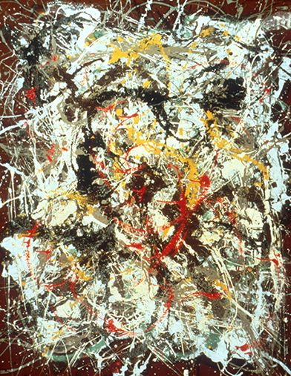
Pop artists moved away from Abstract Expressionism, which was the “in” style of art in the 1950s.
Abstract Expressionist artists like Jackson Pollock did not include recognizable subjects in their paintings. They evoked emotions, feelings, and ideas through formal elements such as:
line, color, shape, form, texture
Jackson Pollock, Number 4, 1950
Carnegie Museum of Art;
Gift of Frank R. S. Kaplan/ ©ARS
Notes:
Additional information:
Abstract Expressionism & Jackson Pollock:
During and after World War II, many European artists, especially Surrealists, came to America. Aware of such artists' work, Jackson Pollock and others of his generation were thus introduced to the exploration of the unconscious and to the psychoanalytical theories of Freud and Jung. Automatic drawing, a technique devised by the Surrealists to elicit the free expression of the creative unconscious, was one method artists used to liberate themselves from academic training and traditional modes of expression. Few pursued this liberation with the vigor and invention of Jackson Pollock. Born and brought up in the western United States, Pollock eventually studied with the painter Thomas Hart Benton at the Art Students League in New York City. Though he came to reject Benton's Renaissance-derived compositions and midwestern imagery, Pollock was profoundly influenced by the emphasis on content and gestural rhythms of the older artist's work.
By 1947 Pollock had devised a working method that featured linear tangles of dripped paint, and he regarded his paintings as records of his own intense activity. He numbered most of these works instead of titling them, thereby avoiding any external reference that might limit their meaning. Pollock's dense, swirling skeins of paint heralded Abstract Expressionism, which established New York as the successor to Paris as the center of the modern movement. It would be a mistake, however, to see Pollock's work as purely automatic. He controlled the flow of paint carefully, forming it into an allover composition in the center of the canvas and leaving the edges largely untouched. Pollock thus followed the compositional practices of Analytical Cubism, but his loops, whorls, and nets of paint are far more lyrical and energetic than the explicitly rational forms of Cubist painting. His paintings suggest centrifugal force combined with an endless series of complex incidents, an impression created as one line or shape overlaps another only to be covered in turn. In larger works the effect is overwhelming, engulfing the viewer in a world unlike any other visual experience. Even in smaller paintings, like this one, the viewer may quickly become lost in the constant motion and flux of the composition.
Retrieved from: http://collection.cmoa.org/CollectionDetail.aspx?item=1009233&retPrompt=Back+to+Results&retUrl=CollectionSearch.aspx%3Fsrch%3DPollock

Slide 6
Pop artists did images that anybody walking down Broadway could recognize in a split second…all the great modern things that the Abstract Expressionists tried so hard not to notice at all.
Andy Warhol, POPism: The Warhol Sixties, 1980

Slide 7
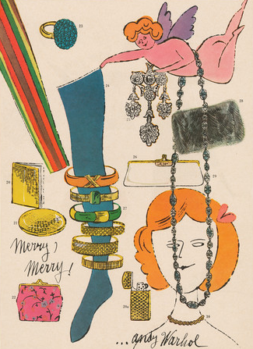
Before Warhol became known as the “Prince of Pop,” he had a successful career as a commercial designer and illustrator in New York City during the 1950s.
His early designs and techniques paved the way for his later Pop works.
Andy Warhol, Black Portfolio (containing tear sheets of Andy Warhol's commercial work), 1950–1960
The Andy Warhol Museum, Pittsburgh; Founding Collection, Contribution The Andy Warhol Foundation for the Visual Arts, Inc., © The Andy Warhol Foundation for the Visual Arts, Inc. 1998.3.5498.1-1998.3.5498.10b
Notes:
Additional information:
Andy Warhol, Black Portfolio (containing tear sheets of Andy Warhol's commercial work), 1950-1960
This illustration is taken from one of Warhol’s black leather portfolios. This particular portfolio consisted of nine plastic sleeves containing “tear sheets” which are pages that can be removed from a newspaper, magazine, or book for use separately. Commercial designers and illustrators often used these tear sheets along with larger samples to show publishers and other potential business clients when applying for jobs. This particular portfolio held tear sheets for important clients of Warhol’s including Harper’s Bazaar and Mademoiselle magazine.

Slide 8
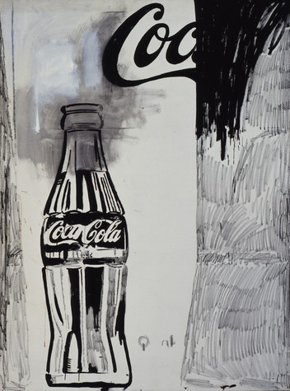
Warhol created his early Pop art from images he enlarged using an opaque projector.
This black and gray composition is an example of Warhol’s “hand-painted Pop” and blends both Pop and abstraction.
Which parts of this painting are Pop and which are abstract?
Andy Warhol, Coca-Cola [2], 1961
The Andy Warhol Museum, Pittsburgh; Founding Collection, Contribution Dia Center for the Arts © The Andy Warhol Foundation for the Visual Arts, Inc., 1997.1.20
Notes:
Additional information:
Opaque Projector:
A device similar to an overhead projector which displays opaque materials by shining a bright lamp onto the object from above. Opaque projectors are typically used to enlarge or project images of book pages, drawings, diagrams etc. They have been produced and marketed as artists’ enlargement tools to allow images to be transferred to surfaces such as prepared canvas, or for lectures and presentations.
Andy Warhol, Coca-Cola [2], 1961:
In 1961, Warhol created his first pop paintings, which were based on comics and ads. Warhol’s 1961 Coca-Cola [2] is a pivotal piece in his career, evidence that his transition from hand-painted works to silkscreens did not happen suddenly. The black and gray composition first sketched then hand painted is a blend of both pop and abstraction, which he turned away from at the beginning of his career before experimenting with it again in the 1980s.

Slide 9
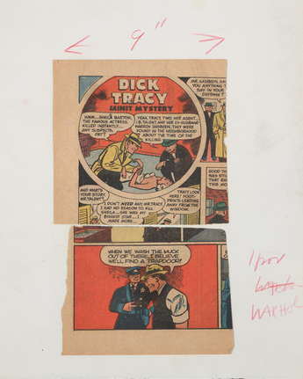
Pop artists used common images from everyday culture as source material for their artwork including:
Advertisements
Consumer goods
Celebrities
Photographs
Comic strips
Andy Warhol, Dick Tracy, n.d.
The Andy Warhol Museum, Pittsburgh; Founding Collection, Contribution The Andy Warhol Foundation for the Visual Arts, Inc., © The Andy Warhol Foundation for the Visual Arts, Inc., 1998.1.2302
Notes:
Additional information:
Andy Warhol, Dick Tracy, n.d.:
This image is possible source material for Andy Warhol's paintings "Dick Tracy" and "Dick Tracy and Sam Ketchum" (1961). Dick Tracy is an American comic strip about a tough police detective that made its debut in 1931. This collage of cartoon strips was taken from a comic book or newspaper and shows Warhol’s notes to the silkscreen print shop written in red colored pencil.

Slide 10
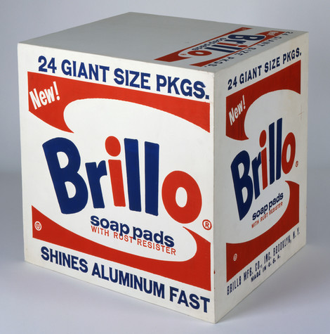
They used bold, flat colors and hard-edge compositions adopted from commercial designs like those found in:
Billboards
Murals
Magazines
Newspapers
Packaging
Andy, Warhol, Brillo Soap Pads Box, 1964
The Andy Warhol Museum, Pittsburgh; Founding Collection, Contribution The Andy Warhol Foundation for the Visual Arts, Inc., © The Andy Warhol Foundation for the Visual Arts, Inc., 1998.1.709
Notes:
Additional information:
Andy Warhol, Brillo Soap Pads Box, 1964:
Warhol made the Brillo and Heinz Boxes in the 1960s in a spirit of exploration, where he wanted to elevate the everyday. Calling to mind a factory assembly line, Warhol created dozens of boxes. The process involved creating wooden replicas of the original boxes, painting them, and then silkscreening the commercial text and imagery onto them. The finished box sculptures were virtually indistinguishable from their cardboard models. Warhol exhibited these at the Stable Gallery in 1964, cramming the space with piled-high boxes, recalling a grocery warehouse.

Slide 11
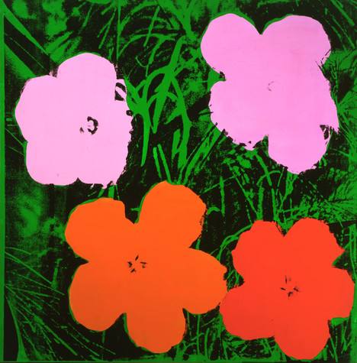
Pop artists reflected 1960s’ culture by using new materials in their artworks including:
Acrylic paints
Plastics
Photographs
Fluorescent and metallic colors
Andy Warhol, Flowers, 1964
The Andy Warhol Museum, Pittsburgh; Founding Collection, Contribution The Andy Warhol Foundation for the Visual Arts, Inc., © The Andy Warhol Foundation for the Visual Arts, Inc., 1998.1.26
Notes:
Additional information:
Andy Warhol, Flowers, 1964:
Warhol produced the Flower paintings in different sizes—from miniature to monumental. He first displayed them at the Leo Castelli gallery in 1964 arranging them in multiple formations, covering the walls of the gallery. The source for the Flower paintings was Patricia Caulfield’s color photograph of hibiscus flowers that appeared in the June 1964 issue of Modern Photography magazine. Caulfield, after seeing a poster for Warhol’s versions in a public place, sued to maintain ownership of the image. The suit was settled out of court, but raised questions around copyright law and artists’ rights to appropriate from existing sources—an issue even more hotly debated today.

Slide 12
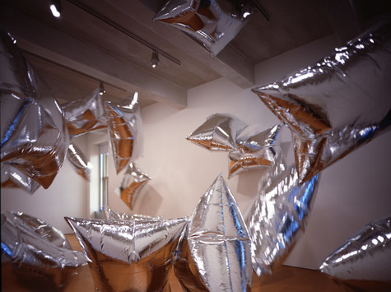
Pop artists also experimented with new technologies and methods of artmaking:
Mass production
Fabrication
Photography
Photographic silkscreen printing
Serials
Andy Warhol, Silver Clouds, 1966
refabricated for The Andy Warhol Museum in cooperation with The Andy Warhol Foundation for the Visual Arts, Inc., and Billy Klüver, 1994
© The Andy Warhol Foundation for the Visual Arts, Inc.,
IA1994.13
Notes:
Additional information:
Andy Warhol, Silver Clouds, 1966:
The Silver Clouds were constructed out of metalized plastic film filled with helium and oxygen. Billy Klüver, an engineer and co-founder (with artist Robert Rauschenberg) of Experiments in Art and Technology (E.A.T.), helped to create the clouds. E.A.T. sought to bring together artists and people working with new technologies and materials to generate ambitious projects. Warhol famously said:
“…it was the perfect time to think silver. Silver was the future, it was spacey… silver was also the past – the Silver Screen… And maybe more than anything, silver was narcissism…” Andy Warhol, POPism, p. 64

Slide 13
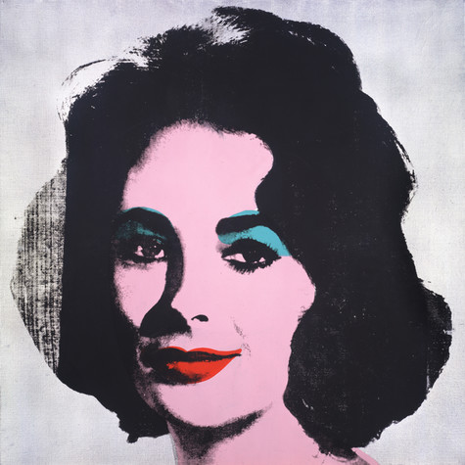
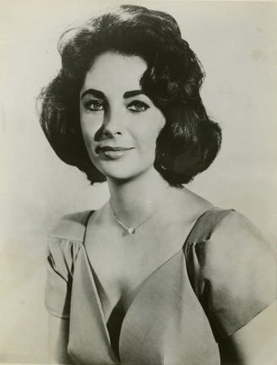
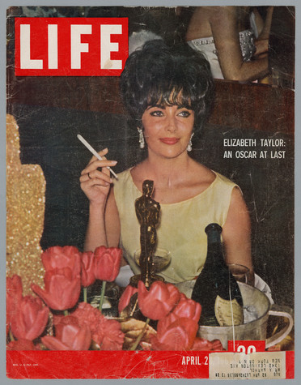
Warhol appropriated (used without permission) images from magazines and newspapers, and press photos of the most popular people of his time.
Publicity still of Elizabeth Taylor, 1957
The Andy Warhol Museum, Pittsburgh; Founding Collection, Contribution The Andy Warhol Foundation for the Visual Arts, Inc., 1998.3.10289.2
Life Magazine, 1961 from Time Capsule 24
The Andy Warhol Museum, Pittsburgh; Founding Collection, Contribution The Andy Warhol Foundation for the Visual Arts, Inc., TC-24.94
Andy Warhol, Silver Liz [Ferus Type], 1963
The Andy Warhol Museum, Pittsburgh; Founding Collection, Contribution The Andy Warhol Foundation for the Visual Arts, Inc., © The Andy Warhol Foundation for the Visual Arts, Inc., 1998.1.55
Notes:
Andy Warhol, Silver Liz [Ferus Type], 1963:
Warhol was drawn to the glamorous worlds of Hollywood, fashion, and celebrity. His interest in pop culture manifested itself early on in his childhood collection of autographed celebrity photographs. Warhol bought and read teen magazines and tabloids to stay current on what was pop, even into adulthood. He carried this interest into his artwork, creating iconic paintings of mega-stars such as Elvis Presley, Marilyn Monroe, and Elizabeth Taylor. Warhol appropriated images for his portraits from magazines, newspapers, or directly from publicity photographs.

Slide 14
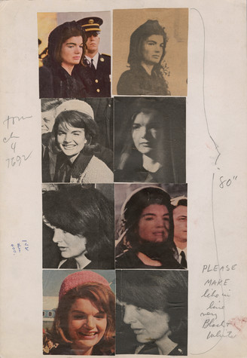
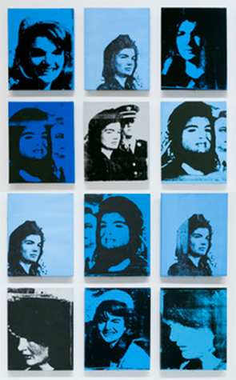
He also used the repetition of media events. What effect does repeating an image over and over have on the viewer?
Andy Warhol, source for Warhol's Jackie series, 1963-1964, The Andy Warhol Museum, Pittsburgh; Founding Collection, Contribution The Andy Warhol Foundation for the Visual Arts, Inc., © The Andy Warhol Foundation for the Visual Arts, Inc., 1998.1.2290
Andy Warhol, Jackie—Smiling, 1964, The Andy Warhol Museum, Pittsburgh; Founding Collection, Contribution Dia Center for the Arts, © The Andy Warhol Foundation for the Visual Arts, Inc., 1998.1.92
Notes:
Additional information:
Andy Warhol, source for Warhol's Jackie series, 1963-1964:
This image shows a collage of newspaper and magazine clippings of Jacqueline Kennedy Onassis (“Jackie”) who was married to President John F. Kennedy. These source images for Warhol’s “Jackie” series show notes for the silkscreen print shop in Warhol's handwriting at lower right "Please make like in line--very black & white" and "80 [inches]".
Andy Warhol, Jackie - Smiling, 1964:
Deeply affected by the assassination of president John F. Kennedy on November 22, 1963, Warhol began a large portrait series of Jacqueline Kennedy. Based on images from magazines and newspapers, these portraits were shown individually and in groupings.
“When President Kennedy was shot that fall, I heard the news over the radio while I was alone painting in my studio… I’d been thrilled having Kennedy as president; he was handsome, young, smart—but it didn’t bother me that much that he was dead. What bothered me was the way the television and radios were programming everybody to feel so sad… It seemed like no matter how hard you tried, you couldn’t get away from the thing.”---Andy Warhol, POPism: The Warhol Sixties, 1980

Slide 15
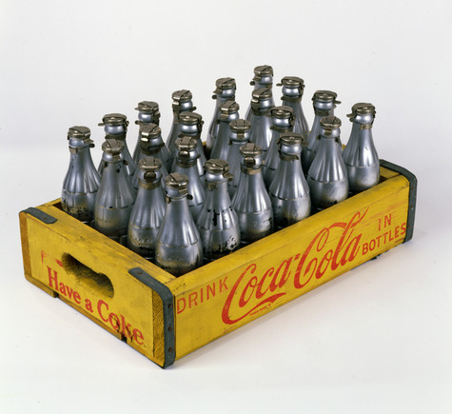
Warhol erased the boundaries between high art and low art by:
Taking common everyday items and giving them importance as art
Questioning what art critics, galleries, and museums considered “art”
Andy Warhol, You’re In (Silver Coke Bottles), 1967
The Andy Warhol Museum, Pittsburgh; Founding Collection, Contribution The Andy Warhol Foundation for the Visual Arts, Inc., © The Andy Warhol Foundation for the Visual Arts, Inc., 1998.1.789a-x
Notes:
Additional information:
Andy Warhol, You’re In (Silver Coke Bottles), 1967:
Warhol was interested in the democratic cultural significance of mass-produced consumer goods. Popular grocery items distributed in vast quantities worldwide, at an affordable price, represented the best and brightest of American consumer society. Warhol’s first paintings of Coke bottles appeared in 1961. Here the artist turned to readymade objects as source material, coating the actual soft drink bottles with silver paint. Three years later Warhol went a step further by filling 100 silver bottles with a perfume he rakishly labelled ‘You’re In’ / ‘Eau d’Andy’. Not surprisingly, the Coca-Cola Company responded with a cease and desist letter.

Slide 16
Once you “got” Pop, you could never see a sign the same way again. And once you thought Pop, you could never see America the same way again.
Andy Warhol, America, 1985

Slide 17
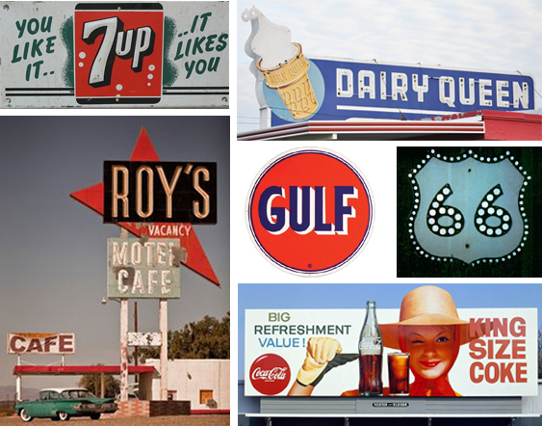
Warhol made the statement on the previous slide while traveling across America for his second gallery exhibition in Los Angeles, California, in 1963.
What do you think he meant by the statement?
All photos courtesy of TripAdvisor
© 2017 TripAdvisor LLC All rights reserved.
Notes:
Additional information:
These are a few signs and symbols that Warhol might have seen during his all-American road trip from New York to Los Angeles in September of 1963. Warhol drove cross-country for his second exhibition at the Ferus Gallery in LA where his iconic images of Elvis Presley and Elizabeth Taylor were shown. Warhol and his traveling companions saw the forerunners of Pop Art along the hundreds of miles of Route 66 in the form of billboards hawking consumer goods and giant, blinking neon signs above roadside motels and diners.
The Trip: Andy Warhol’s Plastic Fantastic Cross-Country Adventure by Deborah Davis
This book chronicles a little-known road trip Andy Warhol took from New York to LA in 1963, and how that journey—and the numerous artists and celebrities he encountered—profoundly influenced his life and art. The Trip captures Warhol’s interactions with Dennis Hopper, Peter Fonda, Marcel Duchamp, Elizabeth Taylor, Elvis Presley, and Frank Sinatra. Along the way he also met rednecks, beach bums, underground filmmakers, artists, poets, socialites, and newly minted hippies, and they each left an indelible mark on his psyche.

Slide 18
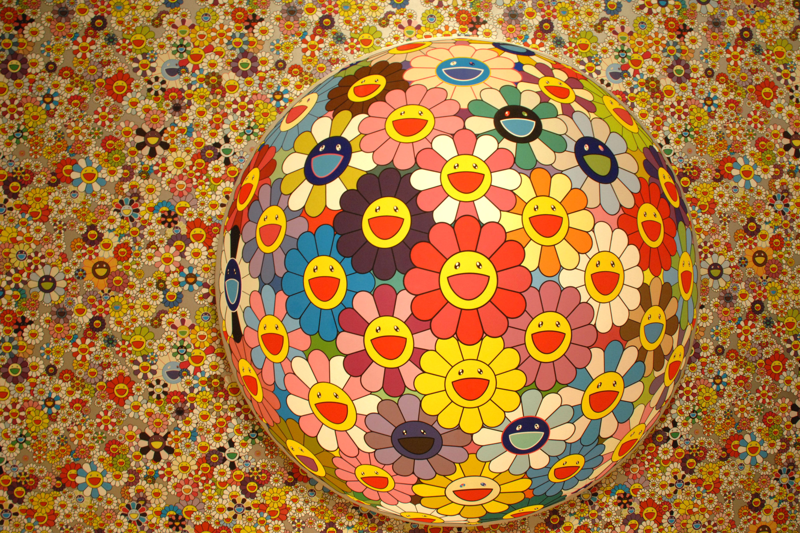
Pop Art continues to influence artists around the world today such as Japanese artist Takashi Murakami.
Takashi Murakami, at the 2008 Brooklyn Ball Celebrating © MURAKAMI Exhibition at The Brooklyn Museum on April 3, 2008, in New York City. (Photo by JOE SCHILDHORN/Patrick McMullan via Getty Images)
Notes:
Additional information:
Takashi Murakami:
Murakami’s art encompasses a wide range of media and has been noted for its use of color, incorporation of motifs from Japanese traditional and popular culture, flat/glossy surfaces, and content that could be described as “cute,” “psychedelic,” or “satirical”. Among his best known recurring motifs are smiling flowers, iconic characters, mushrooms, skulls, and Buddhist iconography.
Like Andy Warhol, he is known for blurring the line between high and low art. He coined the term "superflat”, which describes both the aesthetic characteristics of the Japanese artistic tradition and the nature of post-war Japanese culture and society, and is also used for Murakami’s own artistic style and that of other Japanese artists he has influenced. In accordance with the “superflat” concept, Murakami’s practice involves repackaging elements usually considered “low” or subcultural and presenting them in the “high-art” market. He then further flattens the playing field by repackaging his “high-art” works as merchandise, such as plush toys and T-shirts, making them available at more affordable prices.

