Slide 1

Silkscreen Printing

Slide 2
Introduction & Color Theory
Lesson 1

Slide 3
I tried doing them by hand, but I find it easier to use a screen. This way, I don’t have to work on my objects at all. One of my assistants or anyone else, for that matter, can reproduce the design as well as I could.
Andy Warhol, Andy Warhol, 1969

Slide 4
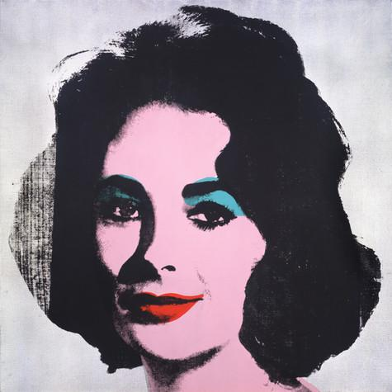
Introduction
Andy Warhol first experimented with simple printmaking methods like rubber stamping and blotted line drawing during his commercial design career in the 1950s.
However, he turned to his most notable style, photographic silkscreen printing, in 1962. This commercial process allowed him to easily reproduce the images that he appropriated from popular culture.
Among his first photographic silkscreen works were his paintings featuring Marilyn Monroe, Elvis Presley, and Elizabeth Taylor.
Andy Warhol, Silver Liz [Ferus Type], 1963
The Andy Warhol Museum, Pittsburgh; Founding Collection, Contribution The Andy Warhol Foundation for the Visual Arts, Inc., © The Andy Warhol Foundation for the Visual Arts, Inc., 1998.1.55
Notes:
Additional information:
Andy Warhol, Silver Liz [Ferus Type], 1963
Warhol appropriated a 1950s publicity photo of Elizabeth Taylor as the source material for the silkscreen. He worked with professionals to have the photos he chose transferred onto the mesh of the screen. When he passed an ink-laden squeegee over the mesh as the silkscreen sat atop his canvas, ink would pass through the holes in the mesh and impress a print of his image onto the canvas.

Slide 5
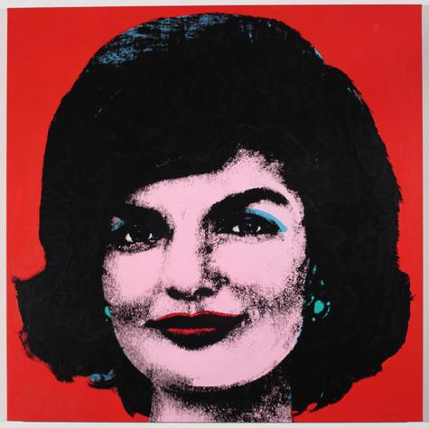
Photographic Silkscreen Printing
The photographic silkscreen printing process uses a light sensitive emulsion applied directly to the silkscreen in order to expose a film positive of the image, using a proper light source.
This process creates a precise and deﬁned image and allowed Warhol and his assistants to mass-produce a large number of prints with relative ease.
While Warhol didn’t invent this process, he developed his own silkscreen printing technique by combining hand-painted backgrounds with photographic silkscreen-printed images to create unique works of art.
Andy Warhol, Red Jackie, 1964
The Andy Warhol Museum, Pittsburgh; Founding Collection, Contribution The Andy Warhol Foundation for the Visual Arts, Inc. © The Andy Warhol Foundation for the Visual Arts, Inc.
1998.1.54
Notes:
Additional information:
Watch Warhol’s photographic silkscreen printing technique here: https://www.youtube.com/watch?v=jNM04-mhMgo&list=PL_CXyOtx7w0rZEwhrVllkNK8lUTDP9oLi

Slide 6
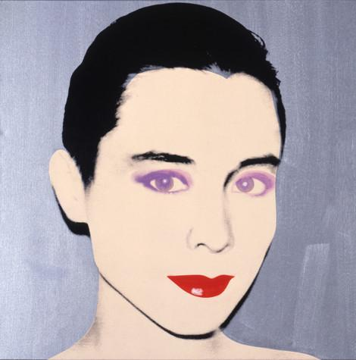
Underpainting
Warhol began each artwork using a high contrast image that was then enlarged and transferred onto a silkscreen.
Each image was first underpainted by tracing simple outlines of the photographic image onto the canvas and painting in blocks of color. Some were painted in slick, hard-edge styles, whereas others had solid fields of color or more gestural brushwork.
Once this initial painted layer was dry, Warhol printed the photographic silkscreen image on top.
Andy Warhol, Tina Chow, 1985
The Andy Warhol Museum, Pittsburgh; Founding Collection, Contribution The Andy Warhol Foundation for the Visual Arts, Inc.
© The Andy Warhol Foundation for the Visual Arts, Inc.
1998.1.521

Slide 7
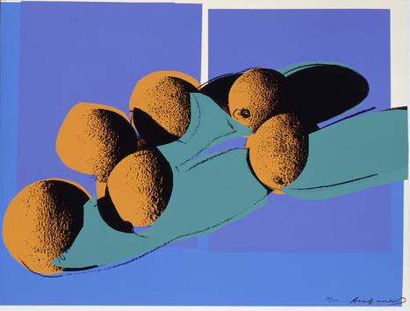
Multilayer Silkscreen Printing
Warhol quickly realized that he could produce art in a systematic manner like an assembly line of a factory.
He worked with assistants and printers to create numerous print portfolios. In 1977 he met printer Rupert Jasen Smith who worked with him to create the series Space Fruit.
This series is an example of multilayer silkscreen printing since each color represents a different layer using multiple screens. This printing process allowed Warhol endless color combinations within each composition.
Andy Warhol, Space Fruit: Still Lifes (Cantaloupes I), 1979
The Andy Warhol Museum, Pittsburgh; Founding Collection, Contribution Dia Center for the Arts
© The Andy Warhol Foundation for the Visual Arts, Inc.
2002.4.19.4
Notes:
Additional information:

Slide 8
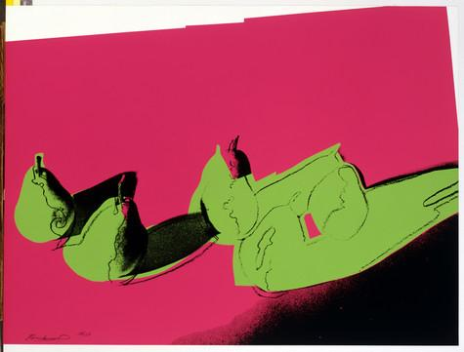
How many layers did Warhol use to create this composition?
He would first print the background color with one screen and the fruit shapes with another screen.
He would then print the photographic image of the fruit using a third screen.
Finally, he would add a hand-drawn layer to finish the work.
Andy Warhol, Space Fruit: Still Lifes (Pears), 1979
The Andy Warhol Museum, Pittsburgh; Founding Collection, Contribution Dia Center for the Arts
© The Andy Warhol Foundation for the Visual Arts, Inc.
2002.4.19.6
Notes:
Additional information:

Slide 9
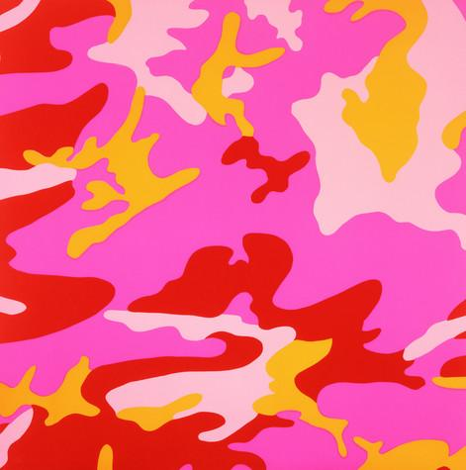
Color Theory
Color theory is the science and art of color; how we perceive color, how we mix color, and the visual effects of specific color combinations.
Since Warhol received a Bachelor of Fine Arts in Pictorial Design, he learned about color theory and how color could be used in art to evoke certain emotions from the audience.
Significant personal, cultural, symbolic, and aesthetic associations and meanings can be made through Warhol’s use of color.
Andy Warhol, Camouflage, 1987
The Andy Warhol Museum, Pittsburgh; Founding Collection, Contribution The Andy Warhol Foundation for the Visual Arts, Inc.
© The Andy Warhol Foundation for the Visual Arts, Inc.
1998.1.2503.3
Notes:
Additional information:

Slide 10
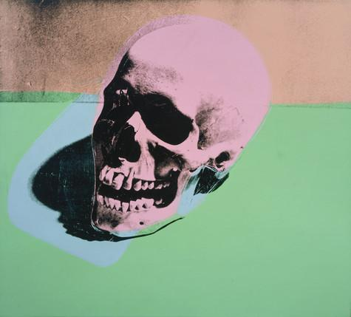
Color and Shape
Shape is considered to be a two-dimensional element, while three-dimensional elements have volume or mass.
Shapes are enclosed objects and can be created by line, color and value changes that define their edges.
Shapes can be
  organic: irregular shapes found in nature, also called “natural”
  geometric: shapes with strong lines and angles such as circles, triangles, and squares
Andy Warhol, Skull, 1976
The Andy Warhol Museum, Pittsburgh; Founding Collection, Contribution Dia Center for the Arts
© The Andy Warhol Foundation for the Visual Arts, Inc.
2002.4.31
Notes:
Additional information:

Slide 11
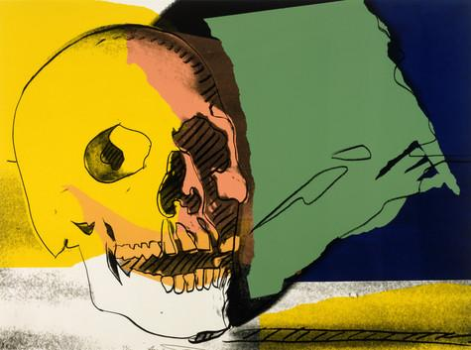
Positive and Negative Space
Negative space describes the space that surrounds an object or image, while positive space describes the image itself. Negative space can help define an object and bring balance to a composition.
Why is it important to consider both
positive and negative space when
creating a composition?
Andy Warhol, Skulls, 1976
The Andy Warhol Museum, Pittsburgh; Founding Collection, Contribution The Andy Warhol Foundation for the Visual Arts, Inc.
© The Andy Warhol Foundation for the Visual Arts, Inc.
1998.1.2416.2
Notes:
Additional information:

Slide 12
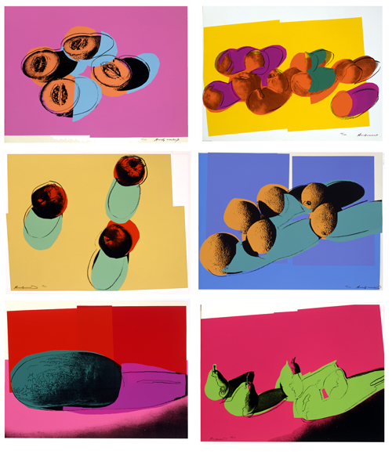
Identify and describe the shapes.
  are they organic or geometric?
  how are the shapes’ edges defined?
Identify the dominant shapes in each composition.
Identify the positive and negative space in each composition.
Andy Warhol, Space Fruit: Still Lifes, 1979
The Andy Warhol Museum, Pittsburgh; Founding Collection, Contribution Dia Center for the Arts
© The Andy Warhol Foundation for the Visual Arts, Inc.
Notes:
Additional information:

Slide 13
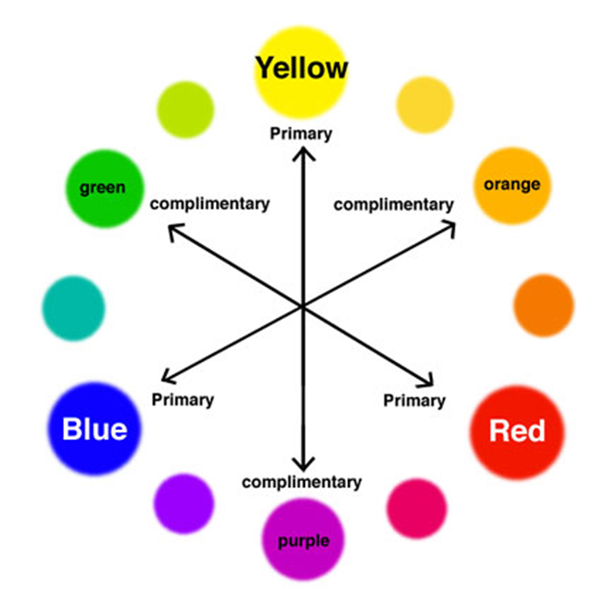
The Color Wheel
Color wheel: a circle with different colored sections used to show the relationship between colors and the essential elements of mixing color.
Color scheme: the combination of colors on the color wheel implemented by artists, designers, and illustrators.
Notes:
Additional information:

Slide 14
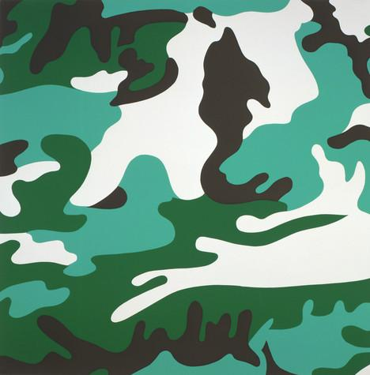
Monochromatic
Monochromatic color schemes use tints, tones,
and shades from the same color:
tint: created when you add white to a color
tone: created when you add both black and white to a color
shade: created when you add black to a color
What color is used to create this artwork?
Can you identify the tints, tones, and shades
in the composition?
Andy Warhol, Camouflage, 1987
The Andy Warhol Museum, Pittsburgh; Founding Collection, Contribution The Andy Warhol Foundation for the Visual Arts, Inc.
© The Andy Warhol Foundation for the Visual Arts, Inc.
1998.1.2503.1
Notes:
Additional information:

Slide 15
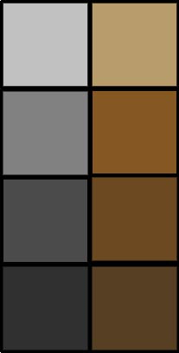
Neutral Colors
Neutral colors or earth tones are not seen on most color wheels. Black, gray, whites are neutral. Browns, beiges and tans are sometimes neutral too. Neutral colors can be made by mixing:
Black and white
Complementary colors
All three primaries together (plus black or white)
Notes:
Additional information:

Slide 16

Analogous
Analogous refers to any three colors which are side by side on a 12 part color wheel, such as red, orange, and purple.
Usually one of the three colors predominates.
Andy Warhol, Camouflage, 1987
The Andy Warhol Museum, Pittsburgh; Founding Collection, Contribution The Andy Warhol Foundation for the Visual Arts, Inc.
© The Andy Warhol Foundation for the Visual Arts, Inc.
1998.1.2503.3
Notes:
Additional information:

Slide 17
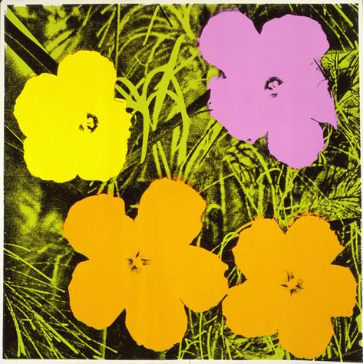
Complementary
Complementary refers to two colors that are the direct opposite of each other, such as yellow and purple.
Complementary colors create the most contrast and balance in design.
Andy Warhol, Flowers, 1970
The Andy Warhol Museum, Pittsburgh; Founding Collection, Contribution The Andy Warhol Foundation for the Visual Arts, Inc.
© The Andy Warhol Foundation for the Visual Arts, Inc.
1998.1.2395.4
Notes:
Additional information:

Slide 18
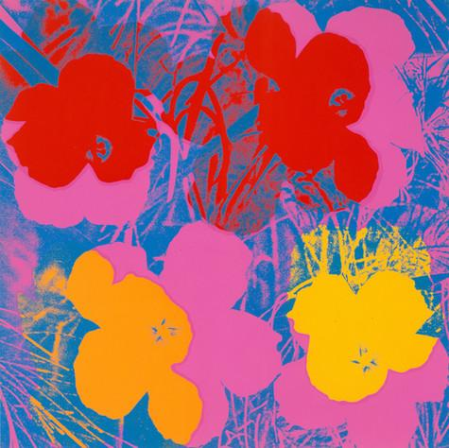
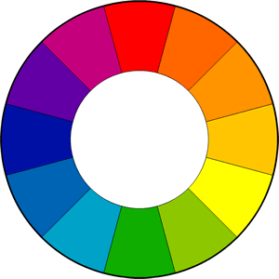
Split Complementary
Split Complementary is when a base color and the two colors opposite it on the color wheel are used as its complement.
Here, the split complement of the blue background are the yellow orange and red orange flowers.
Andy Warhol, Flowers, 1970
The Andy Warhol Museum, Pittsburgh; Founding Collection, Contribution The Andy Warhol Foundation for the Visual Arts, Inc.
© The Andy Warhol Foundation for the Visual Arts, Inc.
1998.1.2395.3
Notes:
Additional information:

Slide 19
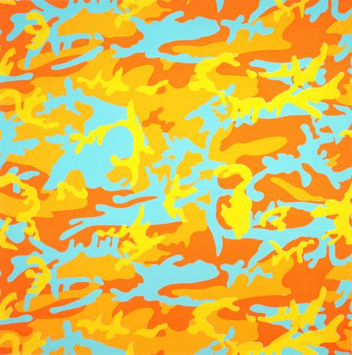
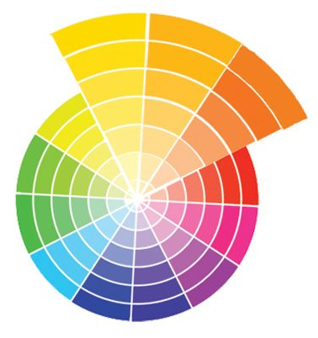
Value
Value refers to the lightness or darkness of a color.
Dark values with black added are called shades and light values with white added are called tints.
Andy Warhol, Camouflage, 1987
The Andy Warhol Museum, Pittsburgh; Founding Collection, Contribution The Andy Warhol Foundation for the Visual Arts, Inc.
© The Andy Warhol Foundation for the Visual Arts, Inc.
1998.1.2503.8
Notes:
Additional information:

Slide 20
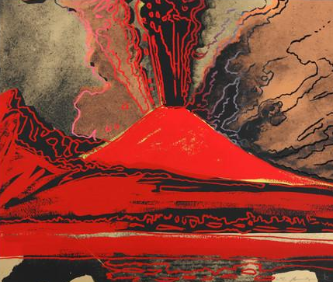
Temperature
The temperature of a color is usually defined in terms of “warm” and “cool”.
Blue, green, and purple are considered cool colors while yellow, orange, and red are considered warm colors.
Color temperature can help enhance the mood of an image.
warm
cool
Andy Warhol, Vesuvius, 1985
The Andy Warhol Museum, Pittsburgh; Founding Collection, Contribution The Andy Warhol Foundation for the Visual Arts, Inc.
© The Andy Warhol Foundation for the Visual Arts, Inc.
1998.1.2489
Notes:
Additional information:

Slide 21
Gathering and Manipulating
Source Images
Lesson 2

Slide 22
With silkscreening, you pick a photograph, blow it up, transfer it in glue onto silk, and then roll ink across it so the ink goes through the silk but not through the glue. That way you get the same image, slightly different each time. It was all so simple—quick and chancy. I was thrilled with it.
Andy Warhol, Popism: The Warhol Sixties, 1980

Slide 23
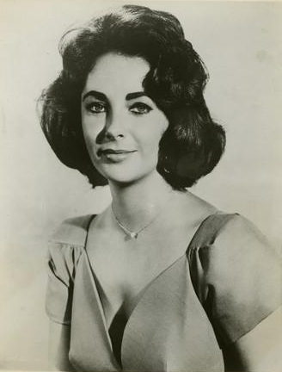
Appropriation
Warhol appropriated (used without permission) images from magazines, newspapers, and press photos of the most popular people of his time.
When manipulating the original image, he paid particular attention to contrast, cropping and color.
Andy Warhol, Silver Liz [Ferus Type], 1963
The Andy Warhol Museum, Pittsburgh; Founding Collection, Contribution The Andy Warhol Foundation for the Visual Arts, Inc., © The Andy Warhol Foundation for the Visual Arts, Inc., 1998.1.55
Publicity still of Elizabeth Taylor, 1957
The Andy Warhol Museum, Pittsburgh; Founding Collection, Contribution The Andy Warhol Foundation for the Visual Arts, Inc., 1998.3.10289.2
Notes:
Additional information:

Slide 24
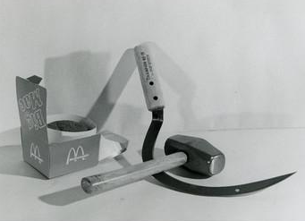
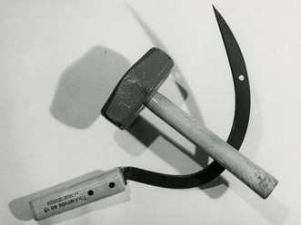
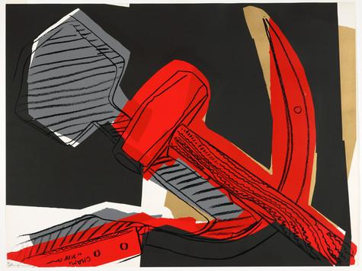
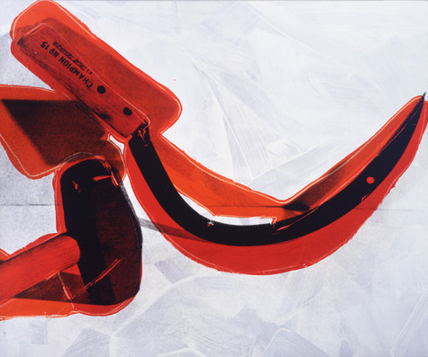
Still Life Arrangements
Warhol and his assistants also set up still life arrangements of objects that were then used as source material for his silkscreens.
They would take multiple photos in varying arrangements, manipulating the lighting to adjust the contrast and enhance or diminish the shadows.
Andy Warhol, Hammer and Sickle with Big Mac, ca. 1976
The Andy Warhol Museum, Pittsburgh; Contribution The Andy Warhol Foundation for the Visual Arts, Inc.
2001.2.611
Andy Warhol, Hammer and Sickle, ca. 1976
The Andy Warhol Museum, Pittsburgh; Contribution The Andy Warhol Foundation for the Visual Arts, Inc.
2001.2.610
Andy Warhol, Hammer and Sickle, 1977
The Andy Warhol Museum, Pittsburgh; Founding Collection, Contribution The Andy Warhol Foundation for the Visual Arts, Inc.
1998.1.2424.4
Andy Warhol, Hammer and Sickle, 1976
The Andy Warhol Museum, Pittsburgh; Founding Collection, Contribution The Andy Warhol Foundation for the Visual Arts, Inc.
1998.1.186
Warhol artwork © The Andy Warhol Foundation for the Visual Arts, Inc.
Notes:
Additional information:

Slide 25
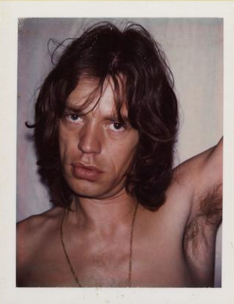
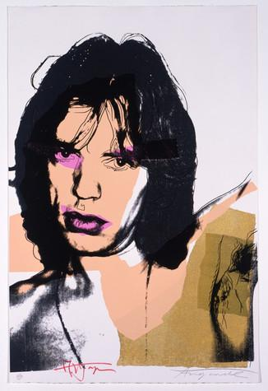
Portraiture
Warhol also created source imagery for his commissioned portraits using photography and photographic silkscreen printing.
He began with a photo shoot at his studio, using a Polaroid camera. The Polaroid afforded a very high contrast image that he enlarged and transferred onto a silkscreen.
Andy Warhol, Mick Jagger from "Little Red Book No. 275", 1975
The Andy Warhol Museum, Pittsburgh; Founding Collection, Contribution The Andy Warhol Foundation for the Visual Arts, Inc.
1998.1.3003.8
Andy Warhol, Mick Jagger, 1975
The Andy Warhol Museum, Pittsburgh; Founding Collection, Contribution The Andy Warhol Foundation for the Visual Arts, Inc. © The Andy Warhol Foundation for the Visual Arts, Inc.
1998.1.2412.4
Notes:
Additional information:

Slide 26
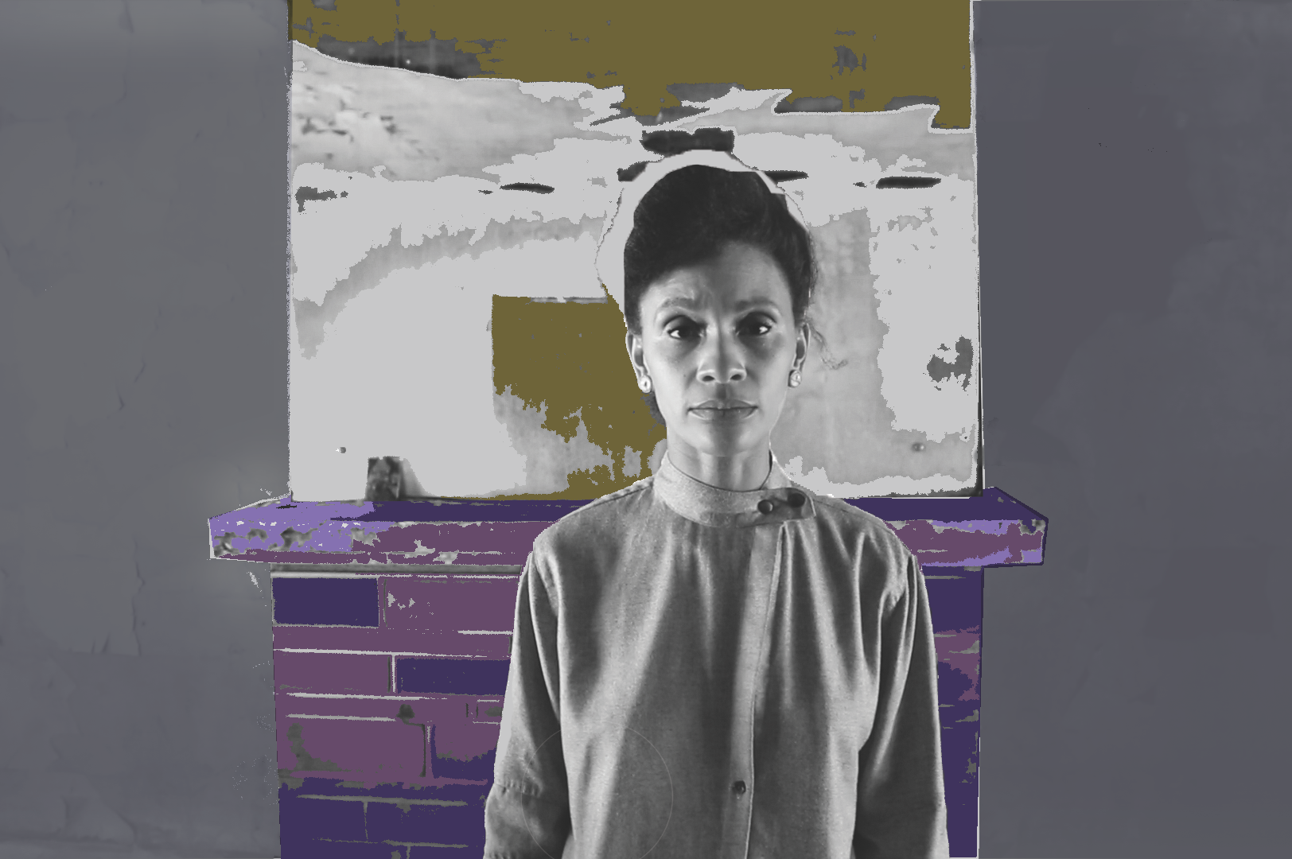
Gathering and Manipulating Images
The first step in creating a photographic silkscreen is to find source images.
Images can be sourced from newspapers, magazines, the internet, or using a camera.
Images must be made into a digital file.
Alisha Wormsley, Untitled, 2017
Silkscreen print on paper

Slide 27
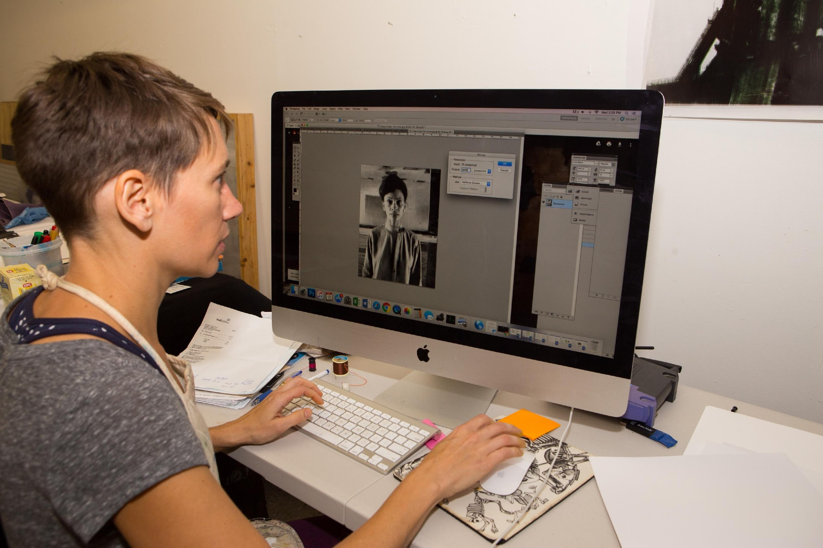
Bitmapping and Film Positive
Use Photoshop or other digital photo editing software to create a high-contrast black and white bitmap of your digital image.
Follow the instructions on the Bitmapping Handout.
Once your image is complete, print it onto a film positive
If you are creating a multilayer print, create a separate image for each layer.
Student manipulating a photograph in Photoshop
Photo by Sean Carroll

Slide 28
Preparing and Exposing Photographic Silkscreens
Lesson 3

Slide 29
Materials
Open silkscreen
Scoop coater
Photosensitive emulsion

Slide 30
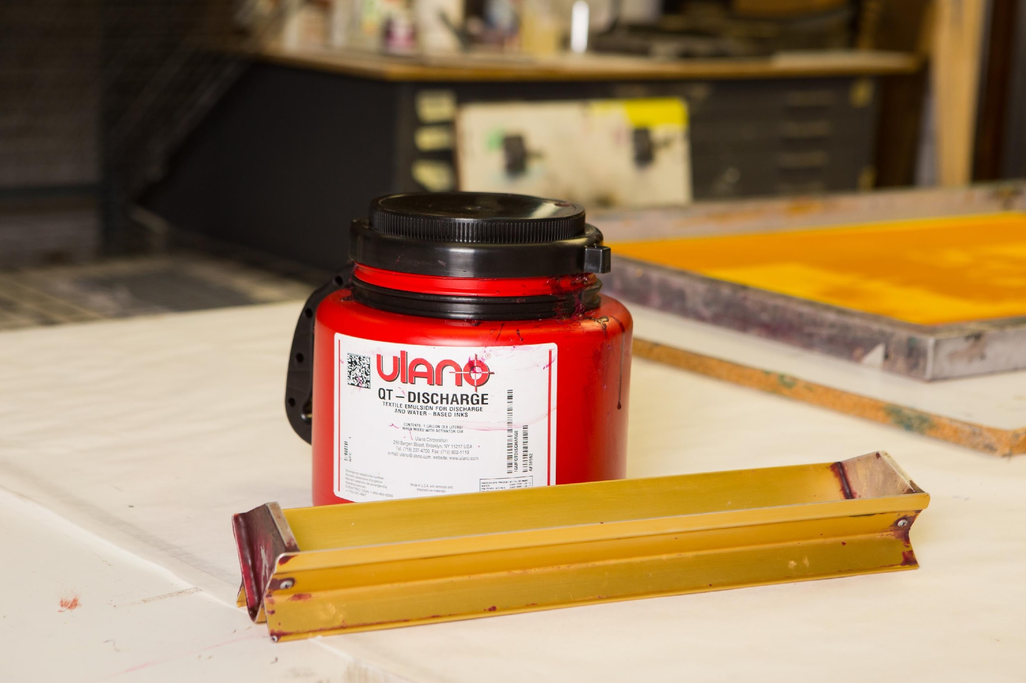
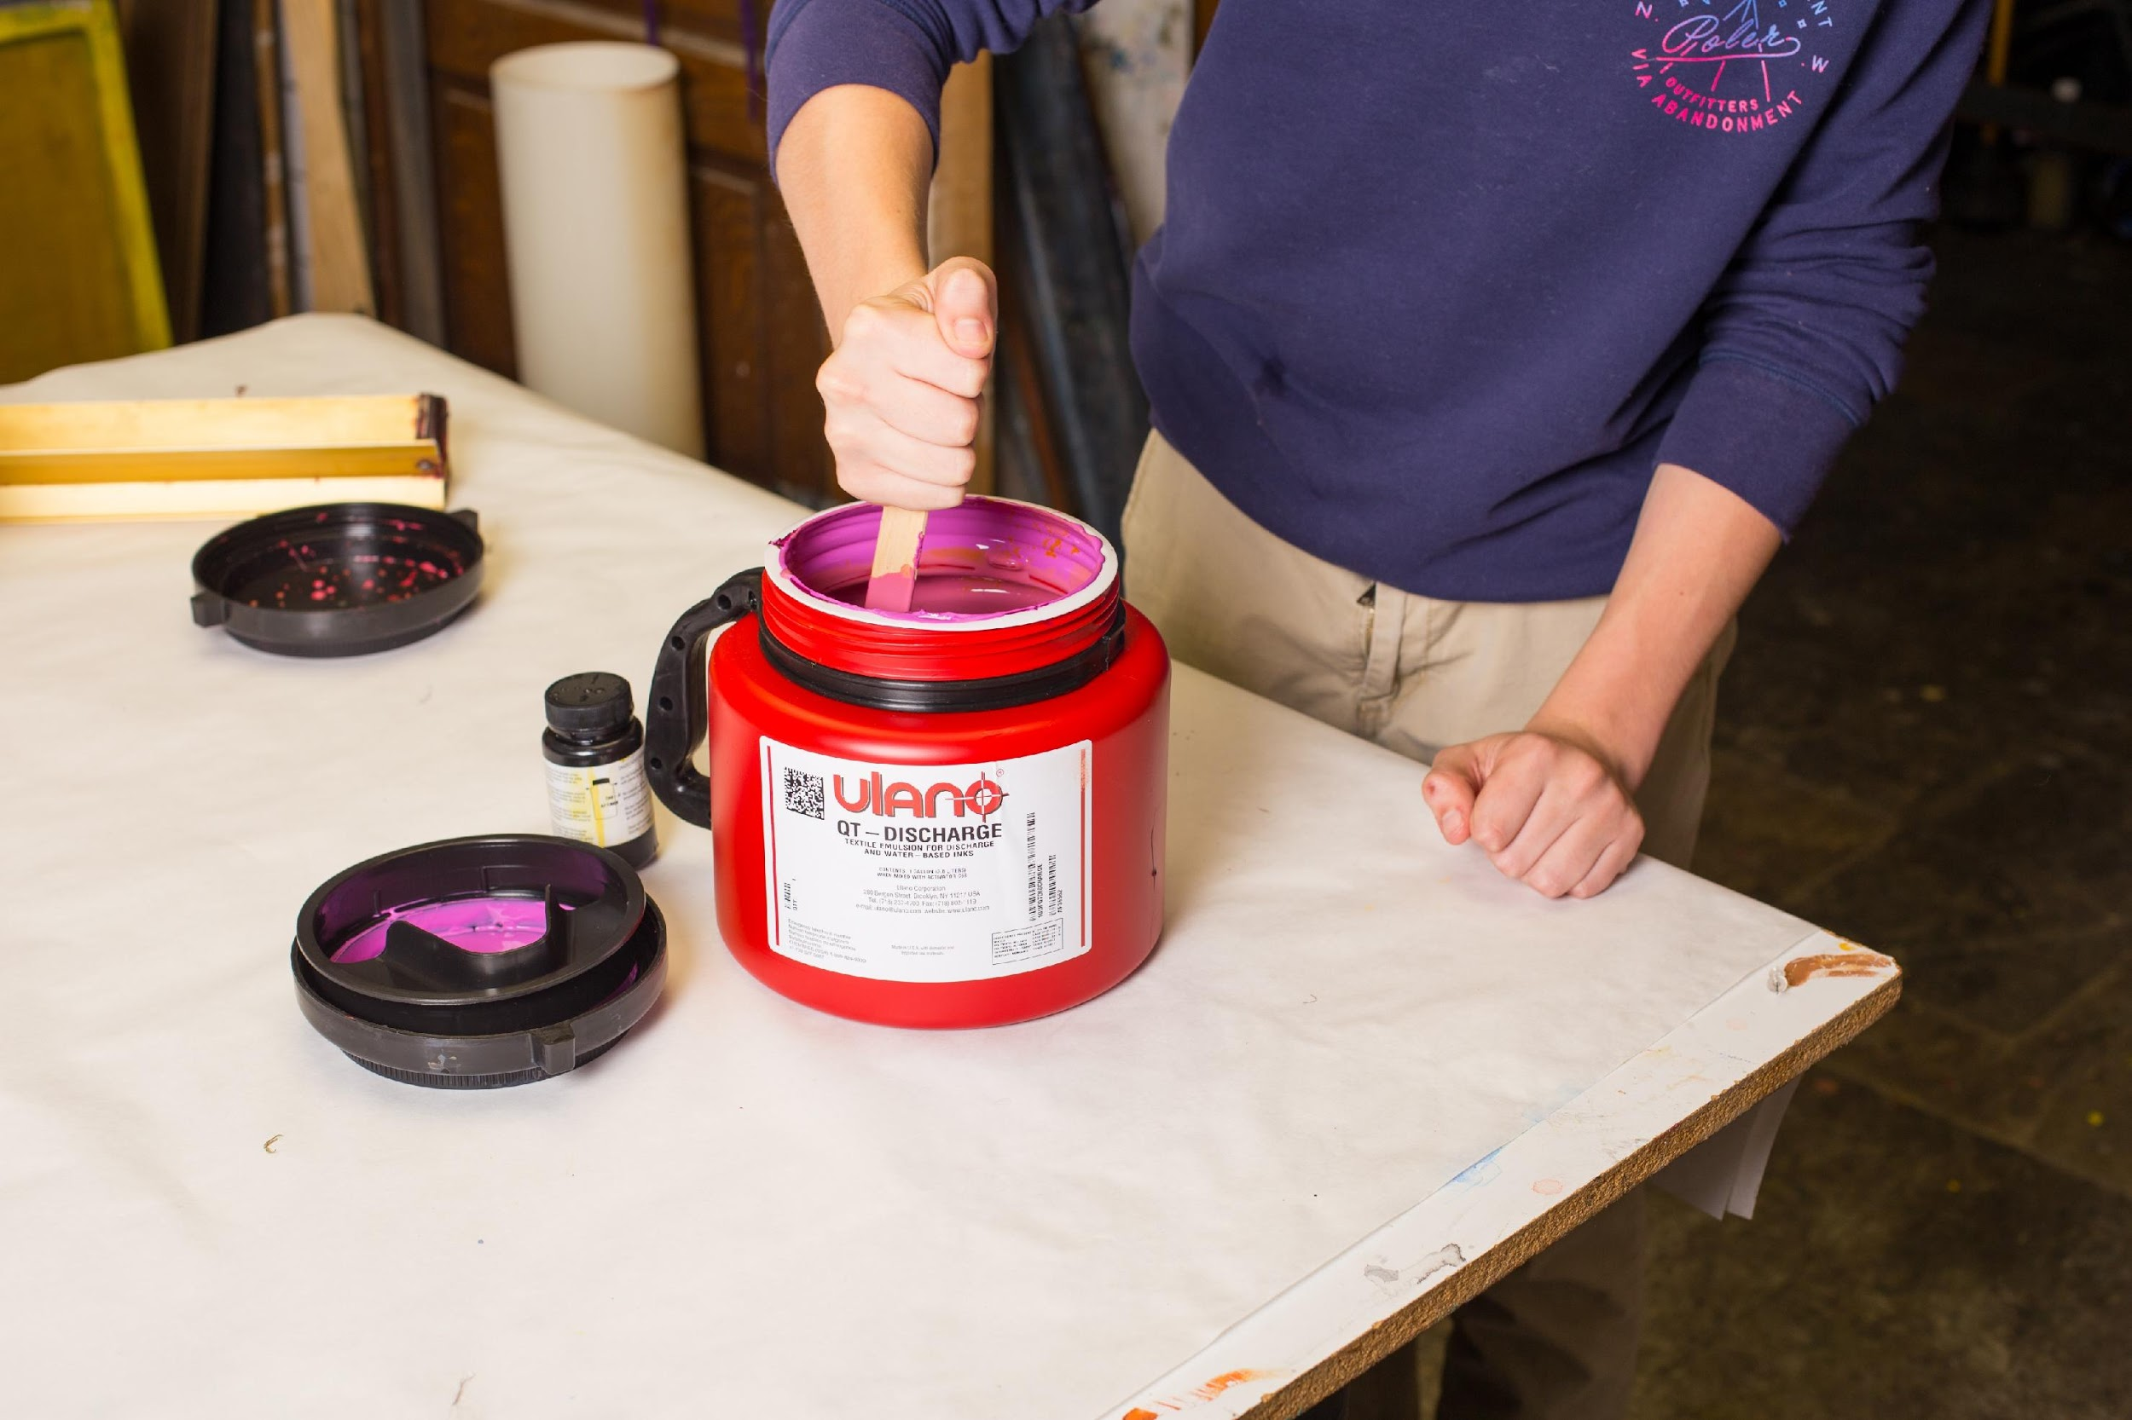
Preparing and Exposing Photographic Silkscreens
You will need photo emulsion and a scoop coater the width of your screen.
Prepare the emulsion according to the package directions.
Photo by Sean Carroll
Photo by Sean Carroll

Slide 31
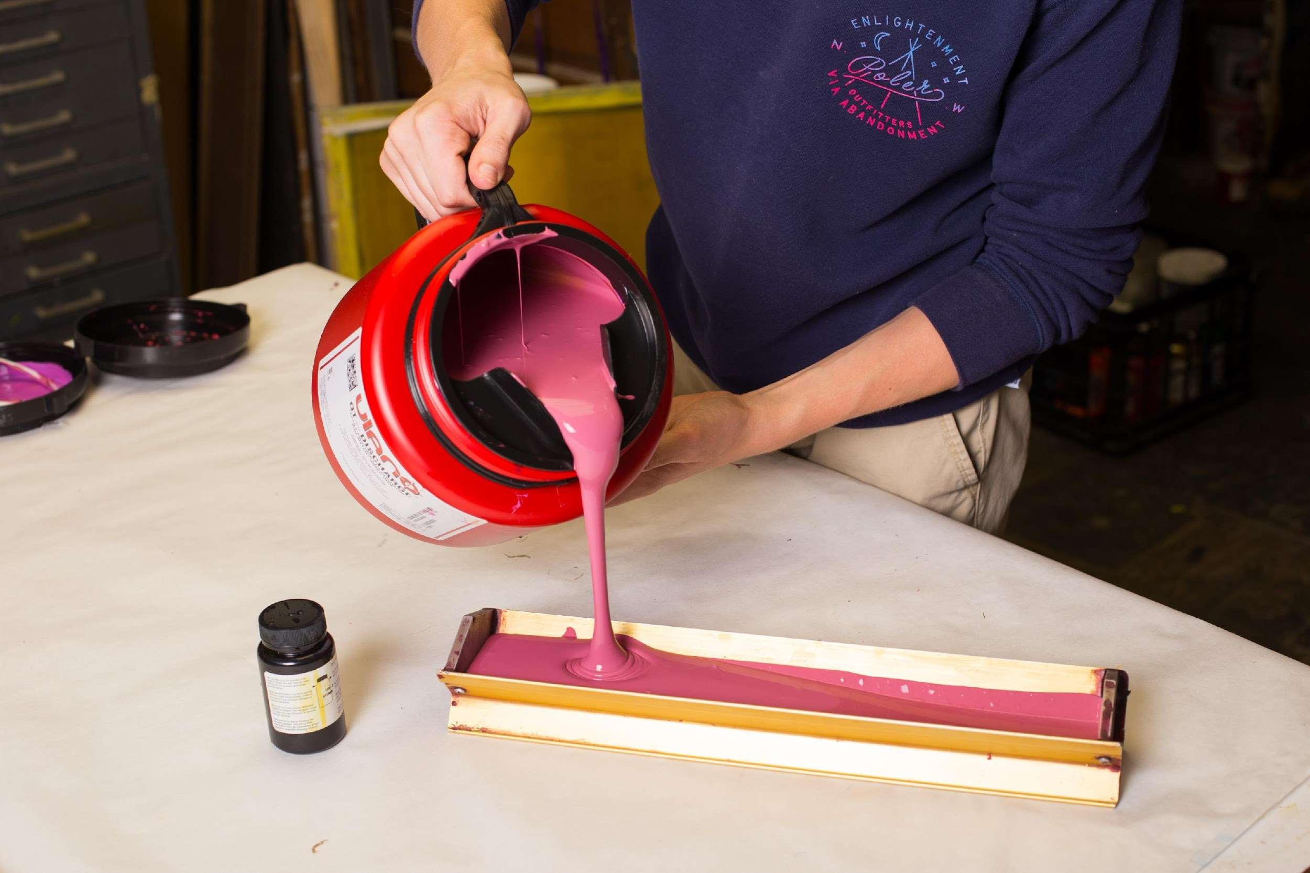
Coating the Screen
In a darkened room or a room with a yellow safe light, pour emulsion into the scoop coater.
Photo by Sean Carroll

Slide 32
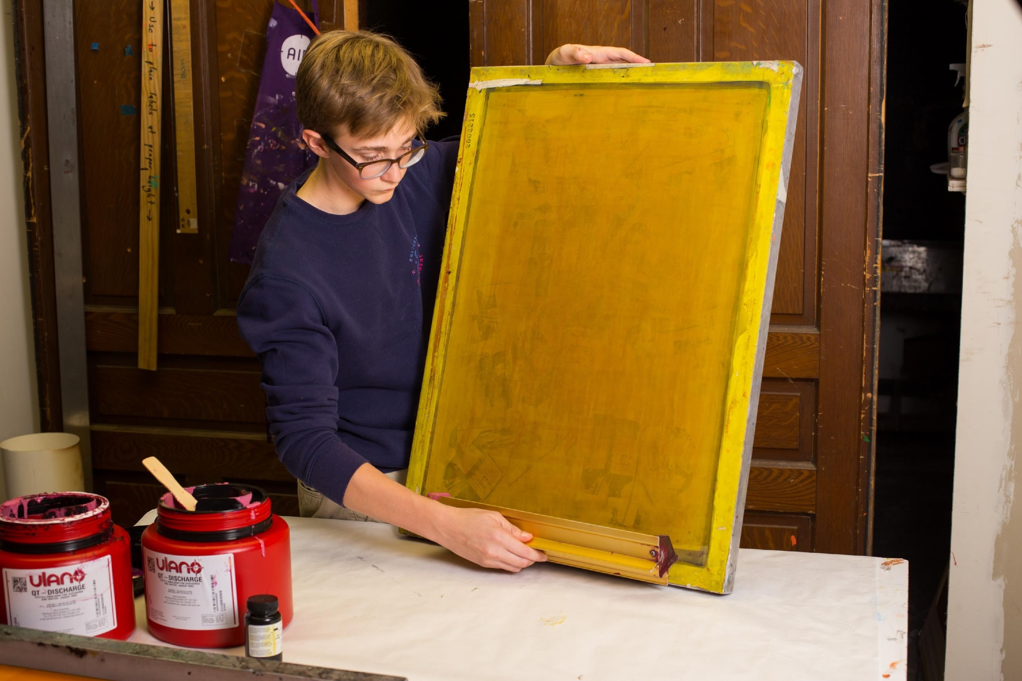
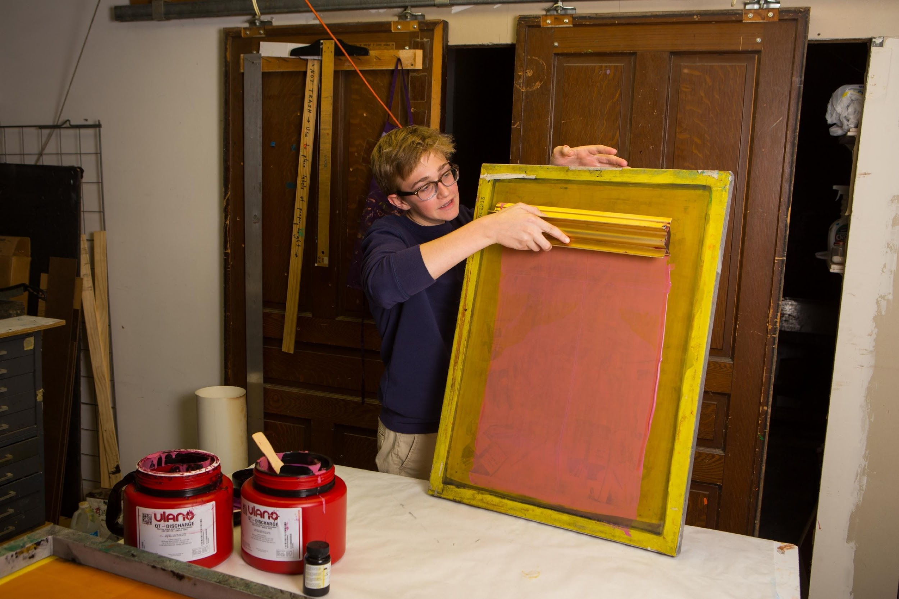
Coat the screen, applying one or two thin coats of emulsion
to the flat side of the screen.
Photo by Sean Carroll
Photo by Sean Carroll

Slide 33
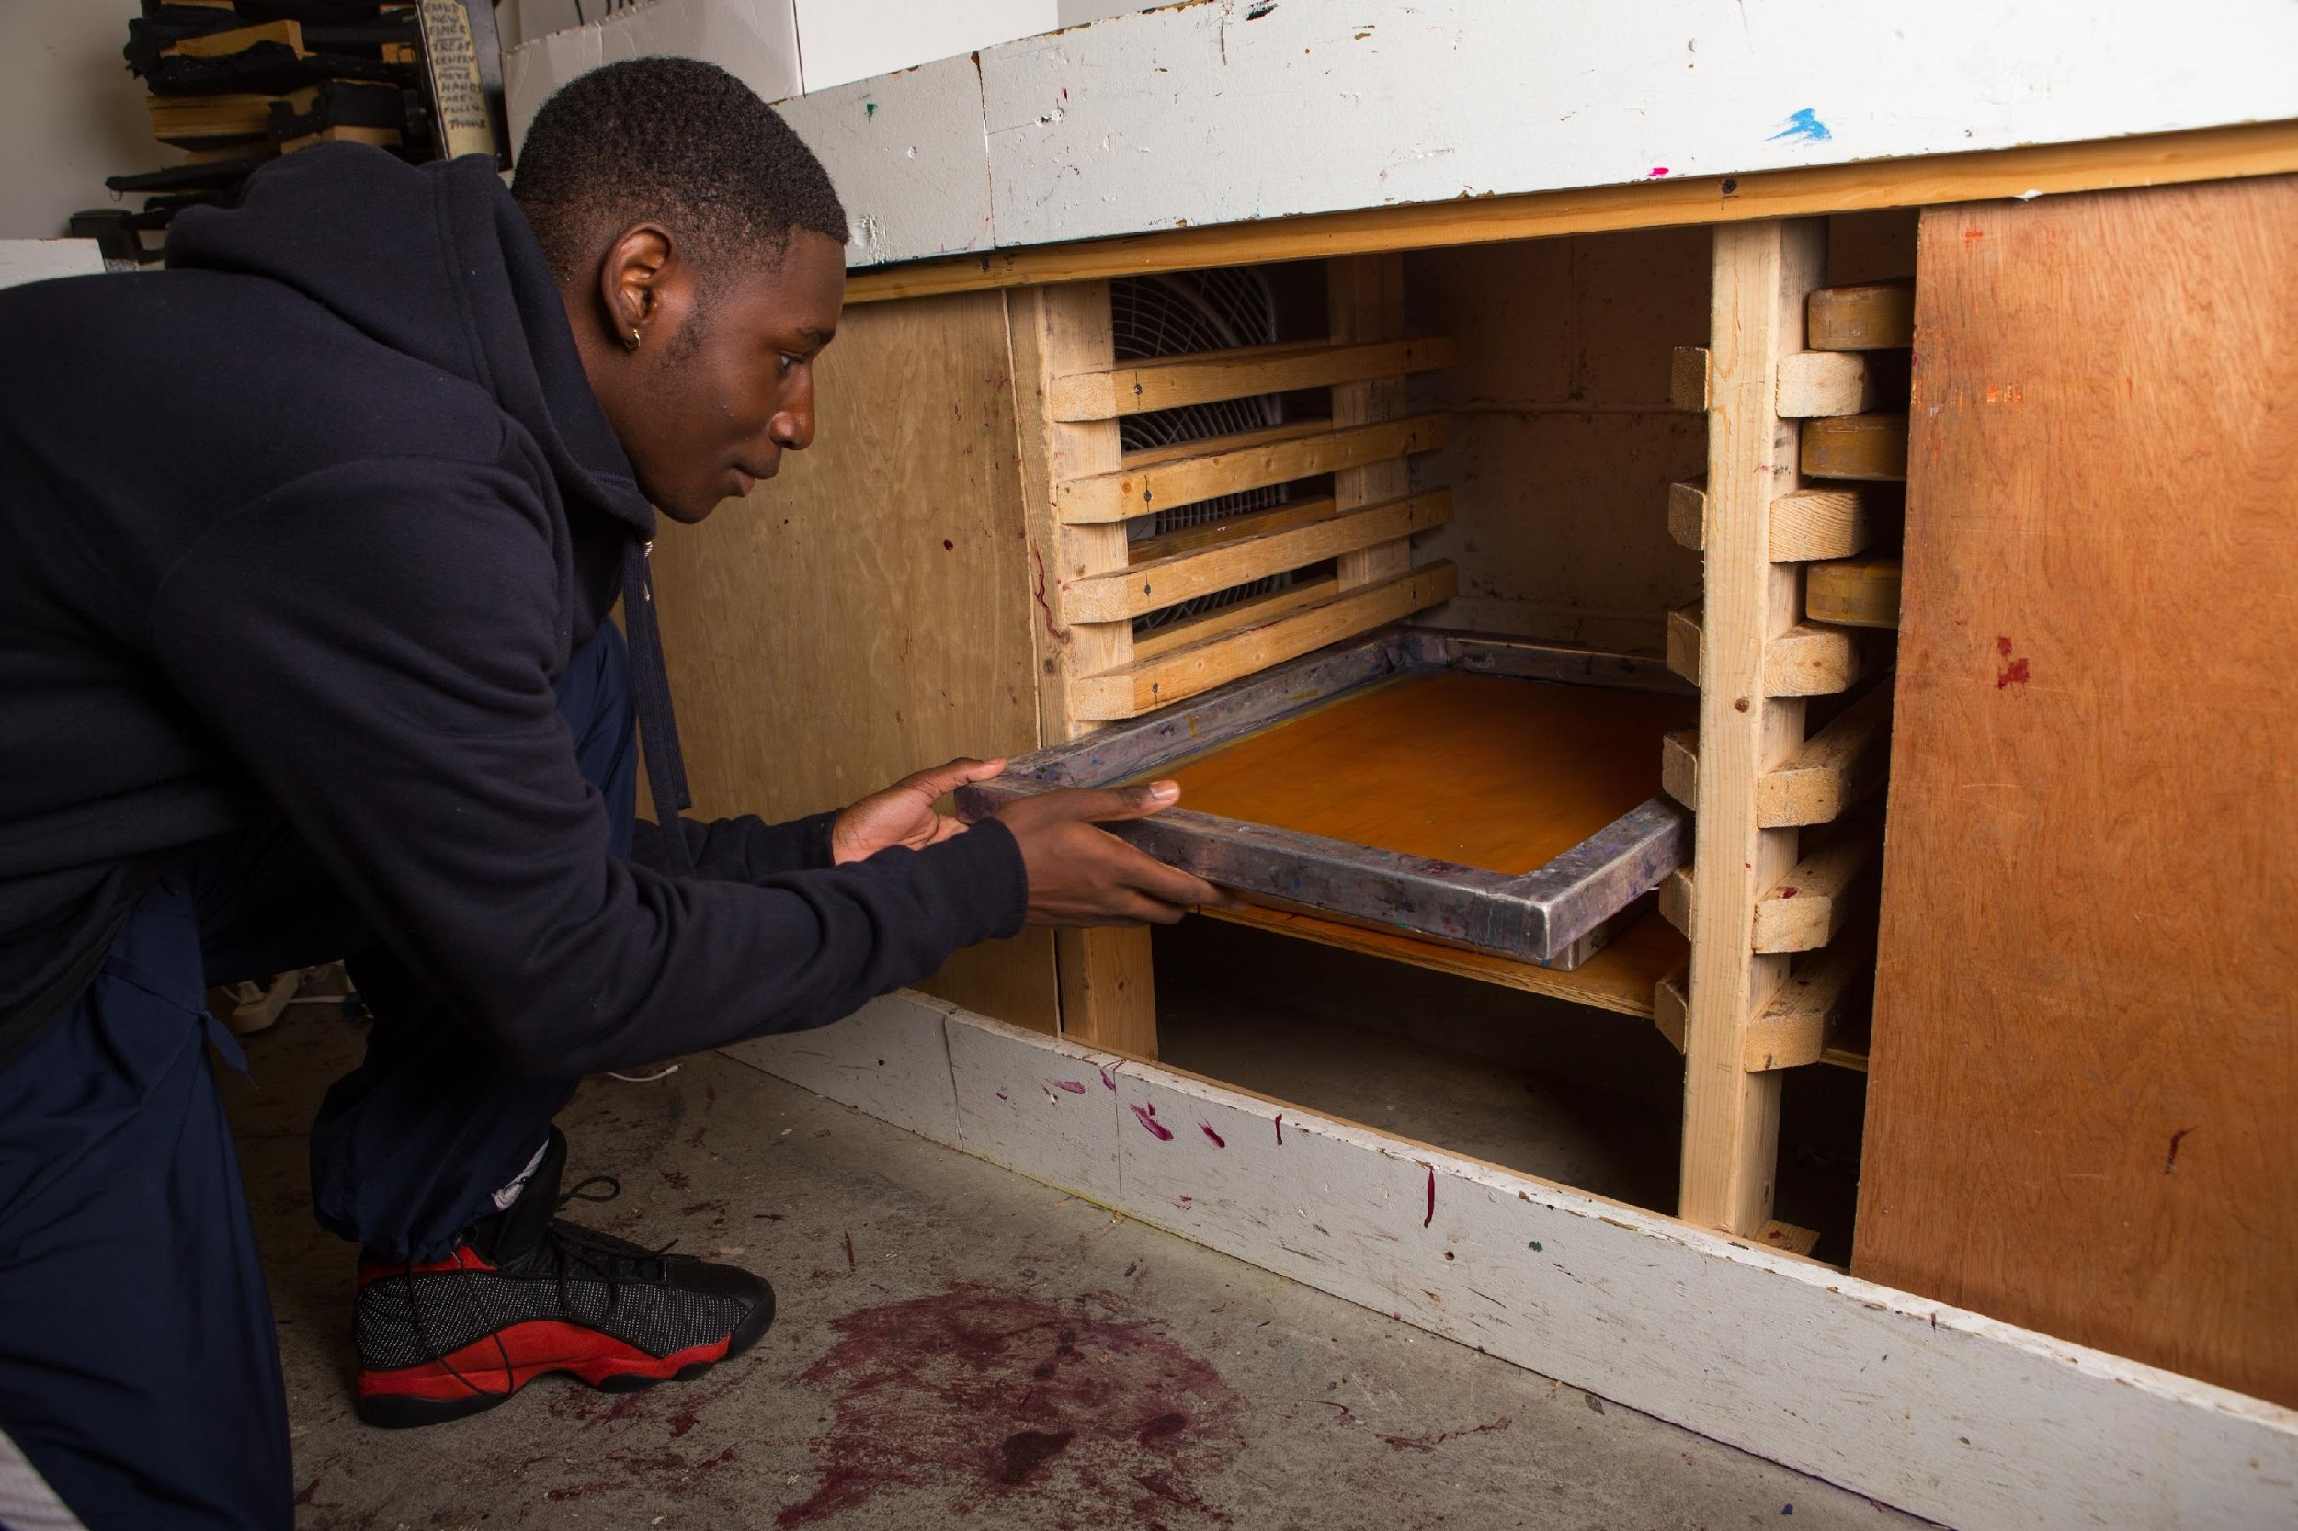
Drying and Storing Screens
Store the coated screens in a dark room or light-tight box until they are dry.
Screens should dry with the flat side down (the side you use the squeegee on should be facing up).
Screens must stay flat when drying, the slightest tilt might cause the emulsion to dry unevenly and run off the screen.
Use a rack like this one to separate multiple screens, or stack them with small blocks between each one.
Photo by Sean Carroll

Slide 34
Exposing Screens
There are different types of exposing units, including light tables (which can easily be built using clear glass and fluorescent light bulbs) and vacuum exposing units. The following slides give instructions for exposing with a light table first, then for a vacuum unit.

Slide 35
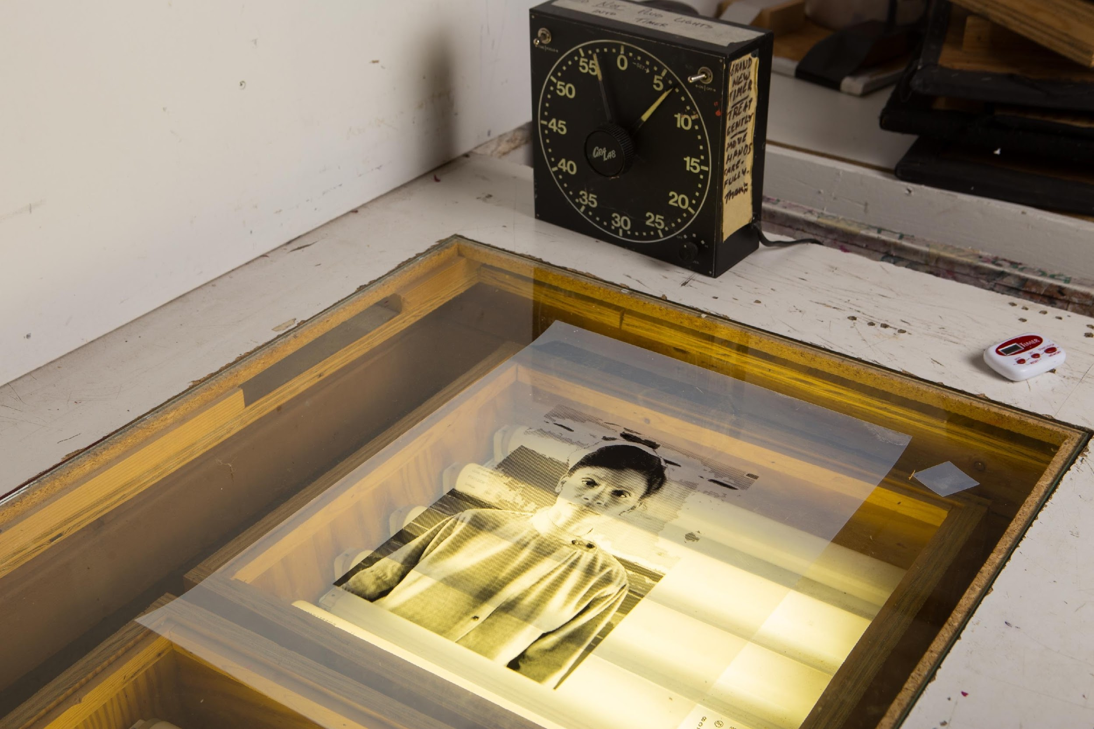
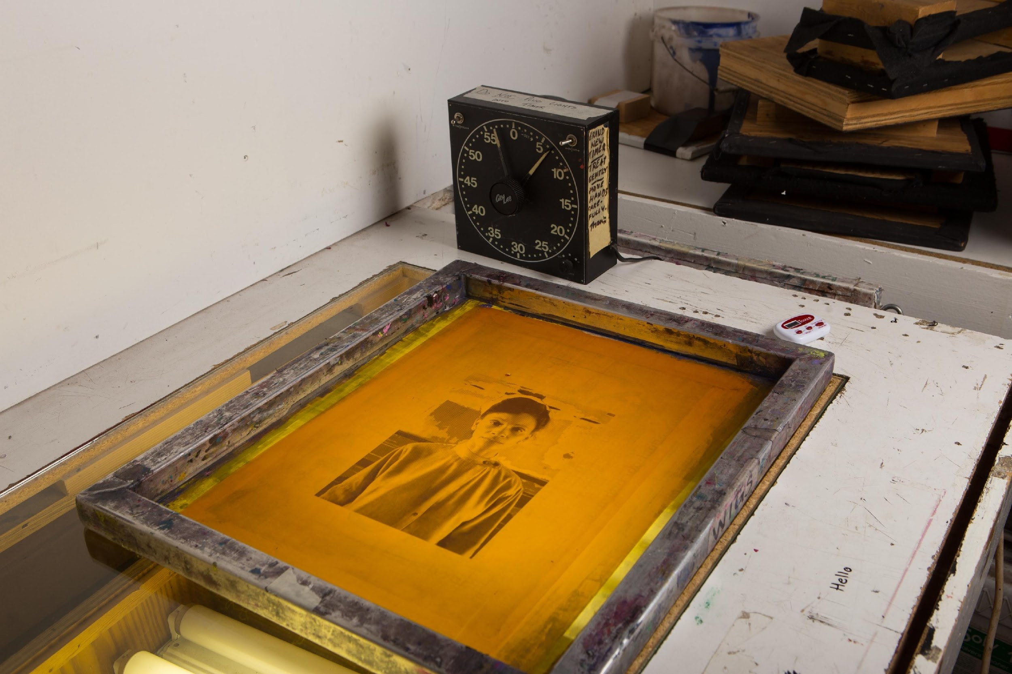
Exposing with a Light Table
Place the film positive onto the light table, making sure that the image is facing right side up.
Place the coated screen on top of the film positive, flat side down.
Photo by Sean Carroll
Photo by Sean Carroll

Slide 36
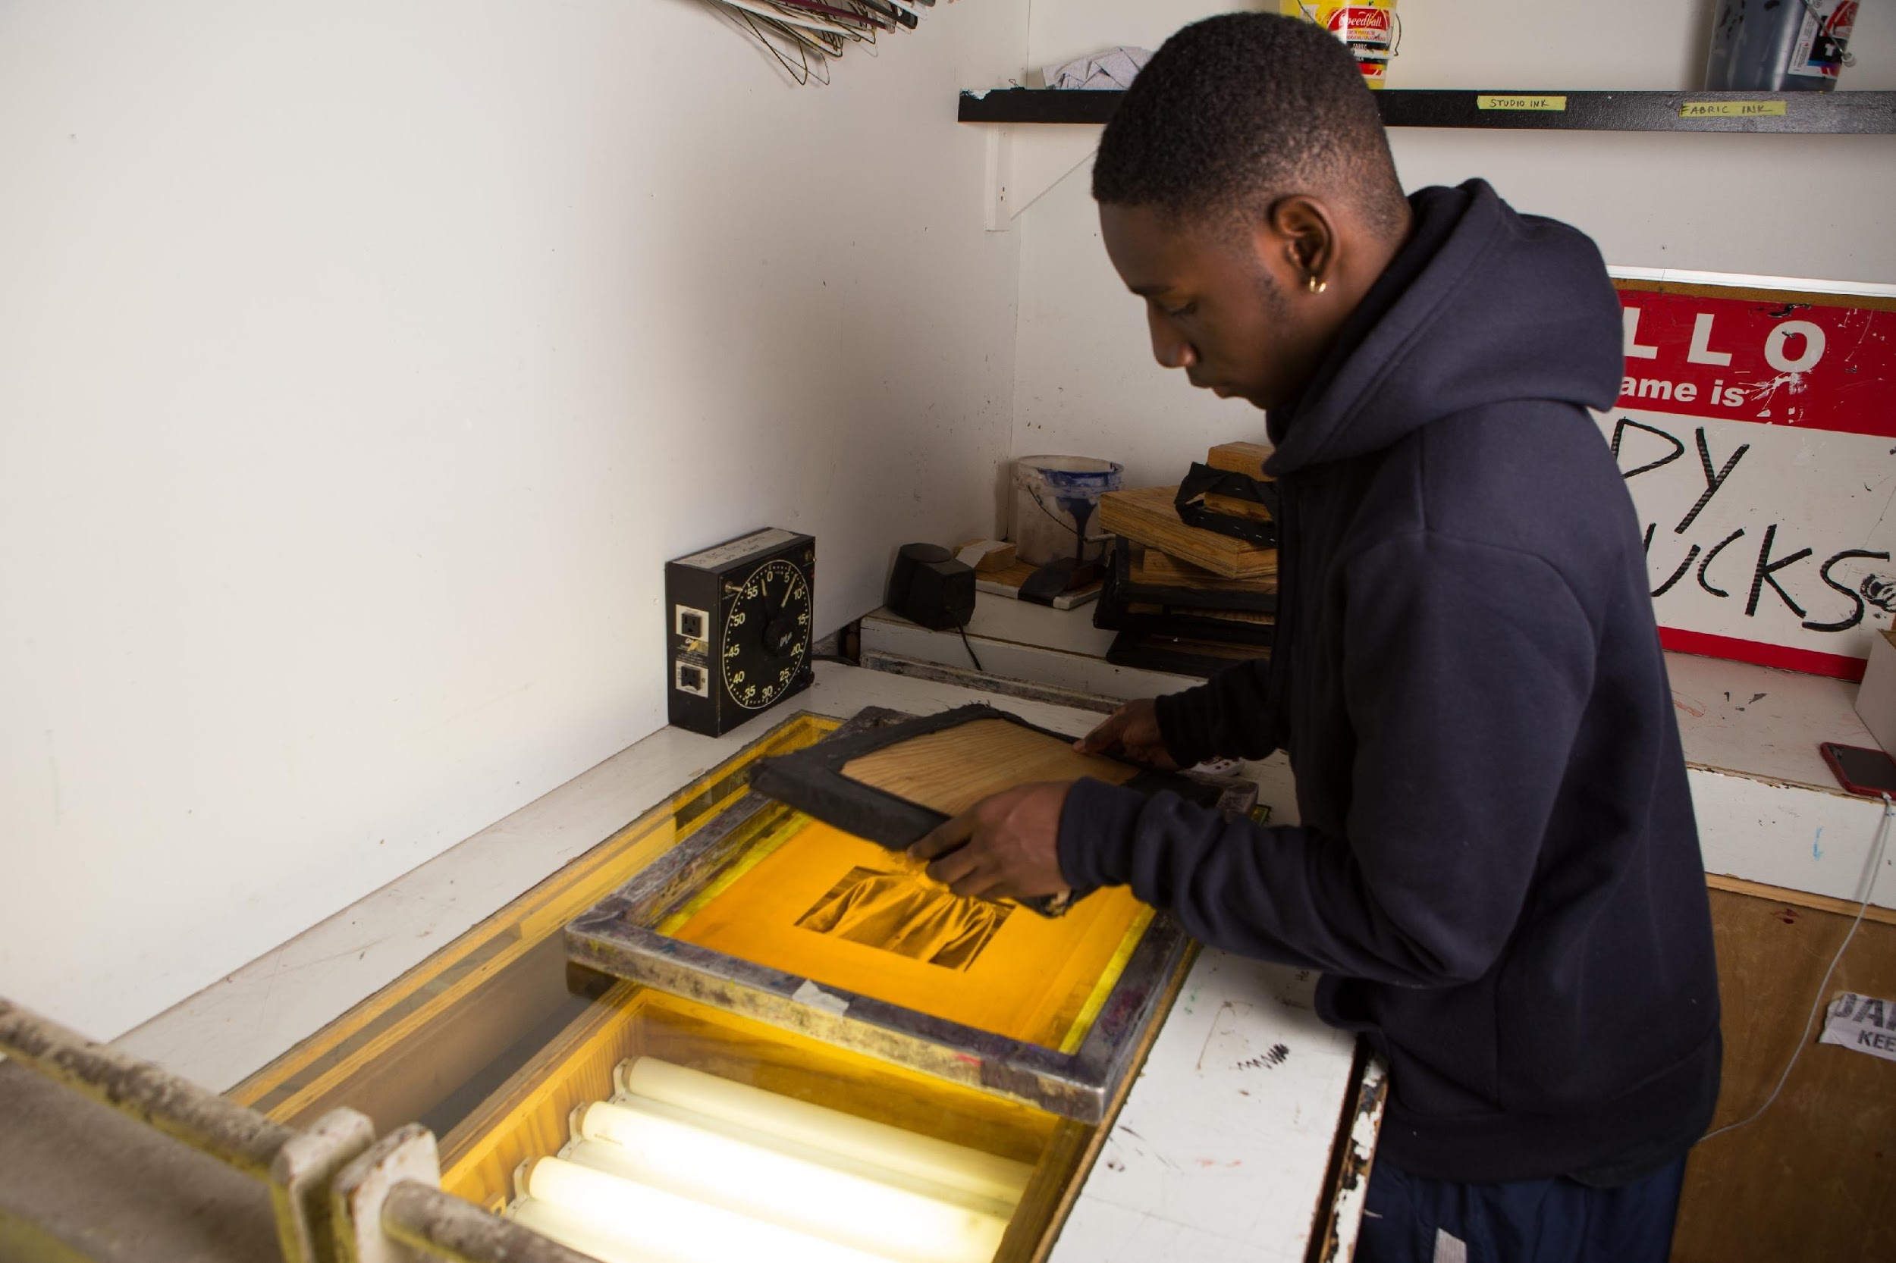
This process involves a direct contact exposure. There should be no space between the film positive and the screen.
Build a flat out of cardboard or plywood that is larger than your image, but small enough to fit inside the screen to ensure a direct contact. Cover the flat in padding and black fabric to protect the screen.
Place the flat on top of your screen, inside the frame.
Photo by Sean Carroll

Slide 37
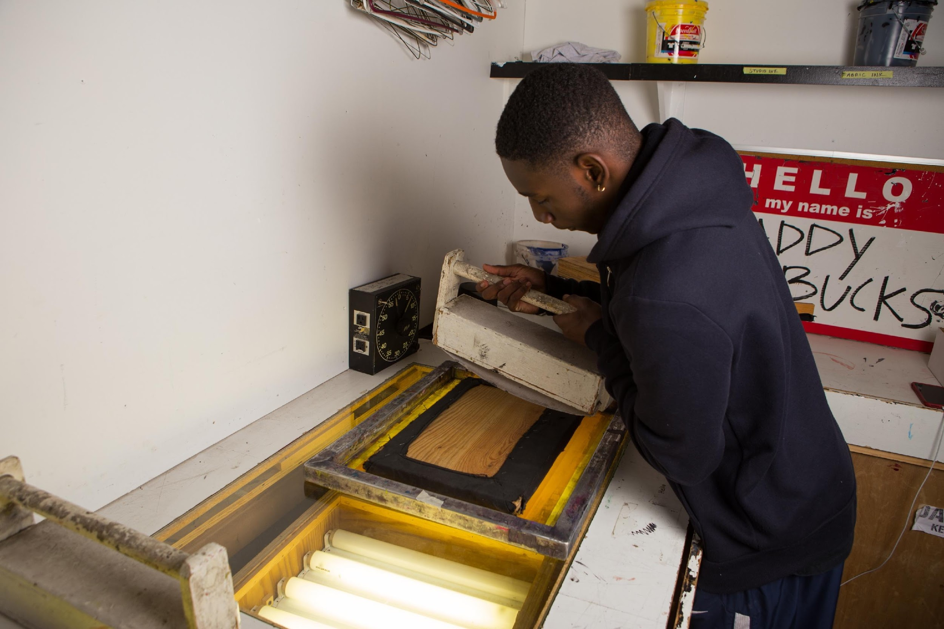
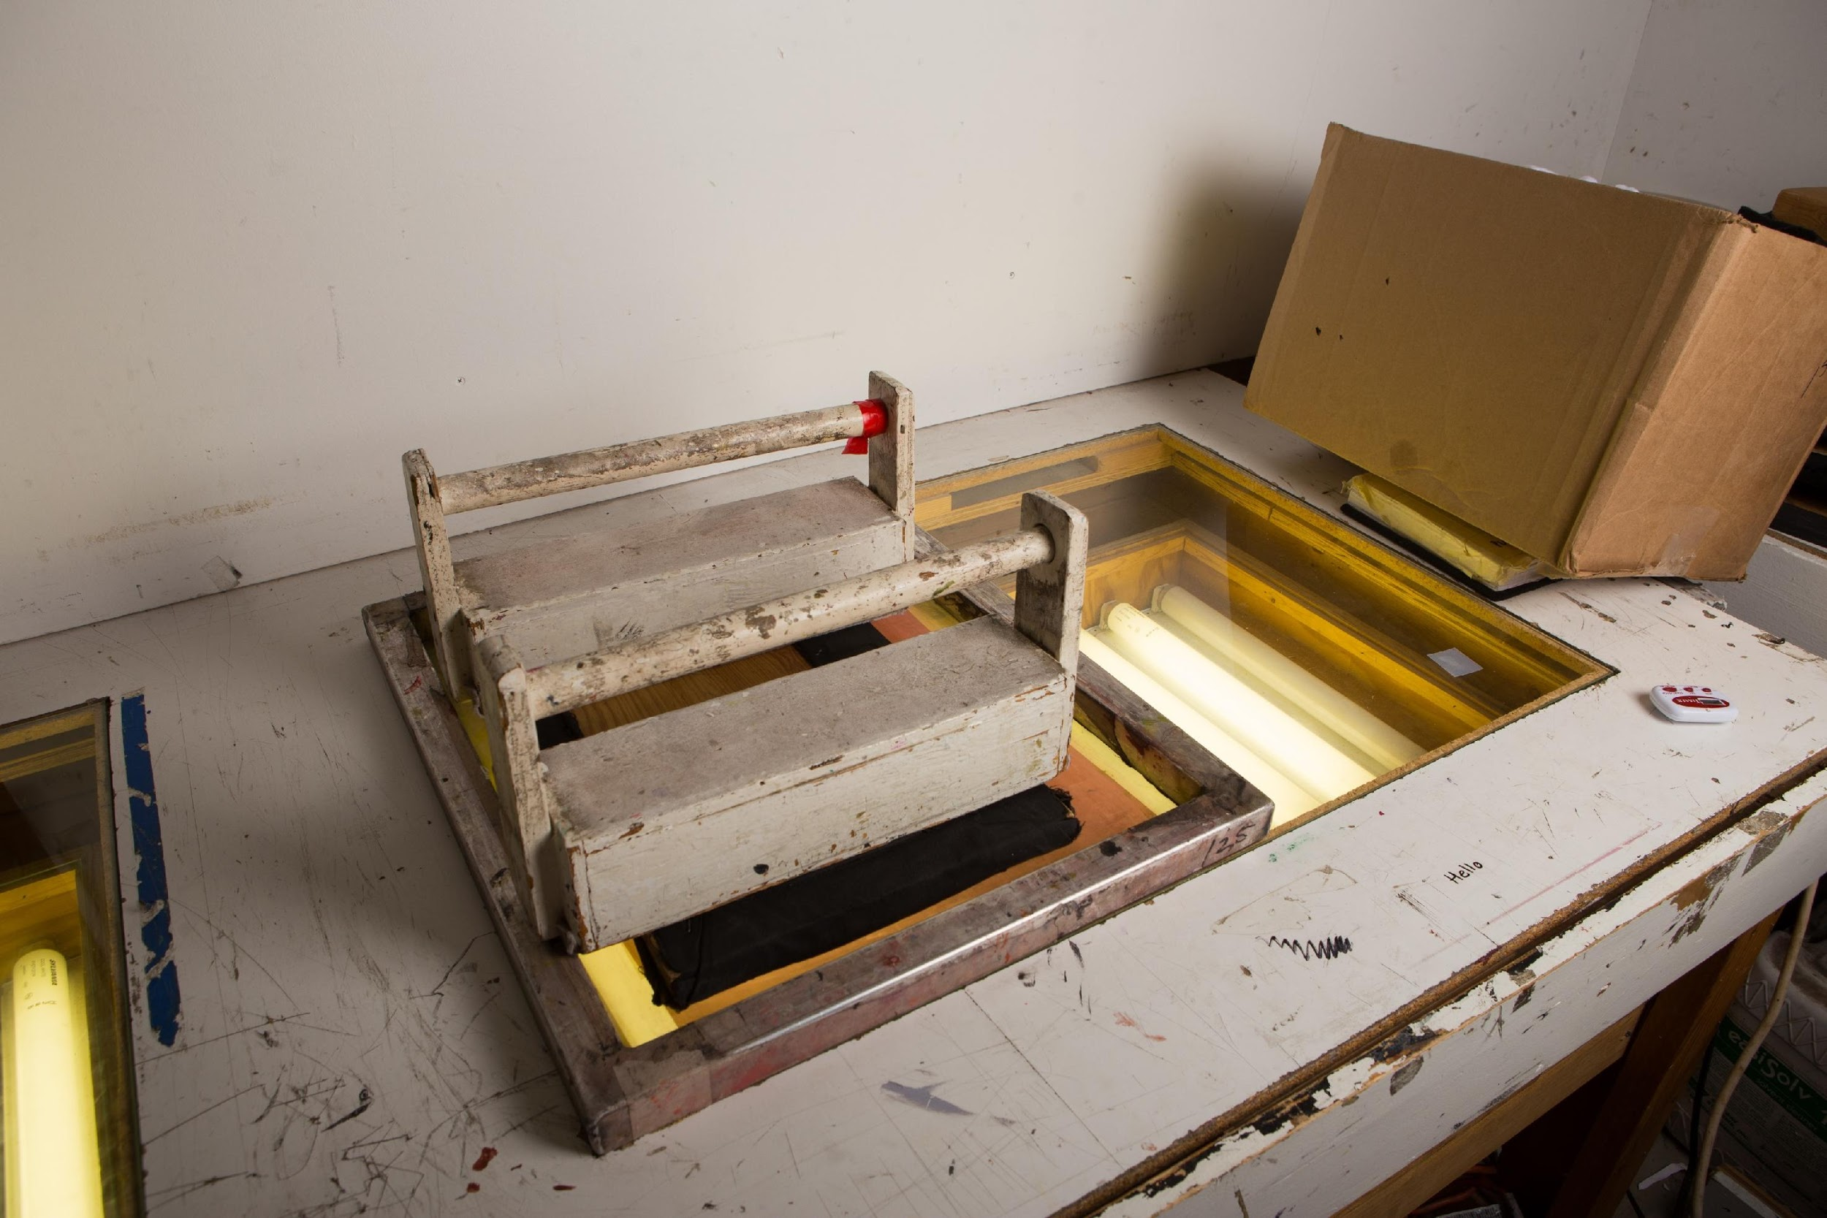
Weigh down the flat with something heavy such as weights, books or reams of paper.
Photo by Sean Carroll
Photo by Sean Carroll

Slide 38
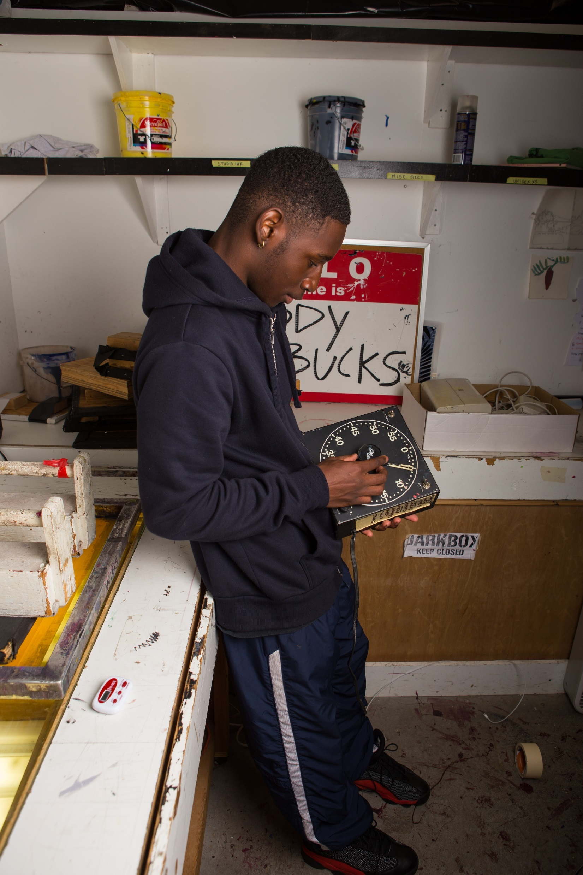
Timing the Exposure
A screen exposure chart should be included with your emulsion. If not, you will need to test exposure times.
A good time to start with is 5 minutes.
Photo by Sean Carroll

Slide 39
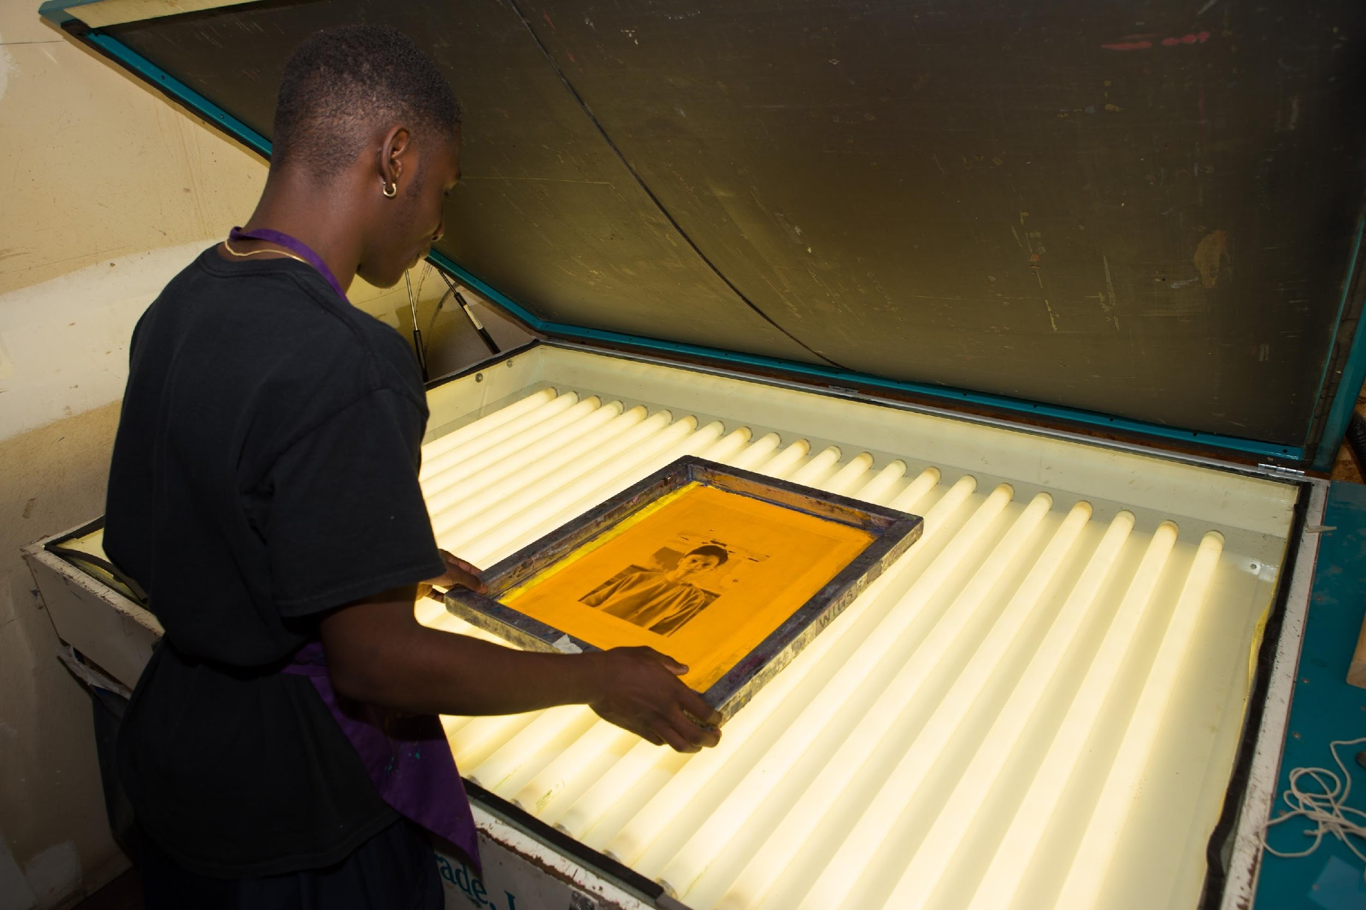
Exposing with a Vacuum Unit
Place the film positive onto the vacuum exposing unit.
Arrange your coated screen on top of the film positive.
Photo by Sean Carroll

Slide 40
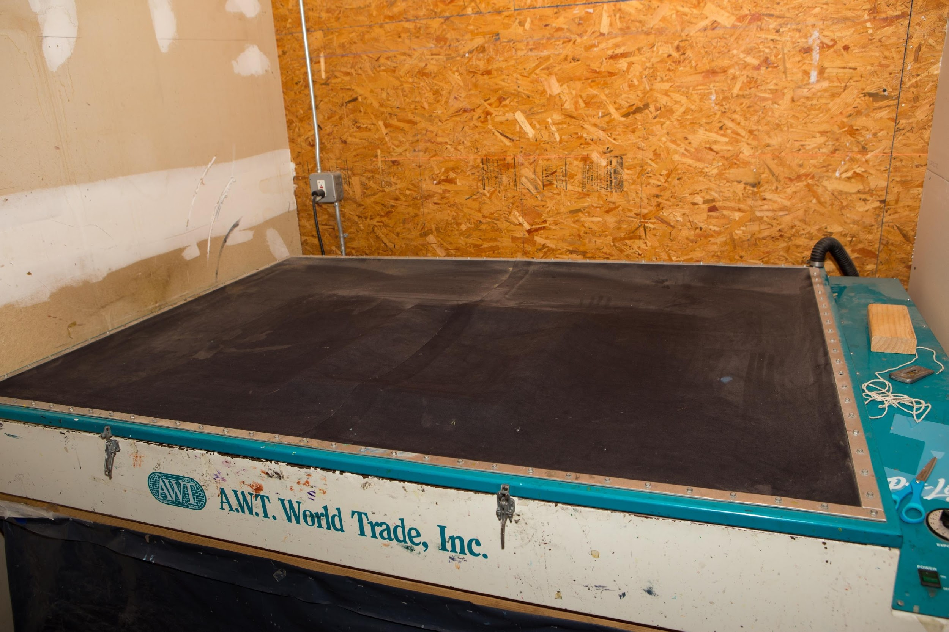
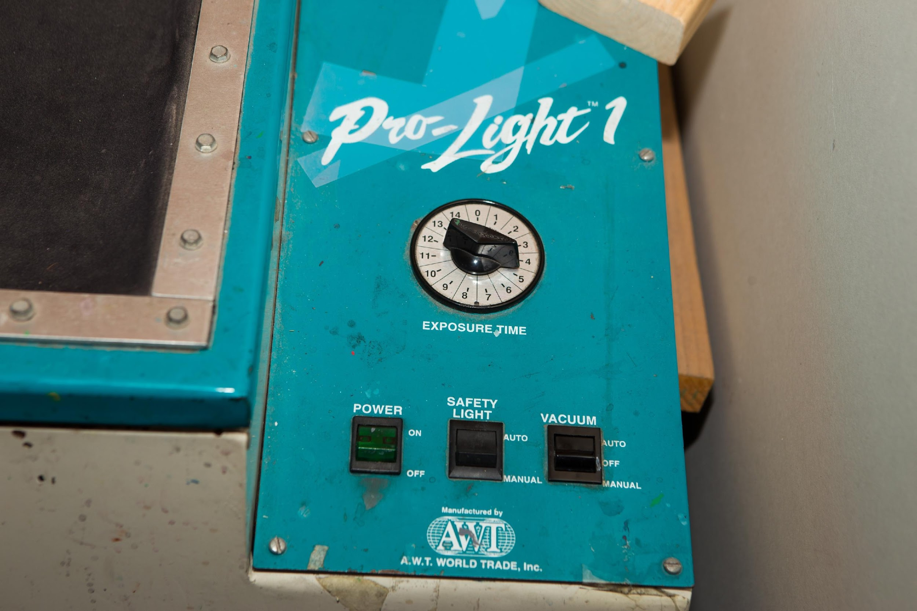
Close the vacuum unit.
Turn on the light and the vacuum then set the timer.
Photo by Sean Carroll
Photo by Sean Carroll

Slide 41
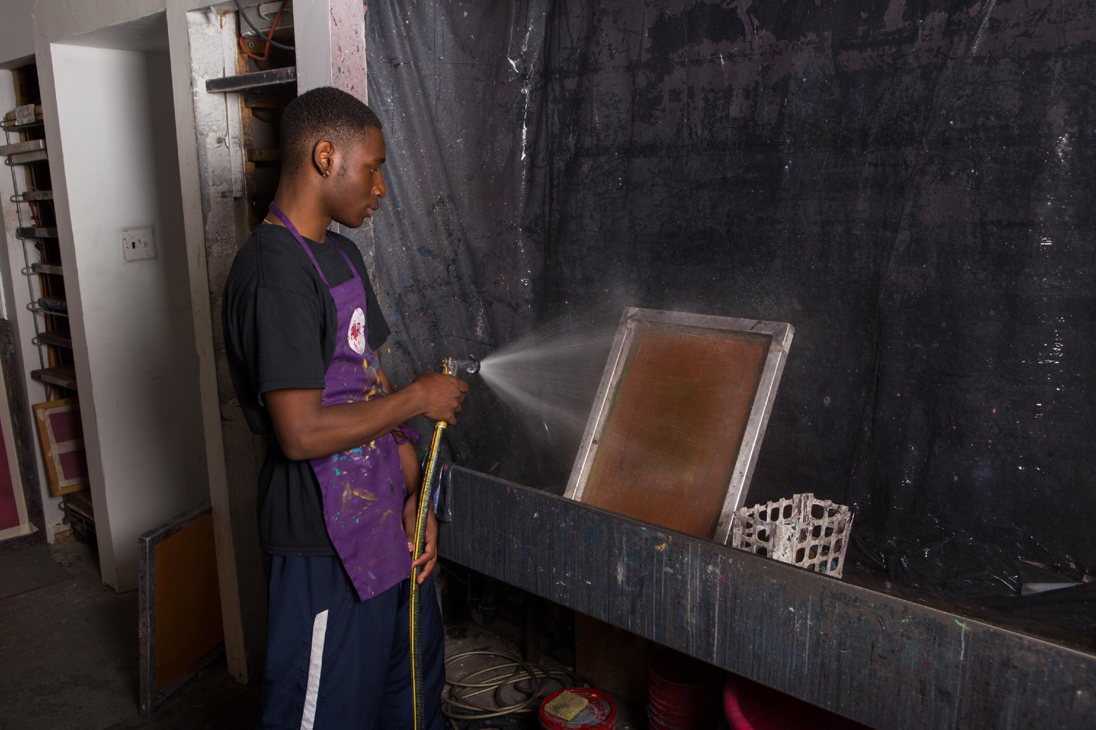
Washing out the Screens
With either exposing method, you will need to wash out the screen as soon as it has finished exposing.
Use a pressure washer or use a sponge to gently massage out the unexposed emulsion.
Rinse the screen on both sides until there are very few white bubbles remaining.
Photo by Sean Carroll

Slide 42
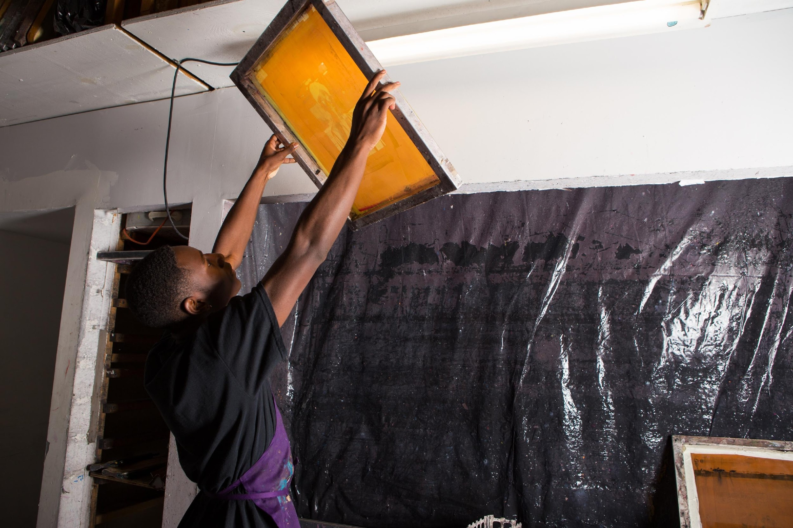
Hold the screen up to a light source to check that you have fully removed any extra emulsion.
You can also check for any holes or thin spots in the emulsion.
Lay your screen to dry on a flat surface or in front of a fan.
Photo by Sean Carroll

Slide 43
Underpainting and Printing
Lesson 4

Slide 44
The reason I’m painting this way is that I want to be a machine.
Andy Warhol, Art News, 1962

Slide 45
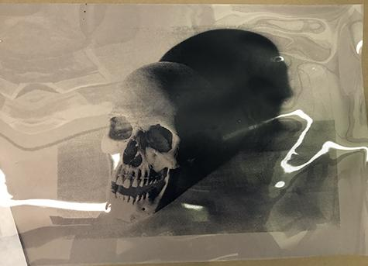
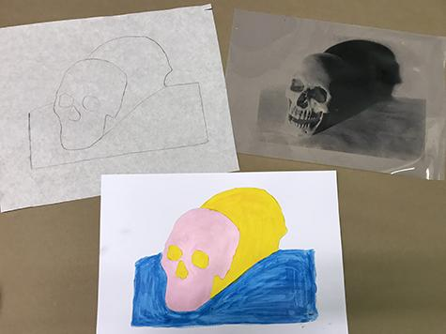
Warhol developed a process called underpainting to add color to his prints before adding the final photographic silkscreen layer.
Step 1: Tracing
Create a simple outline of the image from the film positive that will serve as the guideline for the underpainting.
Film positive with an image of a skull.
Film positive, tracing, and example of an underpainting.

Slide 46
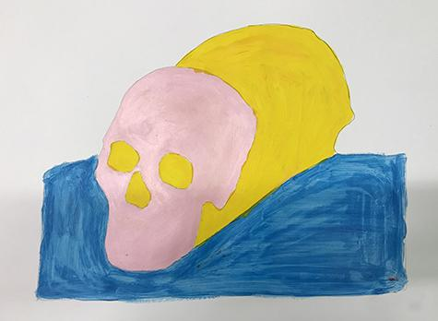
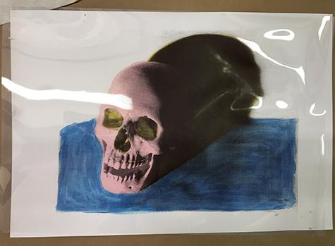
Step 2: Underpainting
Paint in all of the shapes in your tracing. Multiple color combinations could be created using the same tracing.
After the underpainting is dry, the film positive could be placed on top to check for correct color combination and composition.
Example of an underpainting before the final print layer is applied.
Example of an underpainting with the film positive placed on top.

Slide 47
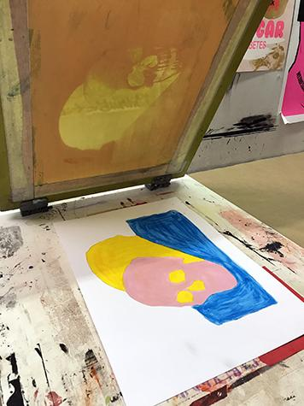
Step 3: Registration
Line up the image on the screen to the underpainting. Check for alignment by placing the screen on top of the underpainting, then adjust accordingly.
Use masking tape to mark where the corners of the paper should be placed. This is especially helpful when making multiple prints to ensure that each underpainting is placed in the same spot on the table.
Example of an underpainting being registered for printing

Slide 48
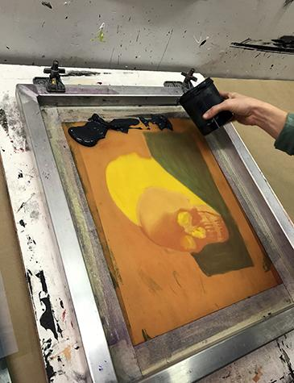

Step 3: Printing
Place ink at the top of the screen then use a squeegee to push the ink through using a 80-90 degree angle as you make a pass.
When the squeegee reaches the bottom of the image, scoop the excess ink up with the squeegee and return to the top of the image for a second pass if needed.
Photos by Sean Carroll

Slide 49

Step 4: Remove screen from print
If the screen is on a hinge clamp lift up the screen and prop it up. Remove the print and place another piece of paper down to begin again. Once you begin to print you need to work quickly because the ink can dry in the screen in a short period.
Step 5: Clean the screen
Remove any excess ink with a rubber scraper then spray with water. Wash with a soft sponge and mild soap. Do not use any rough abrasive cleaners or scrub sponges on the screen. Let the screen dry before printing again.
Example of an underpainting after the final print layer is applied.

Slide 50
Cutting Stencils for Multilayer Prints
Lesson 6

Slide 51

Materials
Film positives
Bond paper or white craft paper—for a one-time use stencil
Duralar—for a reusable stencil
Cutting tool, such as an X-acto knife
Pencil or marker
Light table
Alisha Wormsley, Unititled, 2017
Silkscreen print on paper

Slide 52

Layer 1:
Place one piece of paper or Duralar over a film positive on a light table.
Decide which color will be printed first. Trace only the shape(s) associated with this color.
Photo by Sean Carroll

Slide 53

Layer 1:
Mark the paper “Layer 1-color”.
Carefully cut out the shape(s) using a cutting tool.
Student cutting out a paper stencil using an Xacto knife

Slide 54


Layer 2 and Layer 3:
Continuing to use the film positive, trace the shape(s) for Layer 2 and Layer 3 in the center of another piece of paper. Mark the layer number and color, then also cut out these shapes.
Photo by Sean Carroll
Photo by Sean Carroll

Slide 55


If you are printing more than one color combination, cut extra paper stencils for each layer because the stencils are discarded after printing each layer. Stencils cut from Duralar can be used multiple times.
Paper stencil used to print a layer of purple ink.
Alisha Wormsley, Unititled, 2017
Silkscreen print on paper

Slide 56
Silkscreen Printing with Stencils
Lesson 7

Slide 57

Materials
Two-inch masking tape
¾ -inch blue painter’s tape
10 pieces of final printing paper for each student.
Silkscreens: the exposed screen prepared in lesson 3 and 4, plus an open screen (one that has no emulsion on it)
Squeegees
Hinge clamps
Inks, squeegee, spatula and tape used for silkscreen printing

Slide 58


Mix all 3 colors of ink prior to printing:
• mix ink in re-sealable containers.
• label with name and layer number.
Begin by taping the outer edges of the silkscreen using two-inch masking tape. Tape both sides of the silkscreen.
Three containers of ink mixed by a student.
A silkscreen that has been taped off with masking tape prior to printing.

Slide 59


Place the open silkscreen in the hinge clamps, securely tightening the clamps.
Line up the film positive to one piece of the printing paper then secure it with pieces of blue painter’s tape.
Photo by Sean Carroll
Photo by Sean Carroll

Slide 60


Place the paper and film positive under the screen and register the open screen to the edges of your film positive.
Use blue painter’s tape to mark the edges of the paper on the table you are printing on. This will show you where to put the paper for each print.
Photo by Sean Carroll
Photo by Sean Carroll

Slide 61


Carefully close the screen over the stencil paper and print the ﬁrst color using enough ink for adequate coverage.
Photo by Sean Carroll
Photo by Sean Carroll

Slide 62


The stencil will stick to the back of the silkscreen because the ink acts as an adhesive. Starting from a top corner, slowly peel the stencil away from the screen.
Continue this process, placing each piece of paper inside the tape corners until all 10 pieces of paper are printed.
Remove the stencil from the silkscreen and discard.
Paper stencil used to print a layer of purple ink
Printed first layer of purple ink on paper

Slide 63

Clean the open silkscreen and squeegee thoroughly. The two-inch tape you placed around the edges of the silkscreen should remain until you are ﬁnished printing your entire print.
Making sure the silkscreen is completely dry, place your taped silkscreen into the hinge clamps and securely tighten the clamps.
Photo by Sean Carroll
Photo by Sean Carroll

Slide 64


When Layer 1 of your print is dry, register your next stencil (Layer 2) to the film positive. Once it is in the correct place, use two small pieces of painter’s tape to secure it to the print.
Remove the film positive.
Repeat the printing process for layer 2 of your image.
Photo by Sean Carroll
Printed second layer of greenish-gold ink on paper.

Slide 65


When Layer 2 of your print is dry, register your next stencil (Layer 3) to the film positive. Once it is in the correct place, use two small pieces of painter’s tape to secure it to the print. Remove the film positive.
Repeat the printing process for layer 3 of your image.
Photo by Sean Carroll
Printed third layer of gray ink on paper.

Slide 66


To print Layer 4, the final photographic image, register your film positive to your print using small pieces of painter’s tape to secure it to the print.
Tape the edges of the screen with the two-inch tape on both sides (as in Step #1). Securely tighten your exposed silkscreen in the hinge clamps.
Register your print to the screen and place tape marks on the corners of three edges of your paper. Remove the film positive.
Photo by Sean Carroll
Photo by Sean Carroll

Slide 67

Print your final layer.
Clean your screen. Be sure that no ink is left in the open holes of the screen. Use the soft side of a sponge to help ease the ink out if necessary.
Photo by Sean Carroll
Alisha Wormsley, Unititled, 2017
Silkscreen print on paper

Slide 68

Class Critique
After the final silkscreen prints are dry, hang them up and conduct a class critique.
Try ranking the student work as a class according to various categories and criteria learned in this unit, for example:
Most thoughtful color scheme
Best overall composition
Best use of layers
Best overall printmaking
Finished multilayer silkscreen prints by high school students.

