Slide 1

Silkscreen Printing:
Introduction & Color Theory
Lesson 1

Slide 2
I tried doing them by hand, but I find it easier to use a screen. This way, I don’t have to work on my objects at all. One of my assistants or anyone else, for that matter, can reproduce the design as well as I could.
Andy Warhol, Andy Warhol, 1969

Slide 3
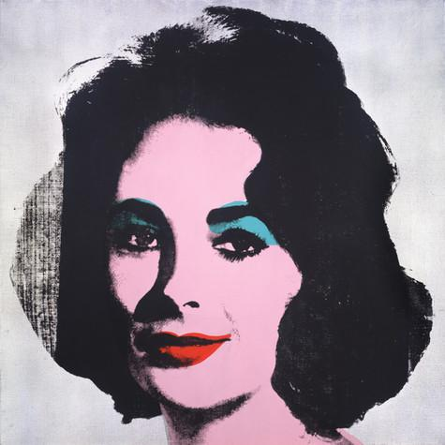
Introduction
Andy Warhol first experimented with simple printmaking methods like rubber stamping and blotted line drawing during his commercial design career in the 1950s.
However, he turned to his most notable style, photographic silkscreen printing, in 1962. This commercial process allowed him to easily reproduce the images that he appropriated from popular culture.
Among his first photographic silkscreen works were his paintings featuring Marilyn Monroe, Elvis Presley, and Elizabeth Taylor.
Andy Warhol, Silver Liz [Ferus Type], 1963
The Andy Warhol Museum, Pittsburgh; Founding Collection, Contribution The Andy Warhol Foundation for the Visual Arts, Inc., © The Andy Warhol Foundation for the Visual Arts, Inc., 1998.1.55
Notes:
Additional information:
Andy Warhol, Silver Liz [Ferus Type], 1963
Warhol appropriated a 1950s publicity photo of Elizabeth Taylor as the source material for the silkscreen. He worked with professionals to have the photos he chose transferred onto the mesh of the screen. When he passed an ink-laden squeegee over the mesh as the silkscreen sat atop his canvas, ink would pass through the holes in the mesh and impress a print of his image onto the canvas.

Slide 4
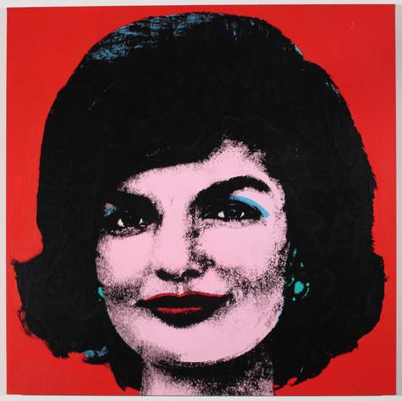
Photographic Silkscreen Printing
The photographic silkscreen printing process uses a light sensitive emulsion applied directly to the silkscreen in order to expose a film positive of the image, using a proper light source.
This process creates a precise and deﬁned image and allowed Warhol and his assistants to mass-produce a large number of prints with relative ease.
While Warhol didn’t invent this process, he developed his own silkscreen printing technique by combining hand-painted backgrounds with photographic silkscreen-printed images to create unique works of art.
Andy Warhol, Red Jackie, 1964
The Andy Warhol Museum, Pittsburgh; Founding Collection, Contribution The Andy Warhol Foundation for the Visual Arts, Inc. © The Andy Warhol Foundation for the Visual Arts, Inc.
1998.1.54
Notes:
Additional information:
Watch Warhol’s photographic silkscreen printing technique here: https://www.youtube.com/watch?v=jNM04-mhMgo&list=PL_CXyOtx7w0rZEwhrVllkNK8lUTDP9oLi

Slide 5
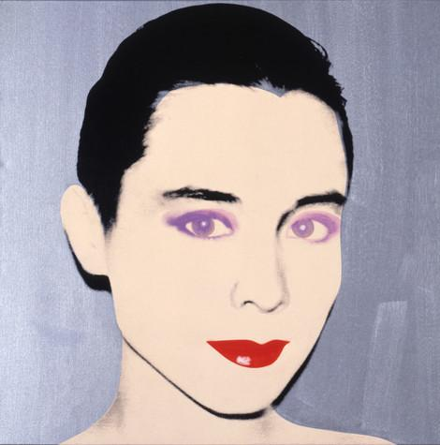
Underpainting
Warhol began each artwork using a high contrast image that was then enlarged and transferred onto a silkscreen.
Each image was first underpainted by tracing simple outlines of the photographic image onto the canvas and painting in blocks of color. Some were painted in slick, hard-edge styles, whereas others had solid fields of color or more gestural brushwork.
Once this initial painted layer was dry, Warhol printed the photographic silkscreen image on top.
Andy Warhol, Tina Chow, 1985
The Andy Warhol Museum, Pittsburgh; Founding Collection, Contribution The Andy Warhol Foundation for the Visual Arts, Inc.
© The Andy Warhol Foundation for the Visual Arts, Inc.
1998.1.521

Slide 6
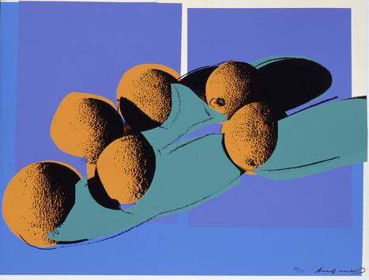
Multilayer Silkscreen Printing
Warhol quickly realized that he could produce art in a systematic manner like an assembly line of a factory.
He worked with assistants and printers to create numerous print portfolios. In 1977 he met printer Rupert Jasen Smith who worked with him to create the series Space Fruit.
This series is an example of multilayer silkscreen printing since each color represents a different layer using multiple screens. This printing process allowed Warhol endless color combinations within each composition.
Andy Warhol, Space Fruit: Still Lifes (Cantaloupes I), 1979
The Andy Warhol Museum, Pittsburgh; Founding Collection, Contribution Dia Center for the Arts
© The Andy Warhol Foundation for the Visual Arts, Inc.
2002.4.19.4
Notes:
Additional information:

Slide 7
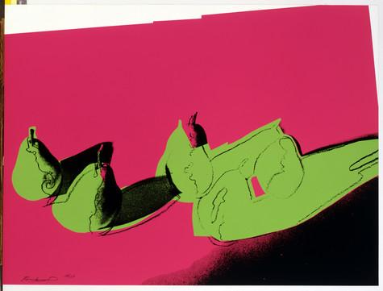
How many layers did Warhol use to create this composition?
He would first print the background color with one screen and the fruit shapes with another screen.
He would then print the photographic image of the fruit using a third screen.
Finally, he would add a hand-drawn layer to finish the work.
Andy Warhol, Space Fruit: Still Lifes (Pears), 1979
The Andy Warhol Museum, Pittsburgh; Founding Collection, Contribution Dia Center for the Arts
© The Andy Warhol Foundation for the Visual Arts, Inc.
2002.4.19.6
Notes:
Additional information:

Slide 8
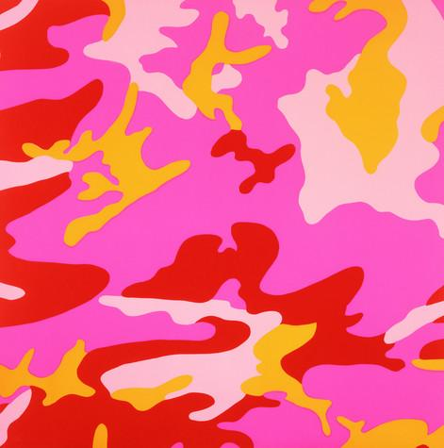
Color Theory
Color theory is the science and art of color; how we perceive color, how we mix color, and the visual effects of specific color combinations.
Since Warhol received a Bachelor of Fine Arts in Pictorial Design, he learned about color theory and how color could be used in art to evoke certain emotions from the audience.
Significant personal, cultural, symbolic, and aesthetic associations and meanings can be made through Warhol’s use of color.
Andy Warhol, Camouflage, 1987
The Andy Warhol Museum, Pittsburgh; Founding Collection, Contribution The Andy Warhol Foundation for the Visual Arts, Inc.
© The Andy Warhol Foundation for the Visual Arts, Inc.
1998.1.2503.3
Notes:
Additional information:

Slide 9
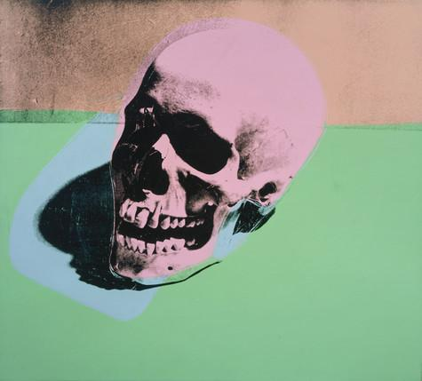
Color and Shape
Shape is considered to be a two-dimensional element, while three-dimensional elements have volume or mass.
Shapes are enclosed objects and can be created by line, color and value changes that define their edges.
Shapes can be
  organic: irregular shapes found in nature, also called “natural”
  geometric: shapes with strong lines and angles such as circles, triangles, and squares
Andy Warhol, Skull, 1976
The Andy Warhol Museum, Pittsburgh; Founding Collection, Contribution Dia Center for the Arts
© The Andy Warhol Foundation for the Visual Arts, Inc.
2002.4.31
Notes:
Additional information:

Slide 10
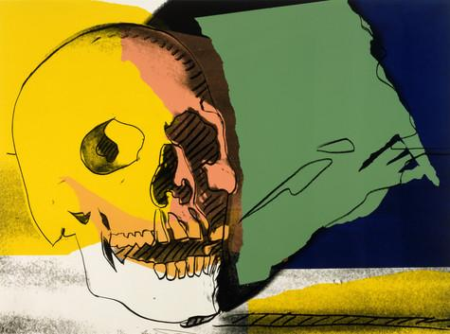
Positive and Negative Space
Negative space describes the space that surrounds an object or image, while positive space describes the image itself. Negative space can help define an object and bring balance to a composition.
Why is it important to consider both
positive and negative space when
creating a composition?
Andy Warhol, Skulls, 1976
The Andy Warhol Museum, Pittsburgh; Founding Collection, Contribution The Andy Warhol Foundation for the Visual Arts, Inc.
© The Andy Warhol Foundation for the Visual Arts, Inc.
1998.1.2416.2
Notes:
Additional information:

Slide 11
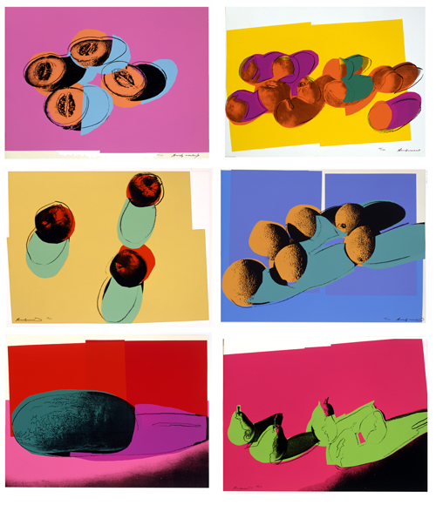
Identify and describe the shapes.
  are they organic or geometric?
  how are the shapes’ edges defined?
Identify the dominant shapes in each composition.
Identify the positive and negative space in each composition.
Andy Warhol, Space Fruit: Still Lifes, 1979
The Andy Warhol Museum, Pittsburgh; Founding Collection, Contribution Dia Center for the Arts
© The Andy Warhol Foundation for the Visual Arts, Inc.
Notes:
Additional information:

Slide 12
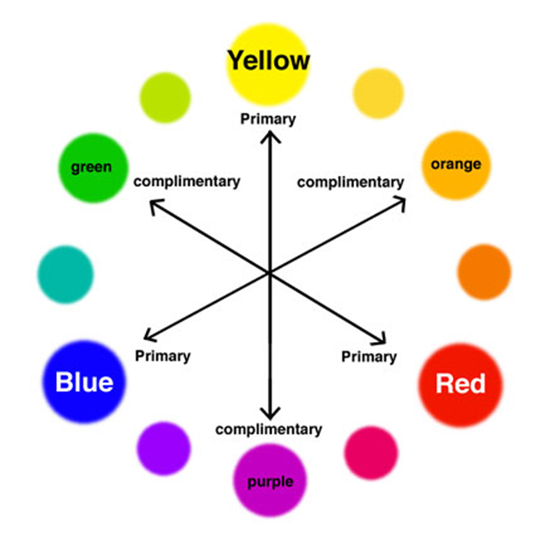
The Color Wheel
Color wheel: a circle with different colored sections used to show the relationship between colors and the essential elements of mixing color.
Color scheme: the combination of colors on the color wheel implemented by artists, designers, and illustrators.
Notes:
Additional information:

Slide 13
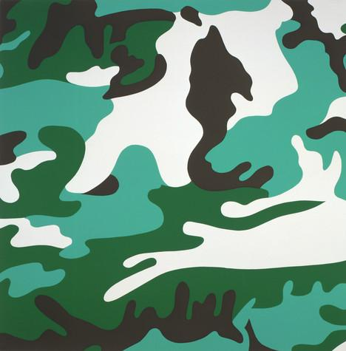
Monochromatic
Monochromatic color schemes use tints, tones,
and shades from the same color:
tint: created when you add white to a color
tone: created when you add both black and white to a color
shade: created when you add black to a color
What color is used to create this artwork?
Can you identify the tints, tones, and shades
in the composition?
Andy Warhol, Camouflage, 1987
The Andy Warhol Museum, Pittsburgh; Founding Collection, Contribution The Andy Warhol Foundation for the Visual Arts, Inc.
© The Andy Warhol Foundation for the Visual Arts, Inc.
1998.1.2503.1
Notes:
Additional information:

Slide 14
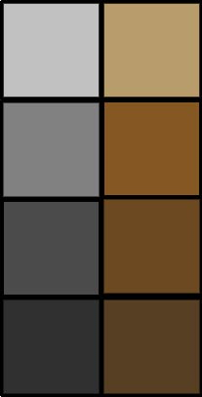
Neutral Colors
Neutral colors or earth tones are not seen on most color wheels. Black, gray, whites are neutral. Browns, beiges and tans are sometimes neutral too. Neutral colors can be made by mixing:
Black and white
Complementary colors
All three primaries together (plus black or white)
Notes:
Additional information:

Slide 15

Analogous
Analogous refers to any three colors which are side by side on a 12 part color wheel, such as red, orange, and purple.
Usually one of the three colors predominates.
Andy Warhol, Camouflage, 1987
The Andy Warhol Museum, Pittsburgh; Founding Collection, Contribution The Andy Warhol Foundation for the Visual Arts, Inc.
© The Andy Warhol Foundation for the Visual Arts, Inc.
1998.1.2503.3
Notes:
Additional information:

Slide 16
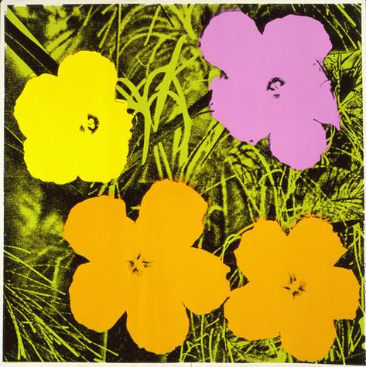
Complementary
Complementary refers to two colors that are the direct opposite of each other, such as yellow and purple.
Complementary colors create the most contrast and balance in design.
Andy Warhol, Flowers, 1970
The Andy Warhol Museum, Pittsburgh; Founding Collection, Contribution The Andy Warhol Foundation for the Visual Arts, Inc.
© The Andy Warhol Foundation for the Visual Arts, Inc.
1998.1.2395.4
Notes:
Additional information:

Slide 17
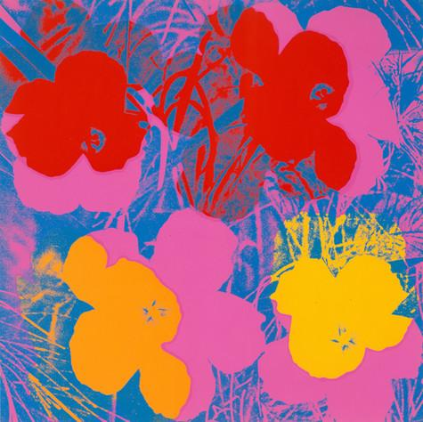
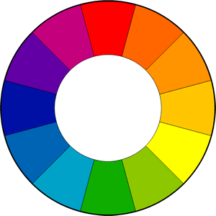
Split Complementary
Split Complementary is when a base color and the two colors opposite it on the color wheel are used as its complement.
Here, the split complement of the blue background are the yellow orange and red orange flowers.
Andy Warhol, Flowers, 1970
The Andy Warhol Museum, Pittsburgh; Founding Collection, Contribution The Andy Warhol Foundation for the Visual Arts, Inc.
© The Andy Warhol Foundation for the Visual Arts, Inc.
1998.1.2395.3
Notes:
Additional information:

Slide 18
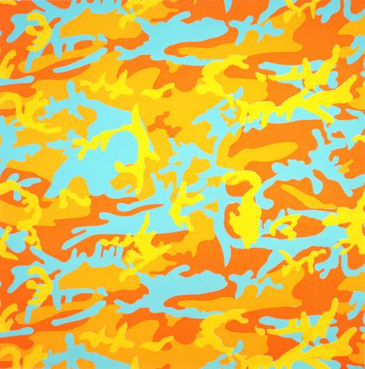
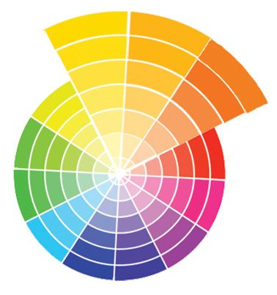
Value
Value refers to the lightness or darkness of a color.
Dark values with black added are called shades and light values with white added are called tints.
Andy Warhol, Camouflage, 1987
The Andy Warhol Museum, Pittsburgh; Founding Collection, Contribution The Andy Warhol Foundation for the Visual Arts, Inc.
© The Andy Warhol Foundation for the Visual Arts, Inc.
1998.1.2503.8
Notes:
Additional information:

Slide 19
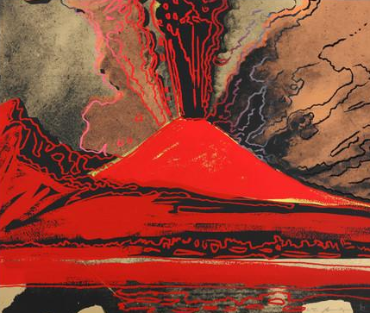
Temperature
The temperature of a color is usually defined in terms of “warm” and “cool”.
Blue, green, and purple are considered cool colors while yellow, orange, and red are considered warm colors.
Color temperature can help enhance the mood of an image.
warm
cool
Andy Warhol, Vesuvius, 1985
The Andy Warhol Museum, Pittsburgh; Founding Collection, Contribution The Andy Warhol Foundation for the Visual Arts, Inc.
© The Andy Warhol Foundation for the Visual Arts, Inc.
1998.1.2489
Notes:
Additional information:

