Slide 1
Silkscreen Printing: Gathering and Manipulating Source Images Lesson 2

Slide 2
With silkscreening, you pick a photograph, blow it up, transfer it in glue onto silk, and then roll ink across it so the ink goes through the silk but not through the glue. That way you get the same image, slightly different each time. It was all so simple—quick and chancy. I was thrilled with it.
Andy Warhol, Popism: The Warhol Sixties, 1980

Slide 3
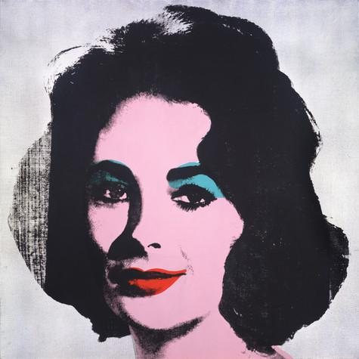
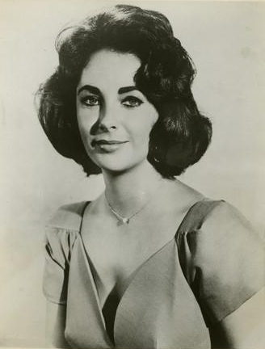
Appropriation
Warhol appropriated (used without permission) images from magazines, newspapers, and press photos of the most popular people of his time.
When manipulating the original image, he paid particular attention to contrast, cropping and color.
Andy Warhol, Silver Liz [Ferus Type], 1963 The Andy Warhol Museum, Pittsburgh; Founding Collection, Contribution The Andy Warhol Foundation for the Visual Arts, Inc., © The Andy Warhol Foundation for the Visual Arts, Inc., 1998.1.55
Publicity still of Elizabeth Taylor, 1957 The Andy Warhol Museum, Pittsburgh; Founding Collection, Contribution The Andy Warhol Foundation for the Visual Arts, Inc., 1998.3.10289.2
Notes:
Additional information:

Slide 4
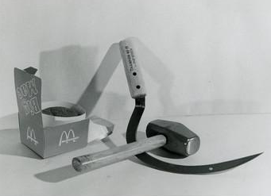
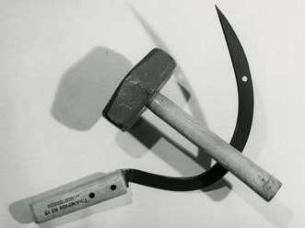
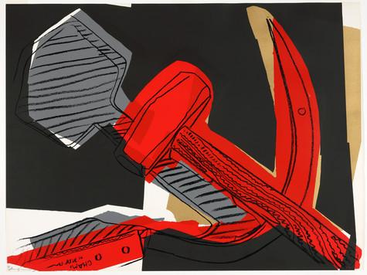
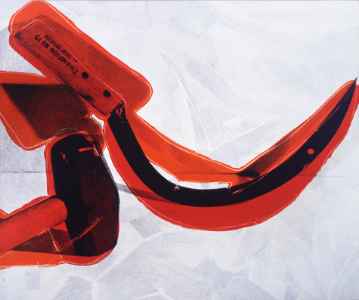
Still Life Arrangements
Warhol and his assistants also set up still life arrangements of objects that were then used as source material for his silkscreens.
They would take multiple photos in varying arrangements, manipulating the lighting to adjust the contrast and enhance or diminish the shadows.
Andy Warhol, Hammer and Sickle with Big Mac, ca. 1976
The Andy Warhol Museum, Pittsburgh; Contribution The Andy Warhol Foundation for the Visual Arts, Inc.
2001.2.611
Andy Warhol, Hammer and Sickle, ca. 1976
The Andy Warhol Museum, Pittsburgh; Contribution The Andy Warhol Foundation for the Visual Arts, Inc.
2001.2.610
Andy Warhol, Hammer and Sickle, 1977
The Andy Warhol Museum, Pittsburgh; Founding Collection, Contribution The Andy Warhol Foundation for the Visual Arts, Inc.
1998.1.2424.4
Andy Warhol, Hammer and Sickle, 1976
The Andy Warhol Museum, Pittsburgh; Founding Collection, Contribution The Andy Warhol Foundation for the Visual Arts, Inc.
1998.1.186
Warhol artwork © The Andy Warhol Foundation for the Visual Arts, Inc.
Notes:
Additional information:

Slide 5
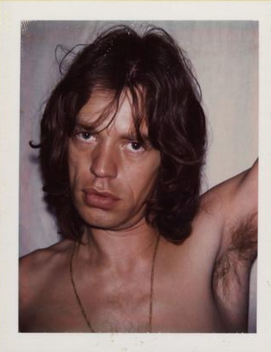
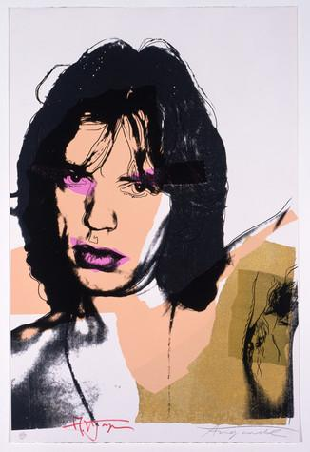
Portraiture
Warhol also created source imagery for his commissioned portraits using photography and photographic silkscreen printing.
He began with a photo shoot at his studio, using a Polaroid camera. The Polaroid afforded a very high contrast image that he enlarged and transferred onto a silkscreen.
Andy Warhol, Mick Jagger from "Little Red Book No. 275", 1975 The Andy Warhol Museum, Pittsburgh; Founding Collection, Contribution The Andy Warhol Foundation for the Visual Arts, Inc. 1998.1.3003.8
Andy Warhol, Mick Jagger, 1975 The Andy Warhol Museum, Pittsburgh; Founding Collection, Contribution The Andy Warhol Foundation for the Visual Arts, Inc. © The Andy Warhol Foundation for the Visual Arts, Inc. 1998.1.2412.4
Notes:
Additional information:

Slide 6
Gathering and Manipulating Images
The first step in creating a photographic silkscreen is to find source images.
Images can be sourced from newspapers, magazines, the internet, or using a camera.
Images must be made into a digital file.
Alisha Wormsley, Untitled, 2017 Silkscreen print on paper

Slide 7
Bitmapping and Film Positive
Use Photoshop or other digital photo editing software to create a high-contrast black and white bitmap of your digital image.
Follow the instructions on the Bitmapping Handout.
Once your image is complete, print it onto a film positive
If you are creating a multilayer print, create a separate image for each layer.
Student manipulating a photograph in Photoshop Photo by Sean Carroll

