Slide 1
Silkscreen Printing: Underpainting and Printing
Lesson 4

Slide 2
The reason I’m painting this way is that I want to be a machine.
Andy Warhol, Art News, 1962

Slide 3
Warhol developed a process called underpainting to add color to his prints before adding the final photographic silkscreen layer.
Step 1: Tracing Create a simple outline of the image from the film positive that will serve as the guideline for the underpainting.
Film positive with an image of a skull.
Film positive, tracing, and example of an underpainting.

Slide 4
Step 2: Underpainting Paint in all of the shapes in your tracing. Multiple color combinations could be created using the same tracing.
After the underpainting is dry, the film positive could be placed on top to check for correct color combination and composition.
Example of an underpainting before the final print layer is applied.
Example of an underpainting with the film positive placed on top.

Slide 5
Step 3: Registration
Line up the image on the screen to the underpainting. Check for alignment by placing the screen on top of the underpainting, then adjust accordingly.
Use masking tape to mark where the corners of the paper should be placed. This is especially helpful when making multiple prints to ensure that each underpainting is placed in the same spot on the table.
Example of an underpainting being registered for printing

Slide 6
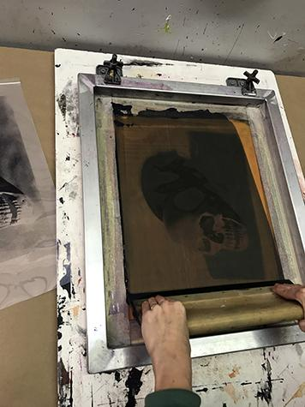
Step 3: Printing
Place ink at the top of the screen then use a squeegee to push the ink through using a 80-90 degree angle as you make a pass.
When the squeegee reaches the bottom of the image, scoop the excess ink up with the squeegee and return to the top of the image for a second pass if needed.
Photos by Sean Carroll

Slide 7
Step 4: Remove screen from print
If the screen is on a hinge clamp lift up the screen and prop it up. Remove the print and place another piece of paper down to begin again. Once you begin to print you need to work quickly because the ink can dry in the screen in a short period.
Step 5: Clean the screen
Remove any excess ink with a rubber scraper then spray with water. Wash with a soft sponge and mild soap. Do not use any rough abrasive cleaners or scrub sponges on the screen. Let the screen dry before printing again.
Example of an underpainting after the final print layer is applied.

