Slide 1
Silkscreen Printing: Cutting Stencils for Multilayer Prints Lesson 6

Slide 2
Materials
Film positives
Bond paper or white craft paper—for a one-time use stencil
Duralar—for a reusable stencil
Cutting tool, such as an X-acto knife
Pencil or marker
Light table
Alisha Wormsley, Unititled, 2017 Silkscreen print on paper

Slide 3
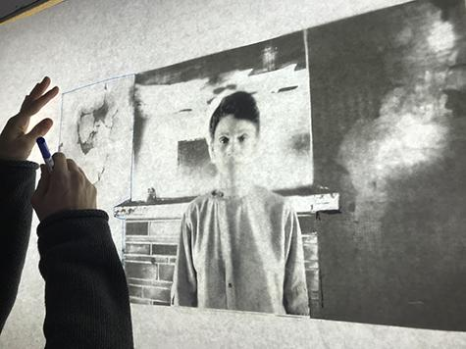
Layer 1:
Place one piece of paper or Duralar over a film positive on a light table.
Decide which color will be printed first. Trace only the shape(s) associated with this color.
Photo by Sean Carroll

Slide 4
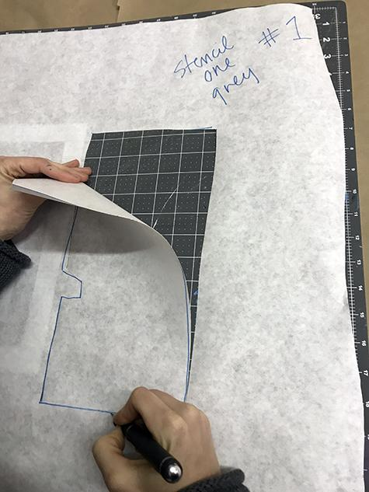
Layer 1:
Mark the paper “Layer 1-color”.
Carefully cut out the shape(s) using a cutting tool.
Student cutting out a paper stencil using an Xacto knife

Slide 5
Layer 2 and Layer 3: Continuing to use the film positive, trace the shape(s) for Layer 2 and Layer 3 in the center of another piece of paper. Mark the layer number and color, then also cut out these shapes.
Photo by Sean Carroll
Photo by Sean Carroll

Slide 6
If you are printing more than one color combination, cut extra paper stencils for each layer because the stencils are discarded after printing each layer. Stencils cut from Duralar can be used multiple times.
Paper stencil used to print a layer of purple ink.
Alisha Wormsley, Unititled, 2017 Silkscreen print on paper

