Slide 1
Silkscreen Printing: Silkscreen Printing with Stencils Lesson 7

Slide 2
Materials
Two-inch masking tape
¾ -inch blue painter’s tape
10 pieces of final printing paper for each student.
Silkscreens: the exposed screen prepared in lesson 3 and 4, plus an open screen (one that has no emulsion on it)
Squeegees
Hinge clamps
Inks, squeegee, spatula and tape used for silkscreen printing

Slide 3
Mix all 3 colors of ink prior to printing:
• mix ink in re-sealable containers.
• label with name and layer number.
Begin by taping the outer edges of the silkscreen using two-inch masking tape. Tape both sides of the silkscreen.
Three containers of ink mixed by a student.
A silkscreen that has been taped off with masking tape prior to printing.

Slide 4
Place the open silkscreen in the hinge clamps, securely tightening the clamps.
Line up the film positive to one piece of the printing paper then secure it with pieces of blue painter’s tape.
Photo by Sean Carroll
Photo by Sean Carroll

Slide 5
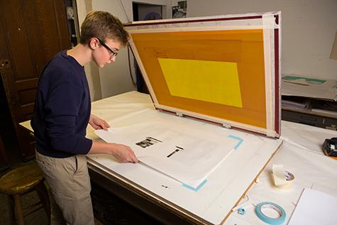
Place the paper and film positive under the screen and register the open screen to the edges of your film positive.
Use blue painter’s tape to mark the edges of the paper on the table you are printing on. This will show you where to put the paper for each print.
Photo by Sean Carroll
Photo by Sean Carroll

Slide 6
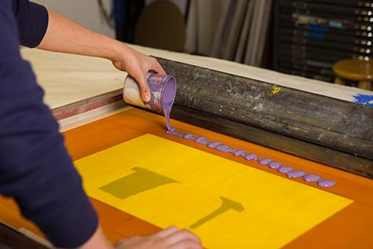
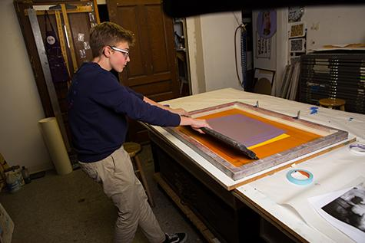
Carefully close the screen over the stencil paper and print the ﬁrst color using enough ink for adequate coverage.
Photo by Sean Carroll
Photo by Sean Carroll

Slide 7
The stencil will stick to the back of the silkscreen because the ink acts as an adhesive. Starting from a top corner, slowly peel the stencil away from the screen.
Continue this process, placing each piece of paper inside the tape corners until all 10 pieces of paper are printed.
Remove the stencil from the silkscreen and discard.
Paper stencil used to print a layer of purple ink
Printed first layer of purple ink on paper

Slide 8
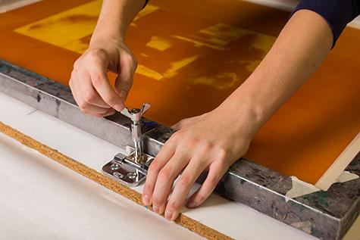
Clean the open silkscreen and squeegee thoroughly. The two-inch tape you placed around the edges of the silkscreen should remain until you are ﬁnished printing your entire print.
Making sure the silkscreen is completely dry, place your taped silkscreen into the hinge clamps and securely tighten the clamps.
Photo by Sean Carroll
Photo by Sean Carroll

Slide 9
When Layer 1 of your print is dry, register your next stencil (Layer 2) to the film positive. Once it is in the correct place, use two small pieces of painter’s tape to secure it to the print.
Remove the film positive.
Repeat the printing process for layer 2 of your image.
Photo by Sean Carroll
Printed second layer of greenish-gold ink on paper.

Slide 10
When Layer 2 of your print is dry, register your next stencil (Layer 3) to the film positive. Once it is in the correct place, use two small pieces of painter’s tape to secure it to the print. Remove the film positive.
Repeat the printing process for layer 3 of your image.
Photo by Sean Carroll
Printed third layer of gray ink on paper.

Slide 11
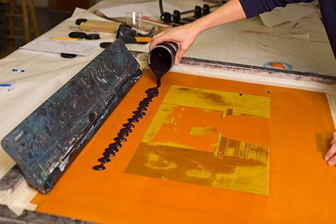
To print Layer 4, the final photographic image, register your film positive to your print using small pieces of painter’s tape to secure it to the print.
Tape the edges of the screen with the two-inch tape on both sides (as in Step #1). Securely tighten your exposed silkscreen in the hinge clamps.
Register your print to the screen and place tape marks on the corners of three edges of your paper. Remove the film positive.
Photo by Sean Carroll
Photo by Sean Carroll

Slide 12
Print your final layer.
Clean your screen. Be sure that no ink is left in the open holes of the screen. Use the soft side of a sponge to help ease the ink out if necessary.
Photo by Sean Carroll
Alisha Wormsley, Unititled, 2017 Silkscreen print on paper

Slide 13
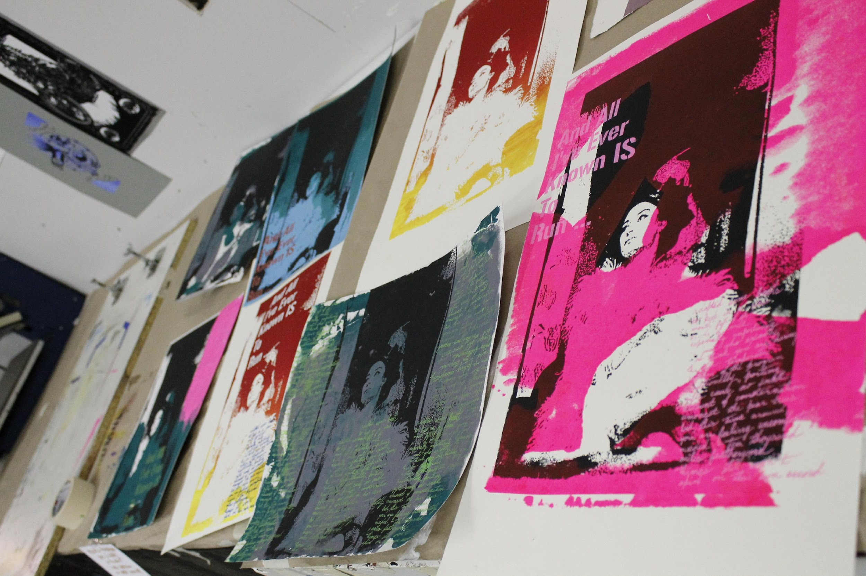
Class Critique
After the final silkscreen prints are dry, hang them up and conduct a class critique.
Try ranking the student work as a class according to various categories and criteria learned in this unit, for example:
Most thoughtful color scheme
Best overall composition
Best use of layers
Best overall printmaking
Finished multilayer silkscreen prints by high school students.

