Slide 1
Critical Response

Slide 2
If you want to know all about Andy Warhol just look at the surface of my paintings and films and me, and there I am. There's nothing behind it.
Andy Warhol, THE EAST VILLAGE OTHER, 1966

Slide 3
While Andy Warhol might have said there was no “mystery” behind his work, he was one of the most complex artists of the 20th century.
In order to understand Warhol and the works of other artists, art critics use many different methods and strategies to analyze and evaluate works of art.
What strategies do you use to
evaluate artwork?
Andy Warhol, Self-Portrait (Yellow), 1986 The Andy Warhol Museum, Pittsburgh; Founding Collection, Contribution The Andy Warhol Foundation for the Visual Arts, Inc., © The Andy Warhol Foundation for the Visual Arts, Inc., 1998.1.815

Slide 4
When we view works of art for the first time, we create an intuitive response that is personal and often purely emotional.
It is usually based on:
personal experiences
feelings
associations
values
likes
dislikes
Photo by Sean Carroll

Slide 5
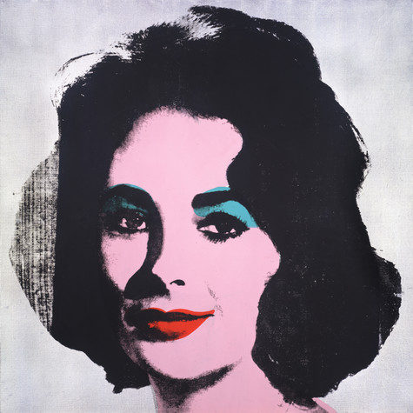
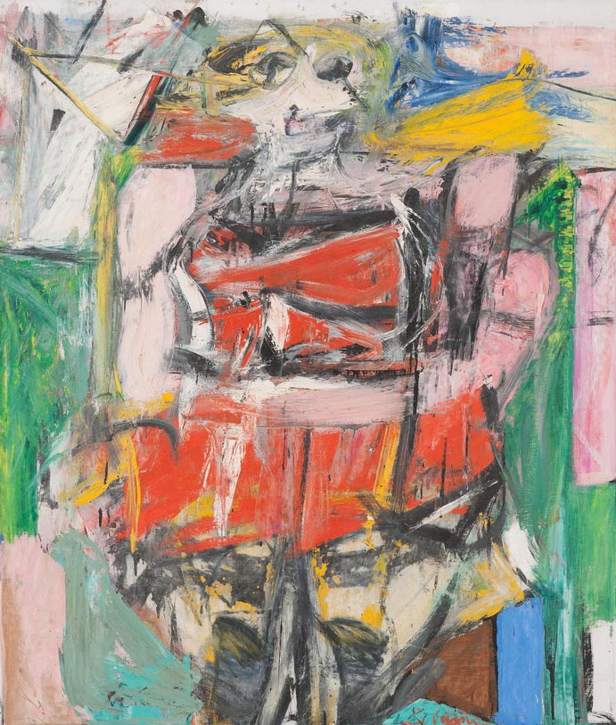
What is your intuitive response to these two works of art? (For use with Lesson 1: Intuitive Prompts handout)
Andy Warhol, Silver Liz [Ferus Type], 1963 The Andy Warhol Museum, Pittsburgh; Founding Collection, Contribution The Andy Warhol Foundation for the Visual Arts, Inc., © The Andy Warhol Foundation for the Visual Arts, Inc., 1998.1.55
Willem de Kooning, Woman VI, 1953
Oil on canvas, 68 x 58 in.
Carnegie Museum of Art, Pittsburgh Gift of G. David Thompson © 2002 The Willem de Kooning Foundation / Artists Rights Society (ARS), New York

Slide 6
Don’t pay any attention to what they write about you. Just measure it in inches.
Andy Warhol, Andy Warhol: In His Own Words, 1991

Slide 7
A critic is someone who forms and expresses judgments of the merits, faults, value or truth of a matter. A critic gives opinions on:
Movies
Books
Music
Food
Art
Where have you seen a critic’s opinion?

Slide 8
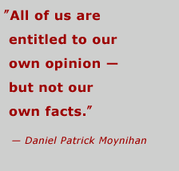
Critics not only state their likes and dislikes, but also explain why, by including facts and evidence that support their opinion.

Slide 9
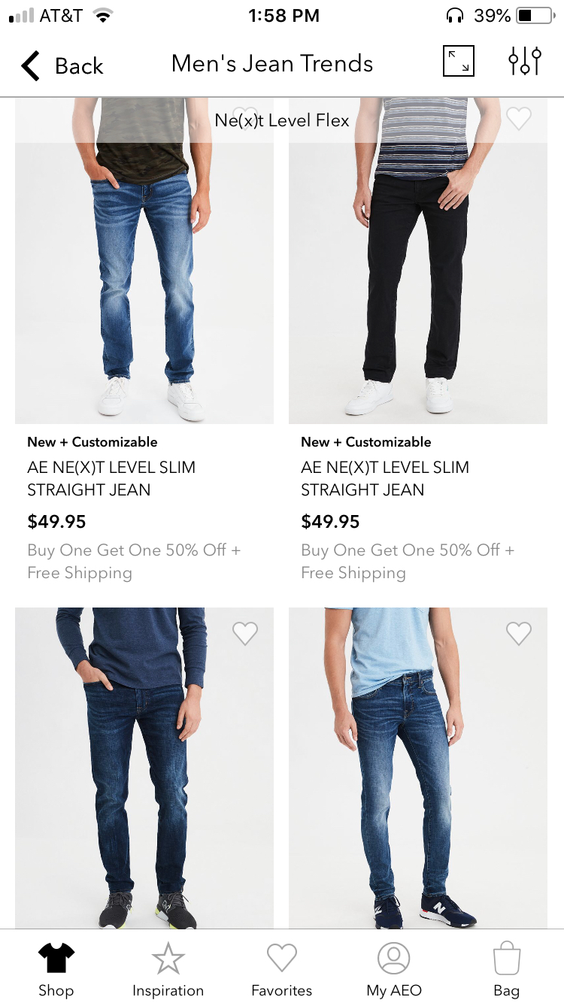
We make critical choices everyday about: music, art, fashion and movies.
When are you a critic?

Slide 10
As a critic it is important to differentiate between an informed opinion and an uninformed opinion:
Informed Opinion: a belief, judgment or way of thinking about something based on reliable information.
Uninformed Opinion: a belief, judgment or way of thinking about something not based on reliable information.

Slide 11
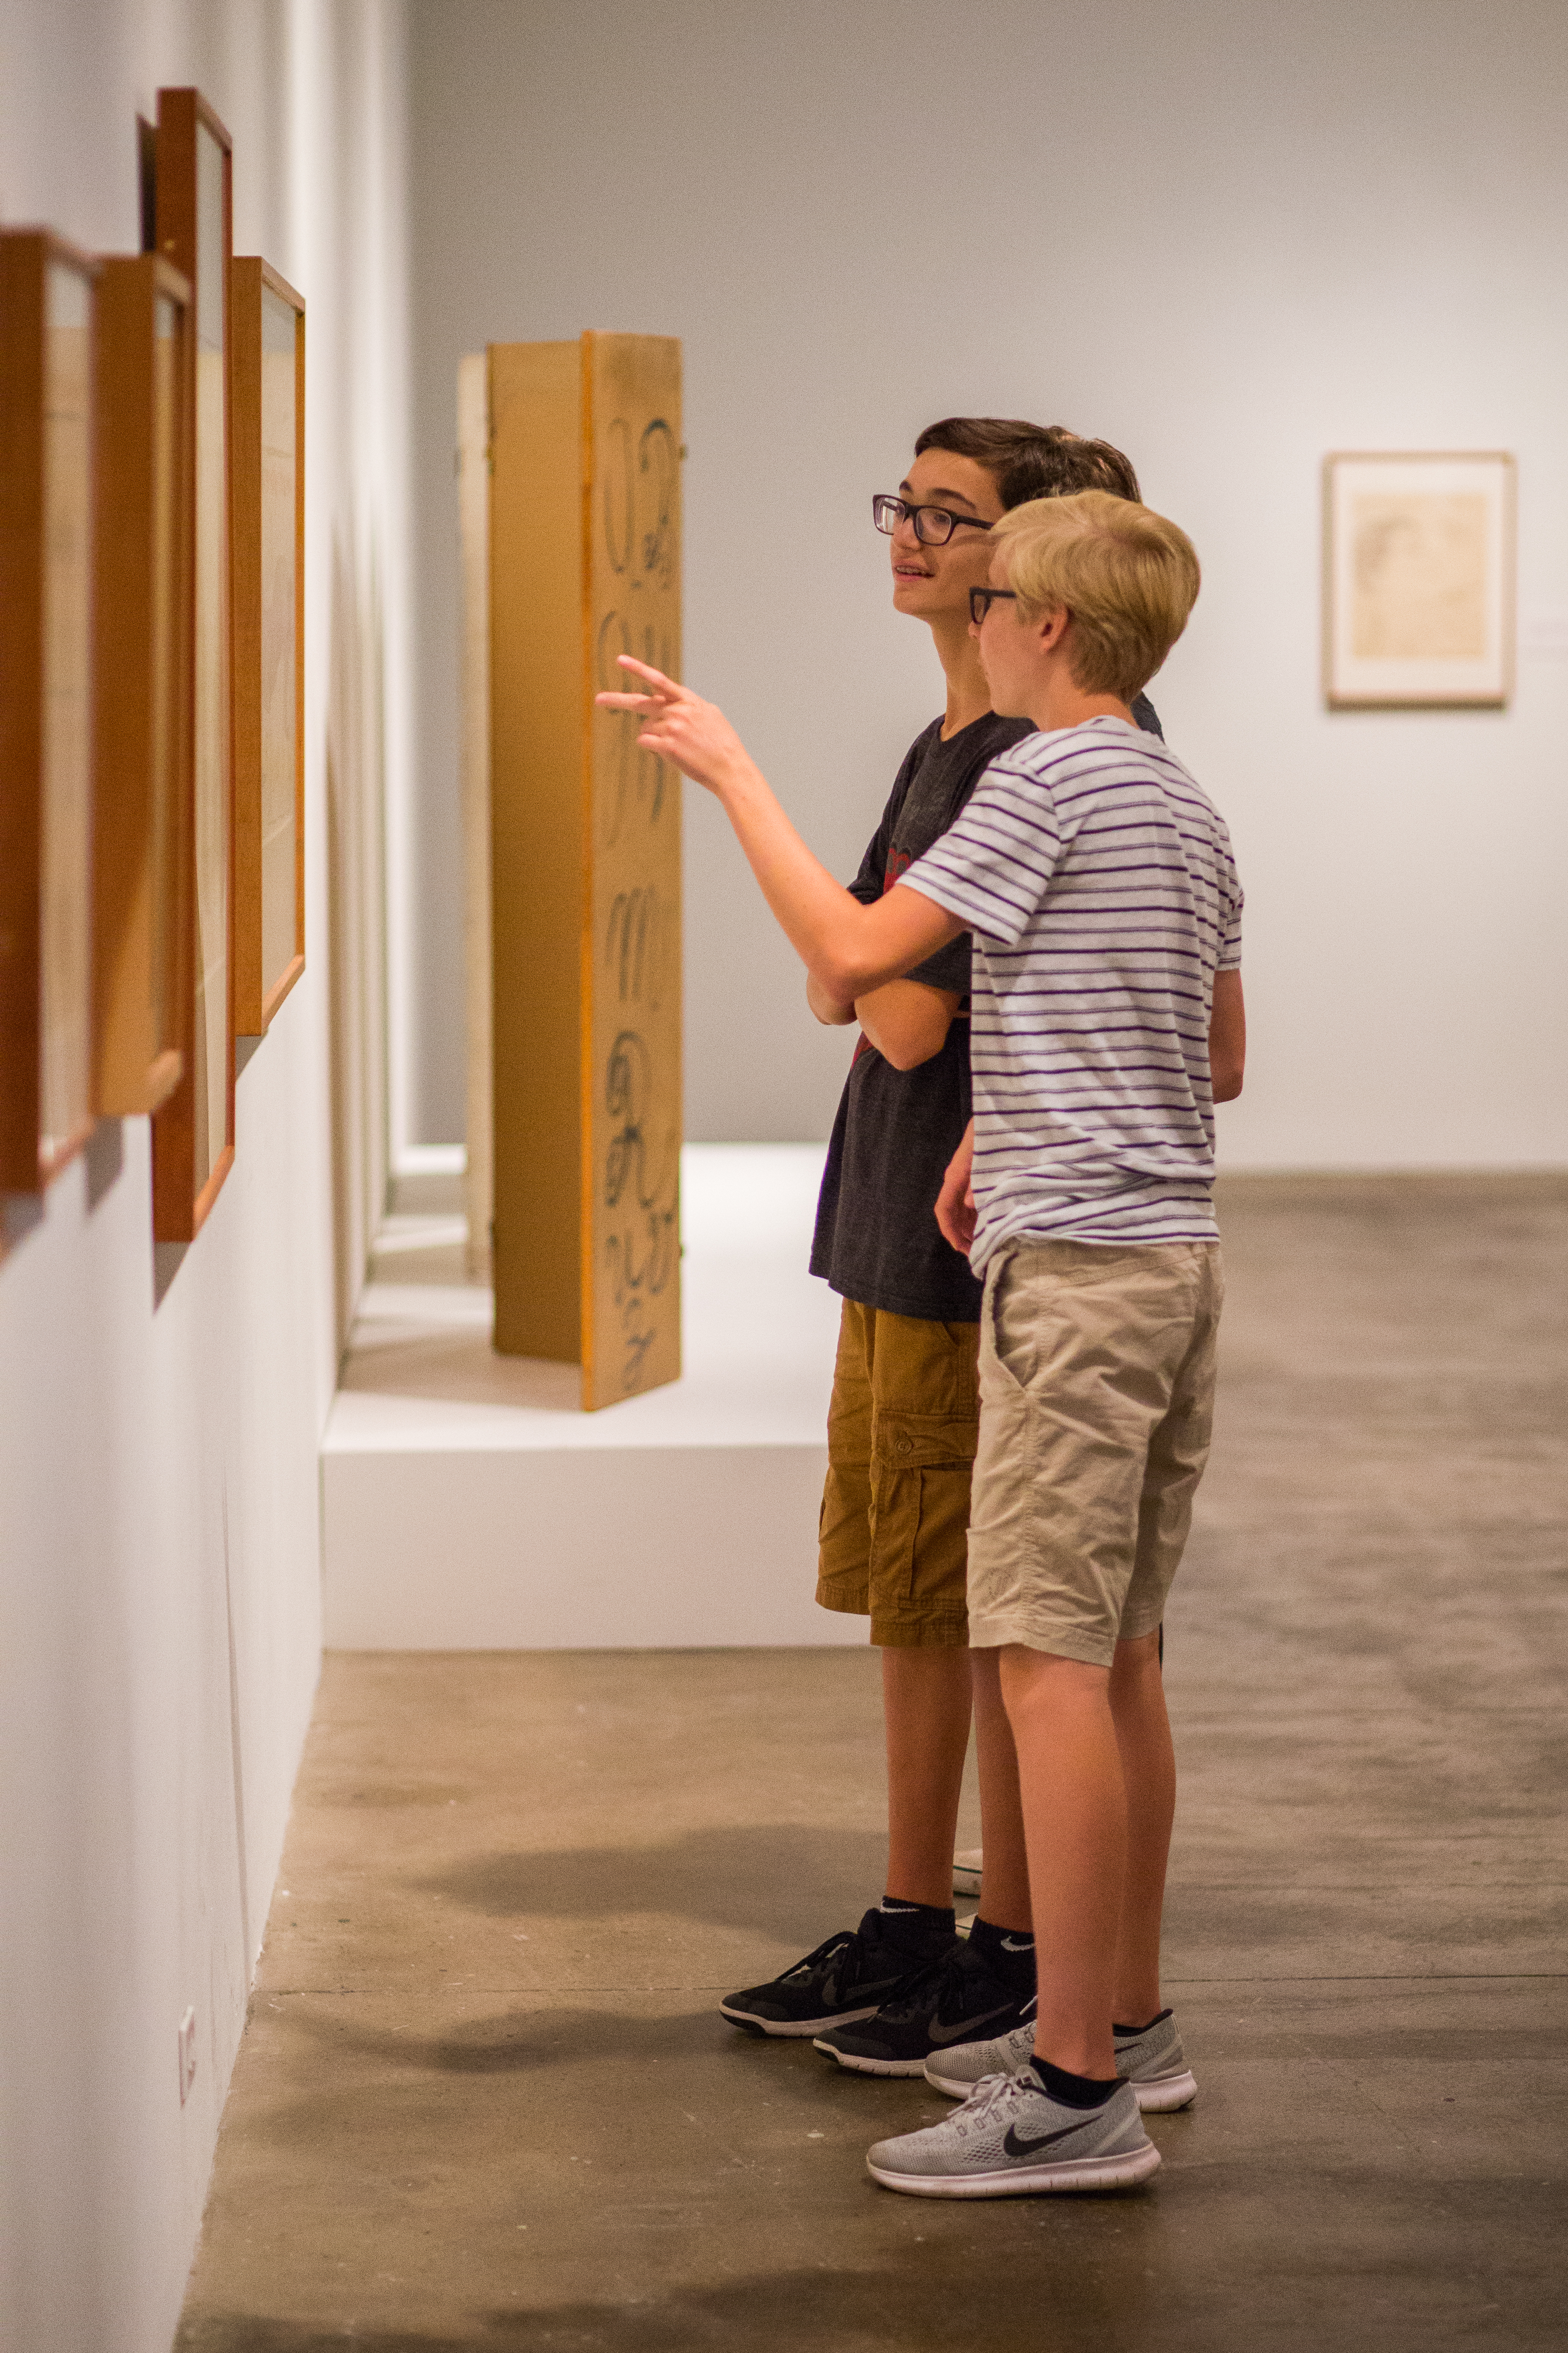
It is also important to consider how our own tastes and biases shape our opinions:
Taste: a personal preference or liking.
Bias: a preference or an inclination that inhibits impartial judgment.
Photo by Sean Carroll

Slide 12
Brainstorming web for identifying music tastes and biases: (For use with Lessons 2 & 3)
______
Music Group

Slide 13
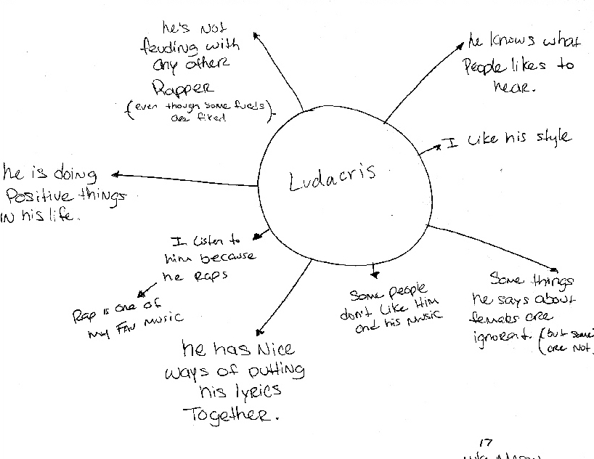
Student example of brainstorming web for identifying
music tastes and biases:

Slide 14
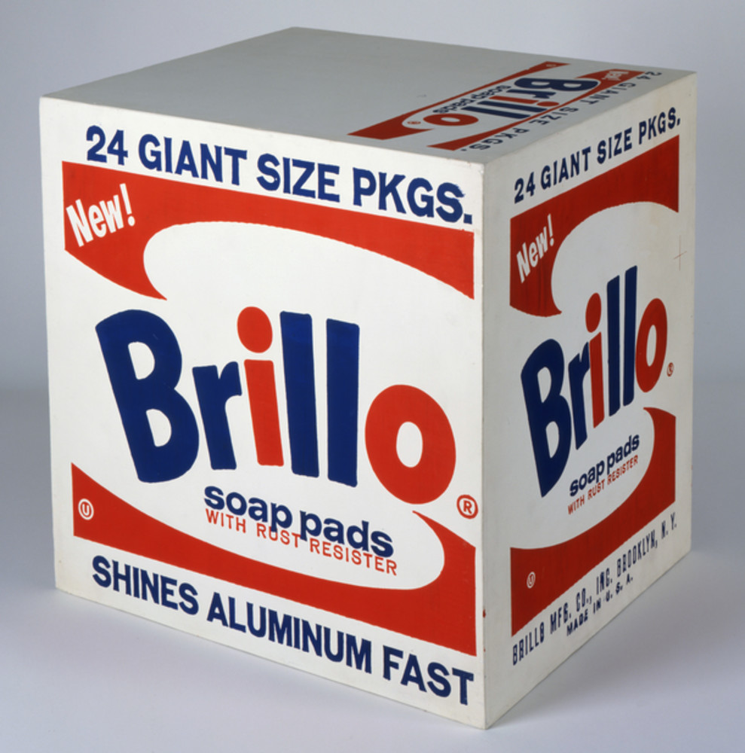
Brainstorming web for identifying art tastes and biases:

Slide 15
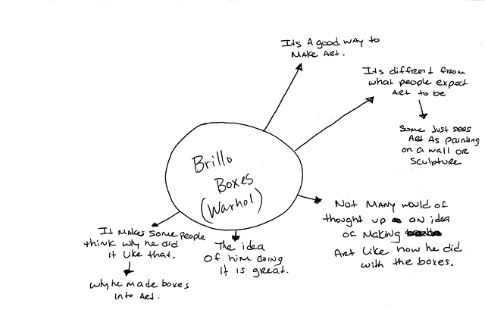
Student example of brainstorming web for identifying art tastes and biases:

Slide 16
Don't think about making art, just get it done. Let everyone else decide if it's good or bad, whether they love it or hate it. While they are deciding, make even more art.
Andy Warhol, Andy Warhol: In His Own Words, 1991

Slide 17
The critical response process helps us organize our thoughts and make intelligent and educated statements about a work of art.
Critical response is a combination of:
Describing
Analyzing
Interpreting
Judging/Evaluating

Slide 18
(for use with Lesson 4 & 5)
Describe:
What does it look like?
What is the subject?
How is it made?
Avoid statements such as: "I like it" or “This is a really bad work of art.”
Willem de Kooning, Woman VI, 1953
Oil on canvas, 68 x 58 in.
Carnegie Museum of Art, Pittsburgh Gift of G. David Thompson © 2002 The Willem de Kooning Foundation / Artists Rights Society (ARS), New York
Andy Warhol, Silver Liz [Ferus Type], 1963 The Andy Warhol Museum, Pittsburgh; Founding Collection, Contribution The Andy Warhol Foundation for the Visual Arts, Inc., © The Andy Warhol Foundation for the Visual Arts, Inc., 1998.1.55

Slide 19
Analyze:
Examine the artists’ methods:
- elements of art: line, shape, color, form, texture, space and value - principles of design: unity, emphasis, balance, proportion, harmony, movement or rhythm
Research the historical and cultural context in which the artwork was made.
Consider the criticisms or opinions that have already been published about the work.
Willem de Kooning, Woman VI, 1953
Oil on canvas, 68 x 58 in.
Carnegie Museum of Art, Pittsburgh Gift of G. David Thompson © 2002 The Willem de Kooning Foundation / Artists Rights Society (ARS), New York
Andy Warhol, Silver Liz [Ferus Type], 1963 The Andy Warhol Museum, Pittsburgh; Founding Collection, Contribution The Andy Warhol Foundation for the Visual Arts, Inc., © The Andy Warhol Foundation for the Visual Arts, Inc., 1998.1.55

Slide 20
Interpret:
What is happening in this work?
What is the mood or feeling?
What is the artist saying?
Make guesses and inferences based on your experiences, values, knowledge, and understanding of art.
Willem de Kooning, Woman VI, 1953
Oil on canvas, 68 x 58 in.
Carnegie Museum of Art, Pittsburgh Gift of G. David Thompson © 2002 The Willem de Kooning Foundation / Artists Rights Society (ARS), New York
Andy Warhol, Silver Liz [Ferus Type], 1963 The Andy Warhol Museum, Pittsburgh; Founding Collection, Contribution The Andy Warhol Foundation for the Visual Arts, Inc., © The Andy Warhol Foundation for the Visual Arts, Inc., 1998.1.55

Slide 21
Judge/Evaluate:
What is your critical judgment (positive or negative) about the work? Support your judgment with informed reasoning.
Is the work of art successful or not? Why?
Does the work have artistic merit? Why?
Willem de Kooning, Woman VI, 1953
Oil on canvas, 68 x 58 in.
Carnegie Museum of Art, Pittsburgh Gift of G. David Thompson © 2002 The Willem de Kooning Foundation / Artists Rights Society (ARS), New York
Andy Warhol, Silver Liz [Ferus Type], 1963 The Andy Warhol Museum, Pittsburgh; Founding Collection, Contribution The Andy Warhol Foundation for the Visual Arts, Inc., © The Andy Warhol Foundation for the Visual Arts, Inc., 1998.1.55

Slide 22
Now you be the critic!
Andy Warhol, Silver Liz [Ferus Type], 1963 The Andy Warhol Museum, Pittsburgh; Founding Collection, Contribution The Andy Warhol Foundation for the Visual Arts, Inc., © The Andy Warhol Foundation for the Visual Arts, Inc., 1998.1.55
Willem de Kooning, Woman VI, 1953
Oil on canvas, 68 x 58 in.
Carnegie Museum of Art, Pittsburgh Gift of G. David Thompson © 2002 The Willem de Kooning Foundation / Artists Rights Society (ARS), New York
Combine your intuitive response with your research and analysis, then write your own critique of the artwork.

