Slide 1

Warhol and Basquiat:
Collaboration and Contrast

Slide 2
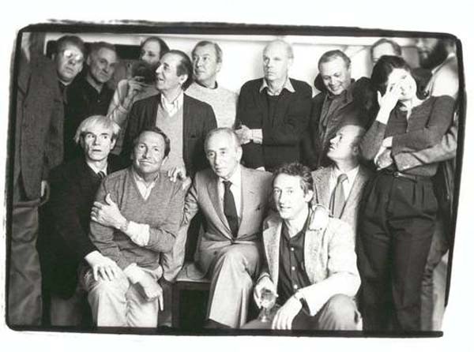
Andy Warhol collaborated with a diverse group of people throughout his career that helped inspire and guide his work, including artists, writers, students, celebrities, musicians, engineers, and fashion designers.
One of his most famous collaborations in the 1980s was with a young painter named Jean-Michel Basquiat.
Andy Warhol with Leo Castelli, Robert Rauschenberg, Ed Ruscha, James Rosenquist, Jasper Johns, Claes Oldenburg and others at the Leo Castelli Gallery - 25th Anniversary luncheon, The Odeon, New York, February 1, 1982. The Andy Warhol Museum, Pittsburgh. Contribution The Andy Warhol Foundation for the Visual Arts, Inc.© AWF

Slide 3
“Jean-Michel got me into painting differently, so that’s a good thing.”
Andy Warhol, The Andy Warhol Diaries, 1984

Slide 4
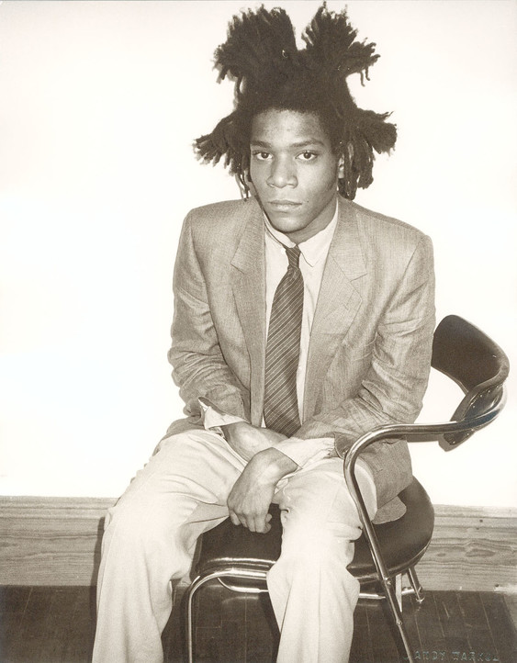
Jean-Michel Basquiat
Jean-Michel Basquiat was born on December 22, 1960.
His mother was Puerto Rican, and his father was an immigrant from Haiti.
He and his two sisters grew up in a middle-class neighborhood in Brooklyn, New York.
He displayed an interest in art at a young age and regularly visited the Brooklyn Museum as a child.
Andy Warhol, Jean-Michel Basquiat, 1982
The Andy Warhol Museum, Pittsburgh; Contribution The Andy Warhol Foundation for the Visual Arts, Inc. 2001.2.549

Slide 5
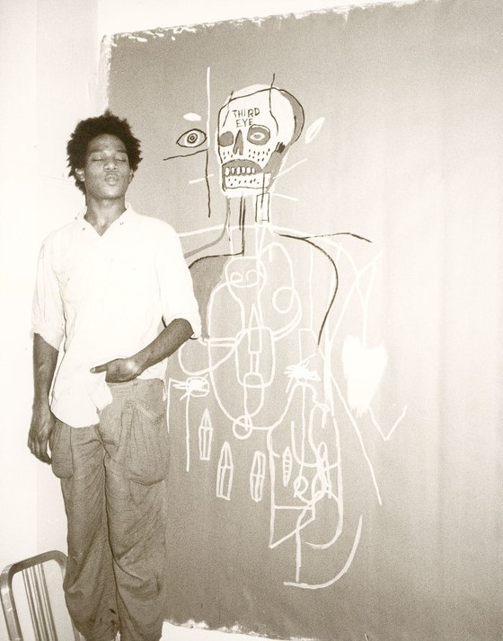
From Street Art to Fine Art
Basquiat gained notoriety with his graffiti tag “SAMO©️” in the 1970s.
He graffitied in neighborhoods with prominent art galleries, capturing the attention of fine art dealers.
Basquiat first met Warhol in 1978 selling postcards of his art outside a trendy restaurant in Soho.
By the age of 22, Basquiat received critical acclaim in the Village Voice and Artforum and had solo shows in New York City, Los Angeles, Modena, Italy and Zurich, Switzerland.
Andy Warhol, Jean-Michel Basquiat, 1984,
The Andy Warhol Museum, Pittsburgh; Contribution The Andy Warhol Foundation for the Visual Arts, Inc. 2001.2.548
Notes:
Additional information:
For a timeline of Jean Michel Basquiat’s life and career, see: https://www.basquiat.com/

Slide 6
An Intergenerational Exchange
Warhol and Basquiat were formally introduced in 1982 by Bruno Bischofberger, a Swiss art dealer who handled European sales for both artists in the early 1980s.
In 1983, Bischofberger suggested that Basquiat and Warhol begin a three-way collaboration project with Francesco Clemente, an Italian painter living in NYC.
Warhol, who was born in 1928 and had been famous for decades, was energized by this creative exchange with a younger generation of artists.
Andy Warhol, Andy Warhol, Jean-Michel Basquiat, and Francesco Clemente, 1984-1985 The Andy Warhol Museum, Pittsburgh; Founding Collection, Contribution The Andy Warhol Foundation for the Visual Arts, Inc. TC533-47-2_int_01

Slide 7
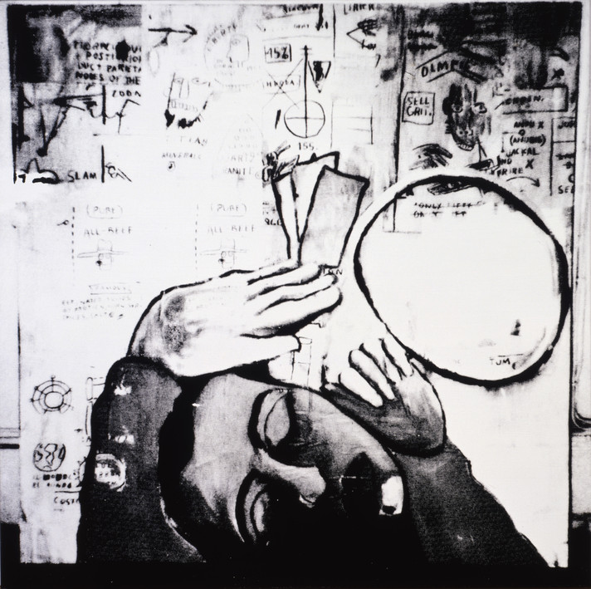
Collaboration by Mail
Warhol, Basquiat, and Clemente collaborated on over a dozen artworks. In the interest of spontaneity, Bischofberger recommended that the artists not work together in the same room.
Instead, each artist would paint part of a canvas and then mail the unfinished artwork to the next artist, who would then add to the painting and mail it to the third artist for completion.
When Warhol was the third artist to receive the canvas, sometimes he simply created a silkscreen print of what Basquiat and Clemente had painted.
Andy Warhol, Jean-Michel Basquiat, Francesco Clemente, Collaboration (Head & Hands), 1984-1985, The Andy Warhol Museum, Pittsburgh; Founding Collection, Contribution The Andy Warhol Foundation for the Visual Arts, Inc. © The Andy Warhol Foundation for the Visual Arts, Inc.
1998.1.492
Notes:
Discussion:
What do you think of this unusual method of collaboration?
Would you rather collaborate with someone in person, or through the mail?
Additional information:
To watch a video with instructions for a collaborative mail art activity, see: https://www.youtube.com/watch?v=Hz_EeNATyw0
Bruno Biscofberger: “To get the most spontaneous work into the collaborations I suggested Basquiat that every artist should, without conferring with the others about iconography, style, size, technique, etc., independently start the paintings, of course in the knowledge that two further artists would be working on the same canvas, and that enough mental and physical space should be left to accommodate them. I further suggested him that each artist send one half of the started collaborations to each of the other artists and the works then be passed on to the remaining artist whose work was still missing. Basquiat liked my proposal and agreed.”
Source: https://www.brunobischofberger.com/collabs-origin

Slide 8
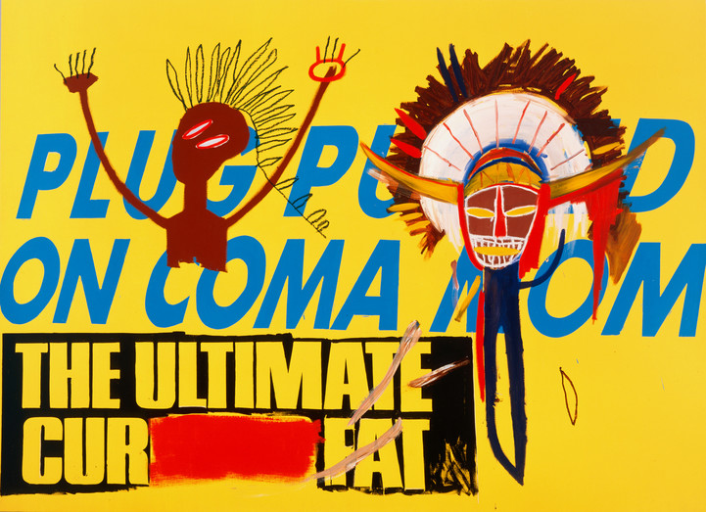
Continued Collaboration
In the mid-1980s, Warhol and Basquiat collaborated on roughly 100 artworks without the involvement of Bischofberger or Clemente.
By this point, the two artists were working together in the same room at Warhol’s studio.
Usually, they did not discuss what they would create before they started painting. They simply took turns adding to the canvas.
Would you prefer to collaborate spontaneously like Warhol and Basquiat, or plan with your partner(s) and discuss along the way? Why?
Jean-Michel Basquiat, Andy Warhol, Collaboration, 1984-1985,
The Andy Warhol Museum, Pittsburgh; Founding Collection, Contribution The Andy Warhol Foundation for the Visual Arts, Inc. © The Andy Warhol Foundation for the Visual Arts, Inc.; © Estate of Jean-Michel Basquiat
1998.1.485
Notes:
Additional information:
“Warhol typically engaged with the canvas first, a series of advertising slogans and designs erupting from his hand in a fury…. Bischofberger testifies that Basquiat typically tackled the canvas after Warhol, allowing Warhol’s work to shape that of his own: ‘Basquiat was usually the second painter to work on the canvasses and had fused his spontaneous, expressive, and effusive iconography with that of Warhol.’”(B. Bischofberger, “Collaborations: Reflections on/and Experiences with Basquiat, Clemente and Warhol”, The Andy Warhol Show, Rome, 2004, p. 44)”
Source: https://www.phillips.com/detail/JEAN-MICHEL-BASQUIAT-AND-ANDY-WARHOL/NY010314/9

Slide 9
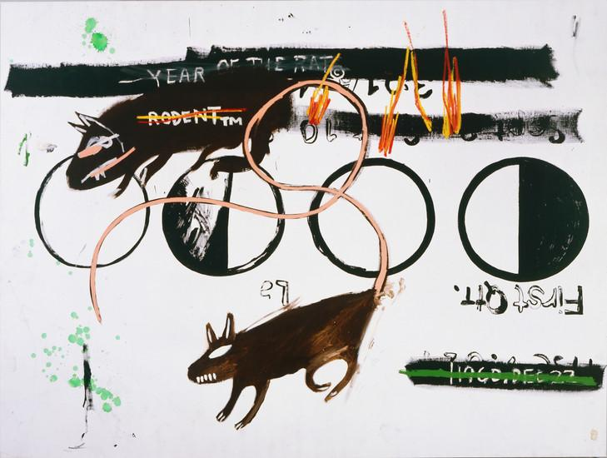
Return to Hand-Painting
The silkscreen had been Warhol’s go-to artmaking tool since 1962.
Although Warhol used silkscreen printing in some of his collaborations with Basquiat, Basquiat encouraged Warhol to do more painting by hand.
Warhol used an overhead projector to project words and images onto the canvas and traced them by hand with his paintbrush.
Can you tell which parts of the paintings are Warhol’s and which are Basquiat’s? How?
Jean-Michel Basquiat, Andy Warhol, Collaboration (Year of the Rat, Rodent (TM)), 1984-1985,
The Andy Warhol Museum, Pittsburgh; Founding Collection, Contribution The Andy Warhol Foundation for the Visual Arts, Inc. © The Andy Warhol Foundation for the Visual Arts, Inc. 1998.1.486
Notes:
Additional information:
“Basquiat’s contribution was two-fold. Firstly, the enthusiasm he epitomized for incorrigible mark-making was sufficient to prompt Warhol to once again pick up a brush. It had been twenty years or thereabouts since Warhol had painted himself, choosing for these collaborations to compete with the young pretender and eschew the indolent comfort of the silkscreen.”
Source: https://www.sothebys.com/en/auctions/ecatalogue/2013/may-2013-contemporary-evening-n08991/lot.61.html

Slide 10
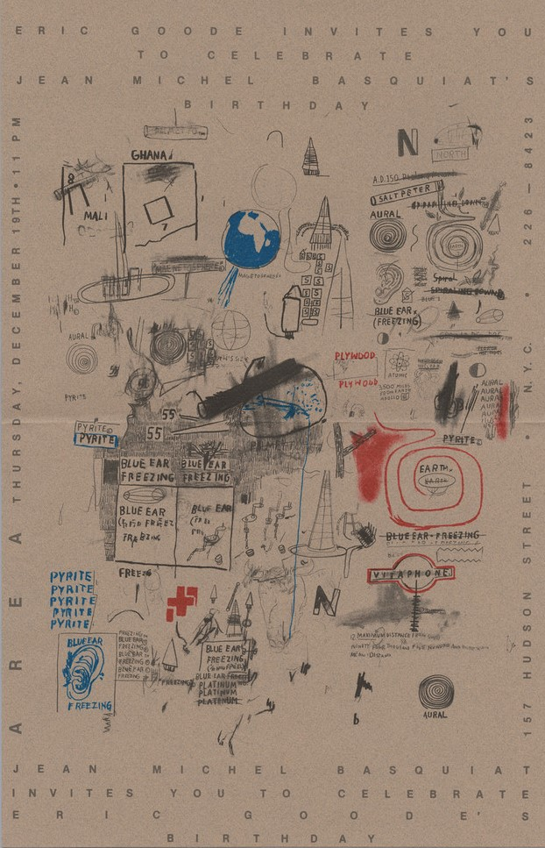
Contrasting Styles
Both artists took inspiration from mass media; they appropriated words and images from books, magazines, newspapers, and television.
Basquiat’s solo work tended to be very dense and busy, with many layers of different words, symbols, and images.
Warhol’s solo work was usually simpler and more straightforward, focusing on a single person or object.
Invitation (for Jean-Michel Basquiat and Eric Goode's birthday party at Area, New York, December 19, 1986), 1986. The Andy Warhol Museum, Pittsburgh; Founding Collection, Contribution The Andy Warhol Foundation for the Visual Arts, Inc. TC512.75
Notes:
Additional information:
The featured image can serve as an example of Jean Michel Basquiat’s solo work. It is an invitation that Basquiat designed for a nightclub called Area. Area was an avant-garde nightclub in lower Manhattan that operated from 1983 to 1987. The club quickly became notorious for its creative, elaborate themes which rotated every six weeks. Some examples of Area themes include “Future,” “Suburbia,” “Confinement,” “Natural History,” “Faith,” “Science Fiction,” Gnarly,” “Disco,” and “Fairy Tales.” To execute these ideas, Area staff members overhauled and redecorated the 13,000 square foot club in just a few days. Andy Warhol once did a performance at Area called the Invisible Sculpture, in which he stood next to an empty plinth. Keith Haring once decorated the Area dancefloor. Jean Michel Basquiat occasionally DJed at Area, usually playing bebop jazz.
To read about Glenn O’Brien’s memories of Area, see: https://glennobrien.com/area/

Slide 11
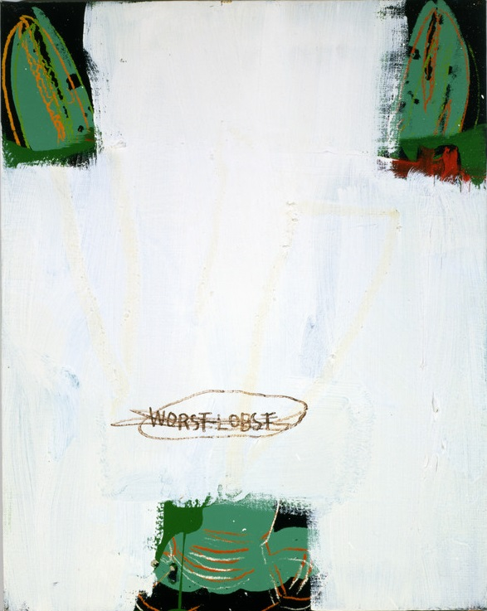
Layers and Coverups
Basquiat would often paint directly on top of what Warhol had painted, covering and concealing most of what Warhol had done.
He did this, in part, to encourage Warhol to add more layers to the artwork. Since Warhol’s solo work tended to focus on one image, he was not inclined to paint as many layers as Basquiat.
This practice also recalls the nature of graffiti art, where new artists paint on top of older pieces on graffitied walls.
How would you feel if your collaborator covered up something you had created?
Jean-Michel Basquiat, Andy Warhol, Collaboration (Lobster), 1984-1985,
The Andy Warhol Museum, Pittsburgh; Founding Collection, Contribution The Andy Warhol Foundation for the Visual Arts, Inc. 1998.1.491
Notes:
Additional information:
Jean Michel Basquiat: "He would put something very concrete or recognizable, like a newspaper headline or a product logo, and then I would try and deface it, and then I would try and get him to work some more on it."
Source: Exh. Cat., Basel, Fondation Beyeler, Basquiat, 2010, p. 47
Keith Haring: “For an artist, the most important and delicate relationship he can have with another artist is one in which he is constantly challenged and intimidated. This is probably the only productive quality of jealousy. The greatest pleasure is to be provoked to the point of inspiration...Painting with Jean-Michel was not easy. You had to forget any preconceived ideas of ownership and be prepared to have anything you’d done completely painted over within seconds...Andy loved the energy with which Jean would totally eradicate one image and enhance another...Layers and layers of images and ideas would build toward a concise climax.”
Source: Painting the Third Mind, 1988 (Exh. Cat., Milwaukee, Milwaukee Art Museum (and travelling), Andy Warhol: The Last Decade, 2009, pp. 203-204)

Slide 12
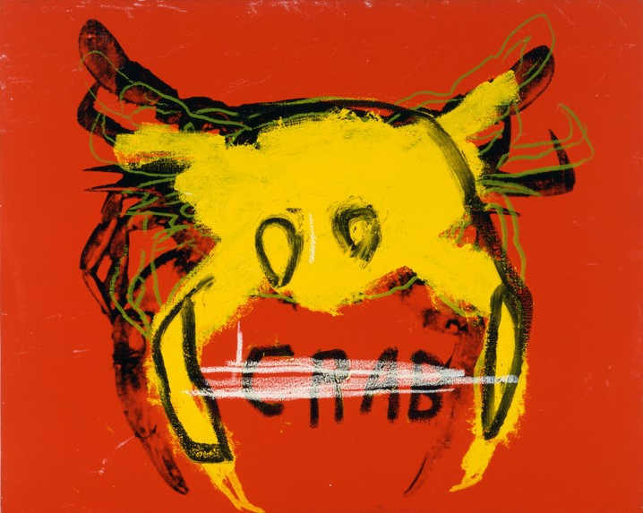
Crossing Out
Basquiat frequently wrote words on his paintings and then crossed the words out, still leaving them readable.
He thought that obscuring the word would make the viewer want to read them more.
If you were taking turns collaborating on an artwork with someone else, would you rather go first or second? Why?
Andy Warhol, Jean-Michel Basquiat, Collaboration (Crab), 1984-1985,
The Andy Warhol Museum, Pittsburgh; Founding Collection, Contribution The Andy Warhol Foundation for the Visual Arts, Inc. 1998.1.490
Notes:
Additional information:
“The notion of exclusion or excision is reiterated in the way that Basquiat often crossed out words or phrases in his works. The technique, he explained, was actually meant to direct attention to them: ‘I cross out words so you will see them more; the fact that they are obscured makes you want to read them.’”
Source: https://whitney.org/collection/works/453

Slide 13
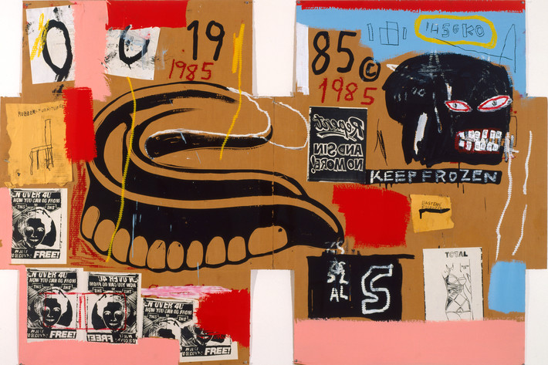
Mixed Media
Basquiat liked to paint on a variety of surfaces other than canvas.
Some of Basquiat’s solo pieces were painted on cardboard boxes, wooden doors, clothing, and even his own refrigerator.
Although they did most of their collaborations on canvas, Warhol and Basquiat occasionally painted on unconventional surfaces, such as the flattened cardboard box seen here.
Andy Warhol, Jean-Michel Basquiat, Dentures/Keep Frozen, 1985,
The Andy Warhol Museum, Pittsburgh; Founding Collection, Contribution The Andy Warhol Foundation for the Visual Arts, Inc.
© The Andy Warhol Foundation for the Visual Arts, Inc. 1998.1.2119
Notes:
Discussion:
What is the most unusual material you’ve used to create art?
Additional information:
For examples of Basquiat’s solo work on unconventional surfaces, see:
https://www.sothebys.com/en/auctions/ecatalogue/2015/contemporary-evening-n09345/lot.42.html
https://www.christies.com/en/lot/lot-5652403

Slide 14
“Jean-Michel and Andy achieved a healthy balance. Jean respected Andy's philosophy and was in awe of his accomplishments and mastery of color and images. Andy was amazed by the ease with which Jean composed and constructed his paintings and was constantly surprised by the never-ending flow of new ideas. Each one inspired the other to outdo the next. The collaborations were seemingly effortless. It was a physical conversation happening in paint instead of words…"
Keith Haring in "Painting the Third Man'', 1988 reprinted in: Exh. Cat., Milwaukee Art Museum, Andy Warhol: The Last Decade, 2009

Slide 15
Discussion Questions
How is working collaboratively different from working independently?
What are the elements of a successful collaboration?

Slide 16
“Jean-Michel called, he wanted some philosophy, he came over and we talked, and he's afraid he's just going to be a flash in the pan. And I told him not to worry, that he wouldn't be.”
Andy Warhol, The Andy Warhol Diaries, 1983

Slide 17
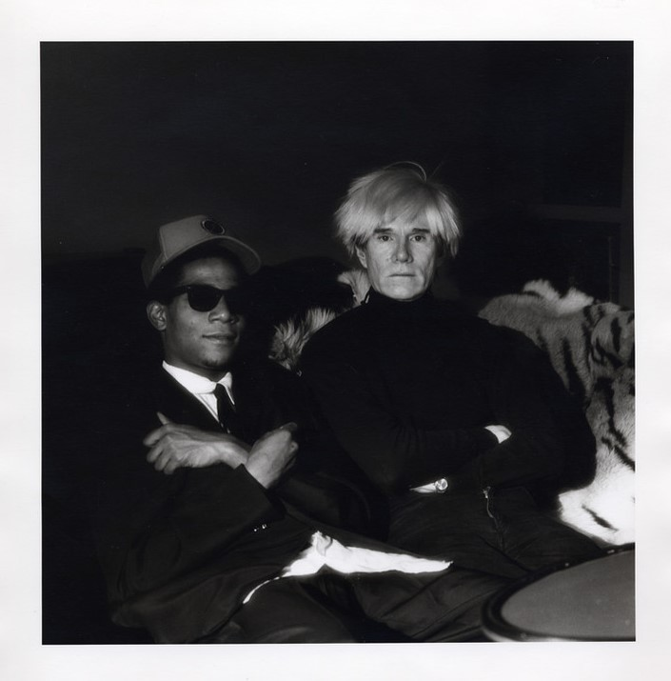
Friendship and Mentorship
In addition to being artistic collaborators, Warhol and Basquiat became close friends. They liked to talk on the phone, attend dinner parties, and go to nightclubs together.
Warhol served as a mentor to Basquiat. As an older and more famous artist, Warhol provided career advice and guidance.
Warhol was also Basquiat’s landlord for a few years. Warhol owned an art studio on Great Jones Street in New York that he rented to Basquiat.
Jeannette Montgomery Barron, Jean-Michel Basquiat and Andy Warhol (April 1985, N.Y.C.), 1985,
The Andy Warhol Museum, Pittsburgh; Gift of Jeannette Montgomery Barron, 2002.2.2
Notes:
Additional information:
“I’d never seen Andy so close with anyone, and I’d never seen Jean so close with anyone – these guys really loved each other” – Jeffrey Deitch
“Late Interview editor Glenn O’Brien insisted, ‘Andy loved Jean-Michel like a son almost.’
Warhol and Basquiat’s friendship was remarkably close. Looking back on Andy’s fondness for Basquiat, fellow artist Fab Five Freddy said, ‘Andy was really giving great advice. He would be like “‘Jean, did you do this? Have you spoke to your mom?'” Tamra Davis testified Warhol’s almost parental role in Basquiat’s life, insisting, ‘Andy really was there for him.’”
Source: http://www.sleek-mag.com/article/warhol-basquiat-bromance/

Slide 18
“Jean-Michel came down to the office early. He was reading his big review in the Voice. They called him the most promising artist on the scene. And at least they didn't mention me and say he shouldn't be hanging around with me the way the New York News thing did.”
Andy Warhol, The Andy Warhol Diaries, 1984

Slide 19
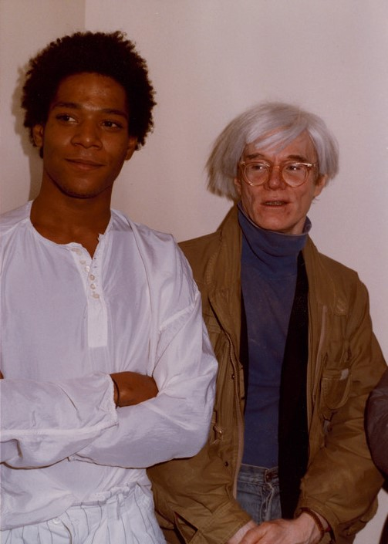
Rumors and Cynicism
In the 1980s, many people in the art world made cynical assumptions about Basquiat and Warhol’s friendship.
Because the two artists differed in terms of age, race, and background, some struggled to understand how they could be friends.
Rumors circulated that Basquiat was using Warhol for his wealth and power.
Others believed that Warhol was using Basquiat for his youth and talent.
Jean-Michel Basquiat and Andy Warhol, 1984,
The Andy Warhol Museum, Pittsburgh; Founding Collection, Contribution The Andy Warhol Foundation for the Visual Arts, Inc. TC386.167.1
Notes:
Discussion:
Has anyone ever judged your friendship or relationship with a particular person?
What is your opinion of Basquiat’s friendship with Warhol?
Do you think two people as different as Basquiat and Warhol can truly be good friends?
Additional information:
“Plenty speculated about the motives behind this odd, unexpected friendship and many thought the two were using each other for personal gain. Warhol’s longtime studio assistant, Ronnie Cutrone, remembers, ‘It was like some crazy-art world marriage, and they were the odd couple. The relationship was symbiotic. Jean-Michel thought he needed Andy’s fame, and Andy thought he needed Jean-Michel’s new blood. Jean-Michel gave Andy a rebellious image again.’”
Source: http://www.sleek-mag.com/article/warhol-basquiat-bromance/

Slide 20
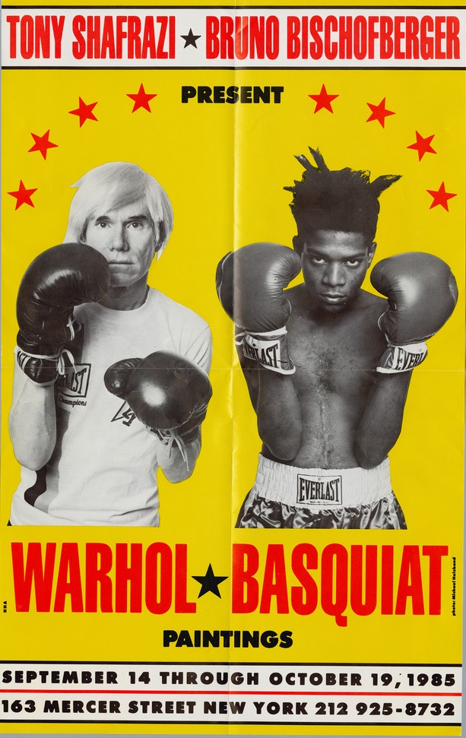
Show at Shafrazi
In September of 1985, an exhibition of Warhol and Basquiat’s collaborations opened at the Tony Shafrazi gallery in New York.
The show was panned by critics. Some reviews included racist and derogatory remarks about the relationship between Warhol and Basquiat.
Both artists worried that they had let the other one down. The backlash in the press put a great strain on their friendship.
Warhol Basquiat paintings / Tony Shafrazi, Bruno Bischofberger, New York, September 14 - October 19, 1985, 1985. The Andy Warhol Museum, Pittsburgh; Founding Collection, Contribution The Andy Warhol Foundation for the Visual Arts, Inc. TC441.161
Notes:
Additional Information:
To read an unflattering review of the show from the New York Times, see: https://www.nytimes.com/1985/09/20/arts/art-basquiat-warhol.html
“Among the countless negative reviews for ‘Paintings,’ many began claiming once again that Warhol had used Basquiat to stay relevant at a time when he was struggling to sell work. ‘Jean-Michel embraced Andy at a time when Andy was not very popular’, recalls Tamra Davis, adding, ‘I don’t know if Jean-Michel felt bad that he let Andy down, or if he believed what the press said that Andy was taking advantage of him.’”
Source: http://www.sleek-mag.com/article/warhol-basquiat-bromance/

Slide 21
“Jean-Michel hasn't called me in a month. so, I guess it's really over.”
Andy Warhol, The Andy Warhol Diaries, 1985

Slide 22
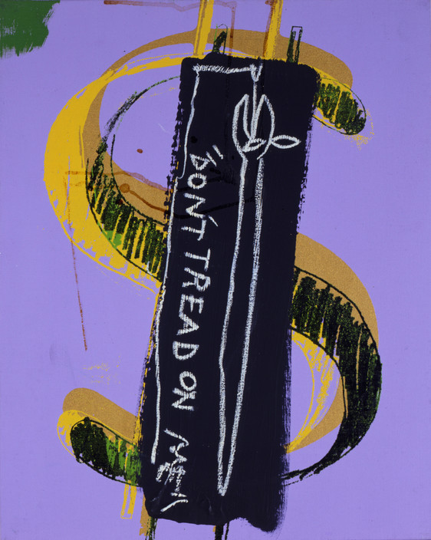
Falling Out
For a couple of months after the Shafrazi show, Basquiat distanced himself from Warhol.
Although many people have assumed that their friendship ended, Basquiat and Warhol were socializing again by December of 1985.
The artists remained friends, but they were not as close as before and they did not collaborate as often.
Jean-Michel Basquiat, Andy Warhol, Collaboration (Dollar Sign, Don't Tread on Me), 1984-1985,
The Andy Warhol Museum, Pittsburgh; Founding Collection, Contribution The Andy Warhol Foundation for the Visual Arts, Inc. © The Andy Warhol Foundation for the Visual Arts, Inc. 1998.1.488
Notes:
Additional Information:
According to The Andy Warhol Diaries, Basquiat called Warhol for the first time in over a month on December 9th, 1985. A couple weeks later, Warhol attended two parties celebrating Basquiat’s 25th birthday.
In 1986, Warhol mentioned Basquiat in his diaries much less frequently than previous years. But the entries show that the two artists continued to occasionally talk on the phone and attend concerts and dinner parties together.

Slide 23
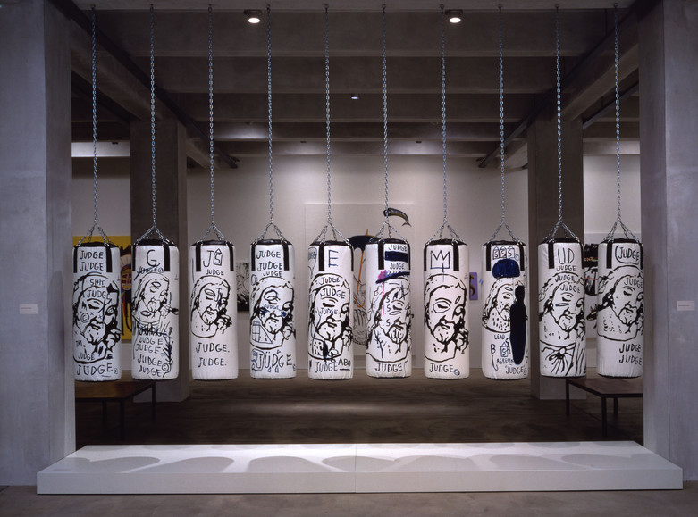
Final Collaboration
Warhol and Basquiat reacted to contemporary social issues through their artwork. They addressed topics like police brutality, racial inequality, drug addiction, and the AIDS epidemic in New York City during the 1980s.
Their final collaboration was a monumental sculpture titled Ten Punching Bags that layered religious imagery with references to the issues affecting their lives and communities.
What issues are affecting your community today? How might you address them in your artwork?
Andy Warhol, Jean-Michel Basquiat, Ten Punching Bags (Last Supper), 1985-1986,
The Andy Warhol Museum, Pittsburgh; Founding Collection, Contribution The Andy Warhol Foundation for the Visual Arts, Inc. Â© The Andy Warhol Foundation for the Visual Arts, Inc. 1998.1.791a-j
Notes:
Additional Information:
To read about Warhol’s Last Supper paintings in the context of the AIDS epidemic, see: https://www.warhol.org/warhols-confession-love-faith-and-aids/
To read about how Warhol’s Catholic faith influenced other artworks earlier in his career, see: https://www.warhol.org/warhols-relationship-with-catholicism-was-far-from-simple-still-he-evoked-god-through-his-art/

Slide 24
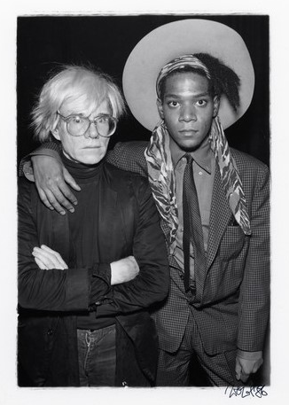
Untimely Deaths
Warhol died on February 22, 1987, at the age of 58, due to complications following a surgery to remove his gallbladder.
Warhol’s death devastated Basquiat. He created a painting titled Gravestone to memorialize Warhol.
After a long struggle with drug addiction, Basquiat died on August 12, 1988, at the age of 27, of an overdose.
Wolfgang Wesener,,
The Andy Warhol Museum, Pittsburgh; Contribution The Andy Warhol and Jean-Michel Basquiat, 1986Andy Warhol Foundation for the Visual Arts, Inc. 2001.2.2055
Notes:
Additional Information:
To see Gravestone, the artwork Basquiat created to memorialize Warhol, see: https://www.wikiart.org/en/jean-michel-basquiat/gravestone

Slide 25
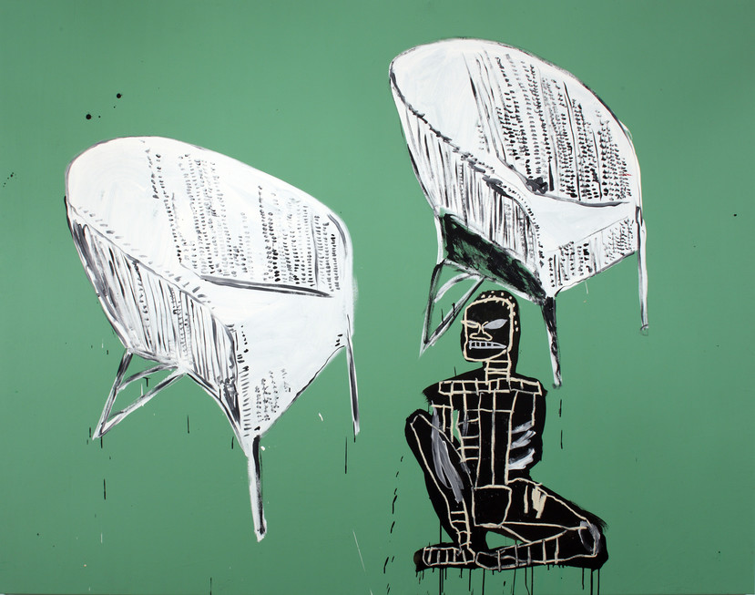
Legacy
Andy Warhol and Jean Michel Basquiat are two of the most important American artists of the twentieth century.
In 2017, a Basquiat painting became the most expensive work of art ever sold by an American artist, beating the record previously held by Warhol.
Basquiat and Warhol continue to inspire generations of artists and influence popular culture today.
Jean-Michel Basquiat, Andy Warhol, Collaboration (Chairs/African), 1984-1985,
The Andy Warhol Museum, Pittsburgh; Founding Collection, Contribution The Andy Warhol Foundation for the Visual Arts, Inc. © The Andy Warhol Foundation for the Visual Arts, Inc. 1998.1.487
Notes:
Additional Information:
To read about Basquiat’s record-breaking art sale in 2017, see: https://money.cnn.com/2017/05/18/luxury/jean-michel-basquiat-untitled-painting-auction-record/index.html

